Slide 1
A Glance to Textbook of China
MINGMING WANG
Beijing Normal University
wangmmbj@163.com
xsjmath@126.com

Slide 2
General Information
One National Curriculum Standard
6 Series of textbooks
_BNUP(NCM)
_REP
_JSP
_HBP
_QDP
-WNNUP
Free for grades 1-9, charge for grades 10-12

Slide 3
The New Century Mathematics
Edit by members of the National Curriculum Standard Group
A Textbook Series for Grade 1 to 12
Publish by Beijing Normal University Publisher

Slide 4
Content Structure
Number and Algebra
Space and Shape
Statistics and Probability
Quantum and Measure

Slide 5
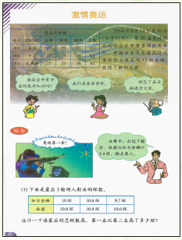
Features
Abundant Backgrounds Based on Students’ Reality

Slide 6
Features
Demonstrating the Essence of Math by Equipping Students With Mathematical Way of Thinking

Slide 7
Features
Ample Learning Resources

Slide 8
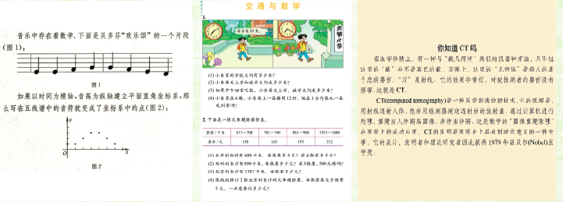
Features
Highlighting the Connections Between Math and Other Subjects
Music& coordinate system
transportation
medicine

Slide 9
Features
Diversified Approaches of Learning by Means of Inquiry and Cooperation
Thinking Listening Talking Doing

Slide 10
Features
Offer Supplementary Accesses to Broaden Students’ View in Math
parallel lines

Slide 11
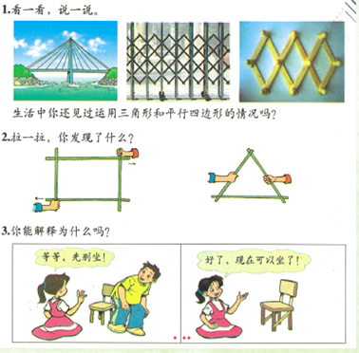
Features
Focus on Knowledge Understanding, Skill Exercises and Experience Accumulation
parallelogram

Slide 12
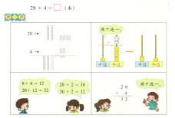
Calculating_ Principles of Algorithm

Slide 13
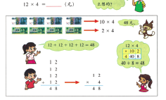
Calculating _ Principles of Algorithm

Slide 14
Calculating-Requirements such as:

Slide 15
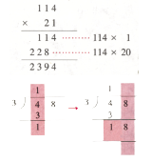
Calculating- Vertical Calculation & Multiplication Table

Slide 16
Number Sense- Expressions of Numbers and Quantities

Slide 17
Number Sense- Comparison of Quantities

Slide 18
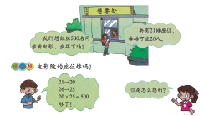
Number Sense -Estimation

Slide 19
Number Sense- Quantity Relations

Slide 20
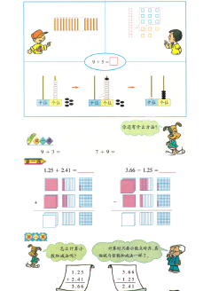
Number Sense- Models and Operations

Slide 21
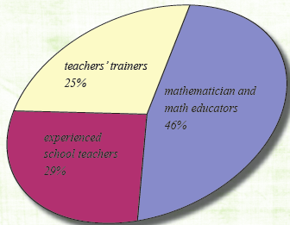
Compiling Team Members from Three Areas

Slide 22
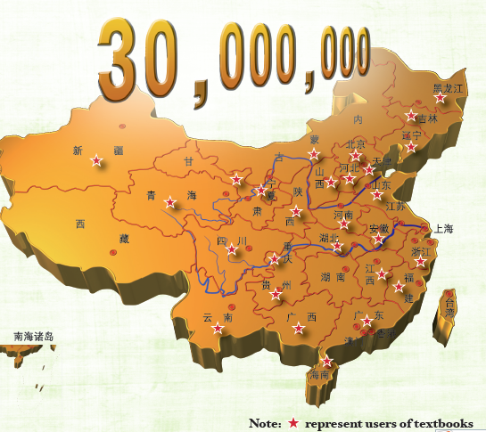

Slide 23
Hope Teachers to Pay Attention on
——”3 Understanding”
How to understand the class
How to understand the text book
How to understand the children(hope more deeply research)
_what has pupils known before class?
_how to understand the pupil’s reaction in the class(his thinking ways as a child , his troubles…)

Slide 24
HOPE MORE COMUNICATION !
THANK YOU !
WELCOME TO CHINA !

