Slide 1
The Role of Text-books and ICT in designing and Implementing Effective Lessons: Examining Curriculum Recommendations and Teaches’ Practice
Madihah Khalid
UBD

Slide 2
SPN 21 and New Curriculum
The new Brunei mathematics curriculum that was launched in conjunction with the New Education System of the 21st Century (SPN 21), implemented fully starting early 2009 advocates the use of multiple representation.
Therefore, various kinds of teaching and learning resources were recommended to accomodate the different representations.
The six different representations are concrete, real-life, verbal, diagram, symbolic and ICT.

Slide 3
The curriculum document suggests the following critical components that pupils must encounter in a mathematics programme in order to achieve the goals of mathematics education and encourage lifelong learning in mathematics. Pupils are expected to:
communicate in order to learn and express their understanding
connect mathematical ideas to other concepts in mathematics, to everyday experiences and to other disciplines
demonstrate fluency with mental mathematics and estimation
develop and apply new mathematical knowledge through problem solving
develop mathematical reasoning and creativity
select and use technologies as tools for learning and solve problems
develop visualization skills to assist in the processing of information, making connections and solving problems
develop positive attitudes and values towards mathematics.
(CDD, 2009)

Slide 4
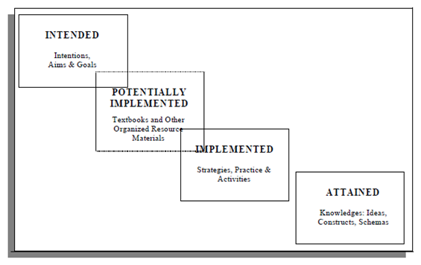
Role of Textbooks
Figure 1: The tripartite model (Valverde et al., 2000, p. 13)

Slide 5
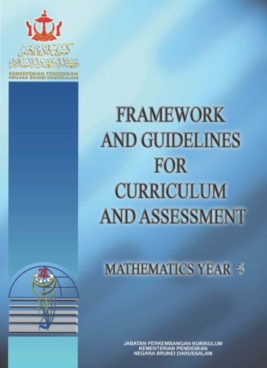
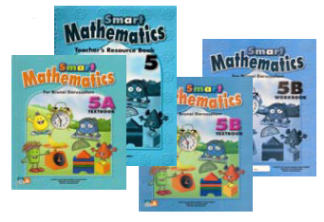
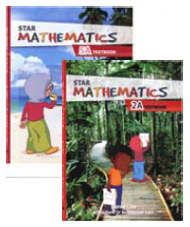
Recommended Bruneian textbooks, work-books, teaching soft-wares and Guide

Slide 6
Role of ICT
Calculators, graphing calculators, computers and other technological devices in the classroom have had are encouraged for the teaching of mathematics. It contributes to the learning of a wide range of mathematical content, and enables pupils to explore and create patterns, examine relationships, test conjectures and solve problems.
The mathematics curriculum supports these developments by placing clear emphasis upon the sensible use of ICT in concept development as well as in technology assisted instruction, problem solving, modelling and interactive learning.
Visualization can be promoted through the use of multiple representations such as concrete material, pictorial images etc. especially ICT.

Slide 7
Information and Communication Technology (ICT) plays a significant role in the teaching and learning of mathematics in school. Teachers should take full advantage of the wide spread use of computers and calculators to enhance the delivery of the mathematics curriculum. The integration of ICT focuses on the provision of opportunities for students to:
learn mathematical concepts with greater clarity, depth and
understanding by bridging the gap between abstract mathematical
concepts and concrete experiences;
consolidate understanding of mathematical concepts and skills;
involve in collaborative work and broaden their learning styles;
participate in projects, tasks and problems which require higher level competencies and skills; and
involve in simulation exercises that allow for different approaches for solving problems to be tested and their consequences observed.
Teachers and pupils are expected to use ICT intelligently and critically in the teaching and learning of mathematics. They must be able to decide when to use the available technology. Wherever appropriate, suggestions on the possible use of ICT in the mathematics curriculum have been included in the teaching notes of the syllabus.

Slide 8
How Brunei Teachers Use Textbooks
Many Bruneian teachers rely solely on the textbooks recommended by the Ministry of Education. They might follow the sequence and recommendations given in the textbook closely where all problems and exercises would be presented and taught to the students.
Most would try to adapt the textbooks according to their students’ ability and situation

Slide 9
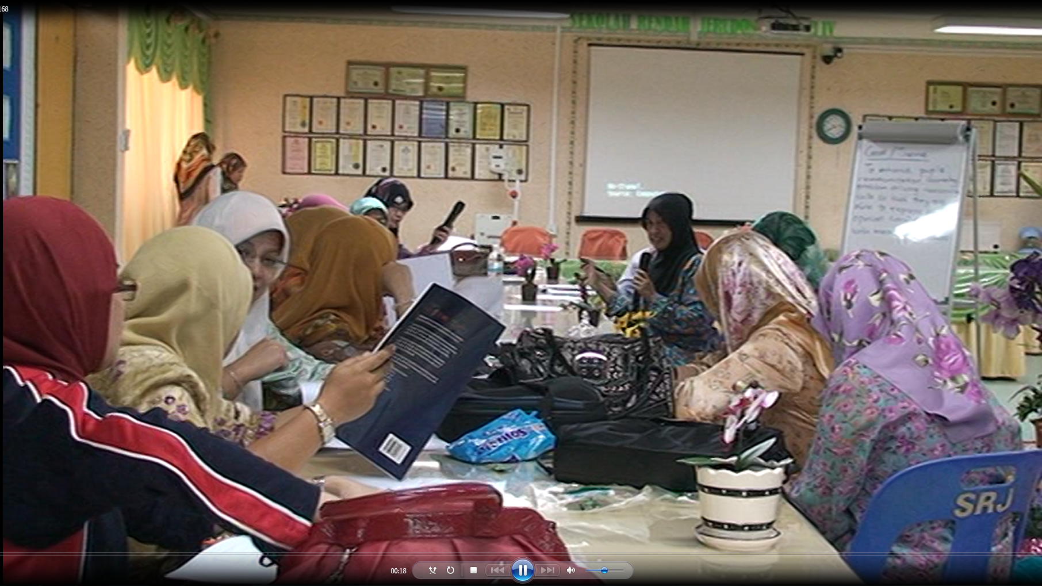

Slide 10
How Brunei Teachers Use Blackboard
Unlike teachers in Japan who has a very unique and purposeful way of using the blackboard, it is hard to categorize Brunei teachers’ use of blackboard in any particular way.
However, with the exposure to Japanese lesson study and maybe because of the influence from it, our teachers are beginning to realize the importance of planning the blackboard use.

Slide 11
The New Technology
With the advent of new technology and the encouragement for its use, teachers began using the smart-board and also the projector in their classrooms. The use of smart-board is popular among the young teachers in Brunei since all schools are provided with at least one interactive whiteboard by September 2007
In view of the popularity of the smart-board among pupils, teachers are looking for tools or softwares that offer interactivity.
The star mathematics text book supplied to primary schools is also accompanied with teacher resource compact discs which contains the ebook version of the text book.
The ebook version has inter-activeness (enlarge images or texts and interactive activities).

Slide 12
Example: Developing understanding for mental calculation of division of a number by powers of ten
Teachers try to design a lesson on this topic and at the same time adhere closely to the theme: ‘to enhance students’ communication, thinking, problem-solving and reasoning skills so that they are able to express their opinions confidently with meaningful ideas’
Lesson start with ‘follow me’ or ‘I have… who has..’ game so that students can connect multiplication and division later in their explanation.

Slide 13
During the development stage, the teacher continues by asking pupils to pick one of the nine cards containing division statements for example 450 ÷ 10.
Students were asked to solve this by whatever method they knew. Some responded by saying that they use the reverse of multiplication (the answer is 45 because 45X10 is 450), some by long division etc. Here, the teacher asked students to interpret the meaning of multiplication that emphasize grouping.
After going through more cards and arranging the cards in groups that shows certain kinds of patterns, students were expected to be able to then explain why they can take away zeroes when dividing.
They were expected to be able to say something like ‘86X100 means 86 groups of 100 which gives 8600. 8600÷100 means finding how many groups of 100 there are in 8600. There are 86 groups of 100 in 8600 (because 8600=86X100 which means 86 groups of 100). Other pupils even point out to the reverse nature of multiplication and division.

Slide 14
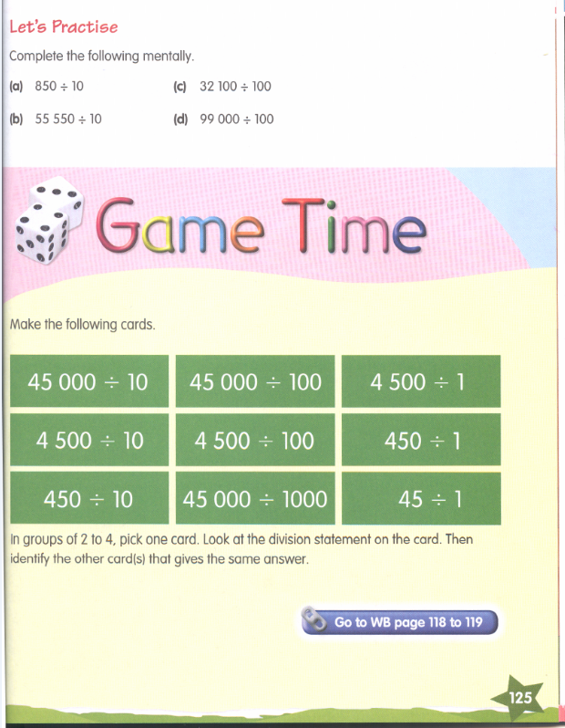

Slide 15
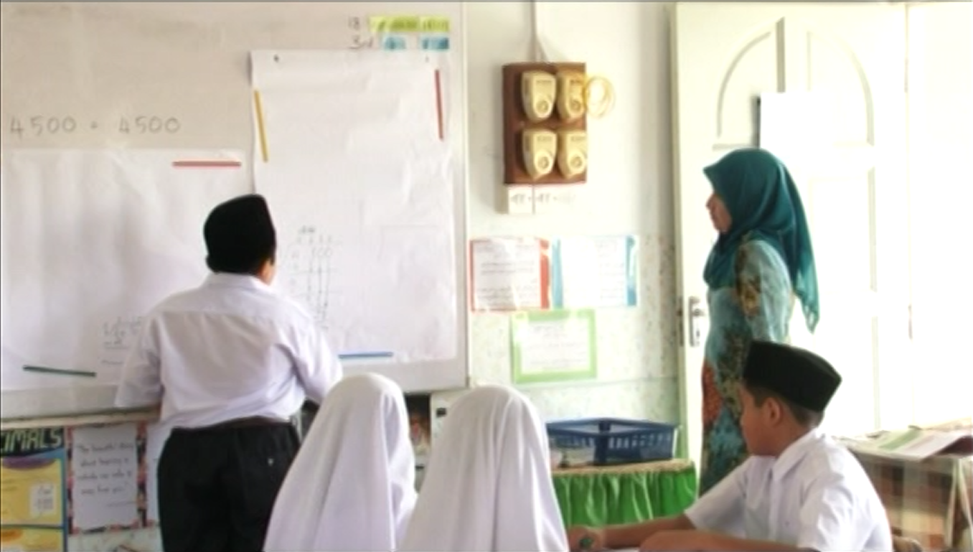

Slide 16
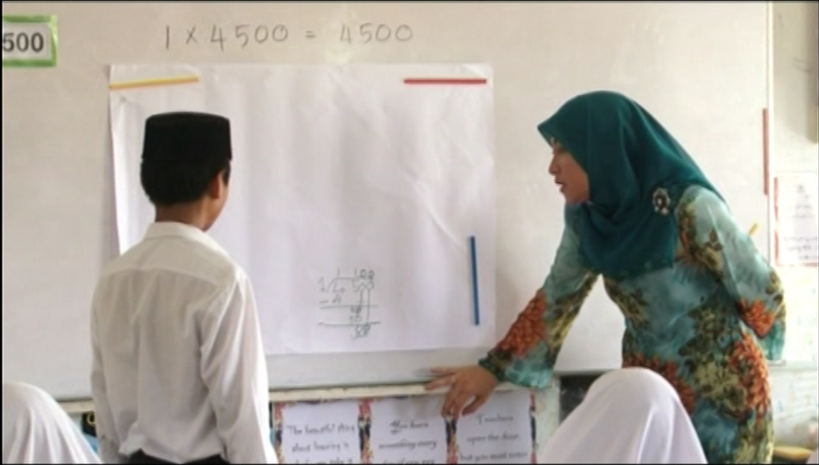

Slide 17
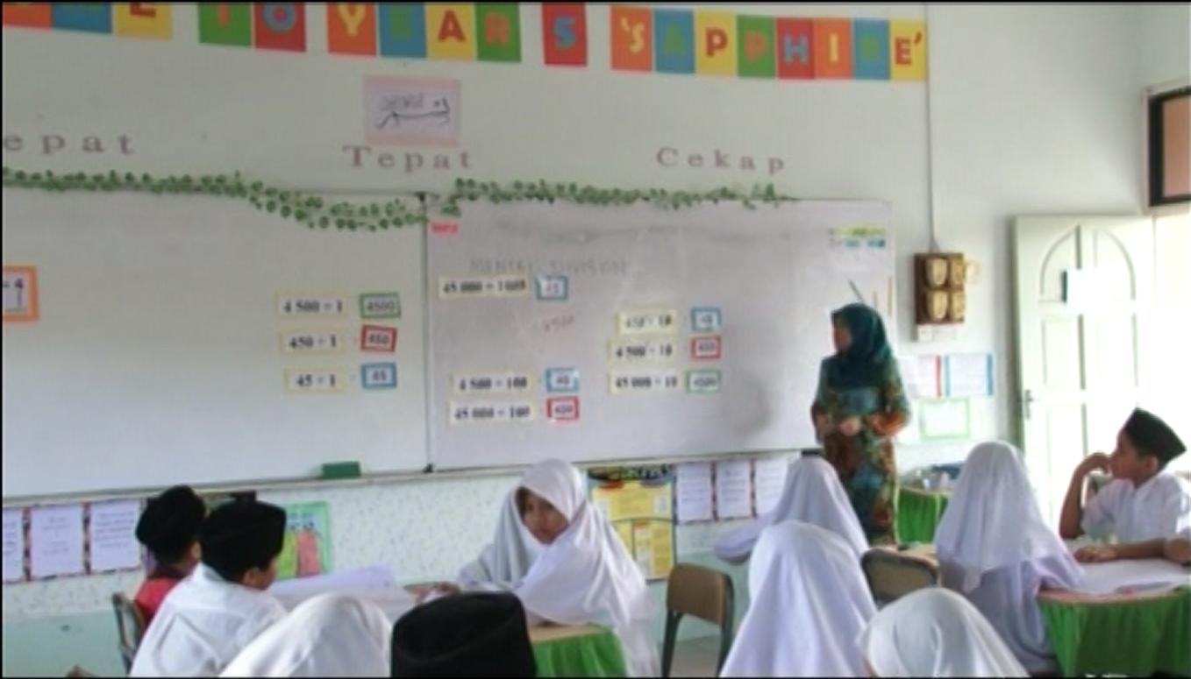

Slide 18
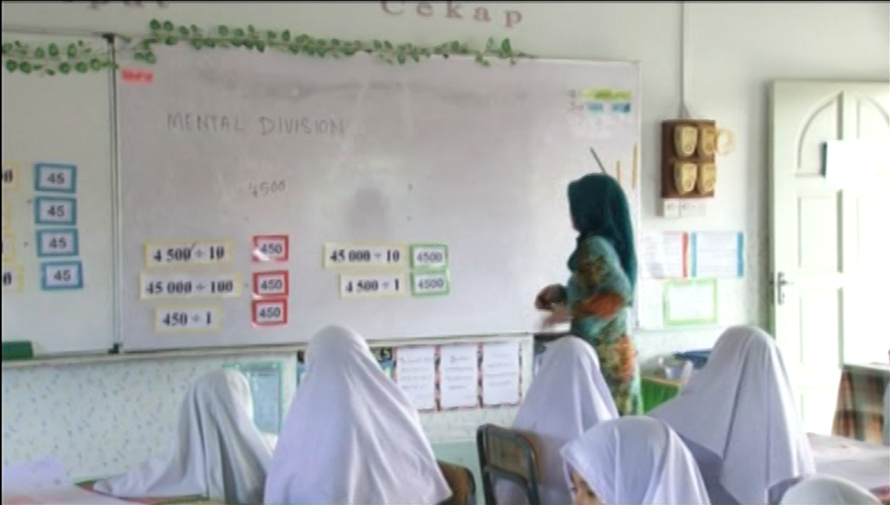

Slide 19
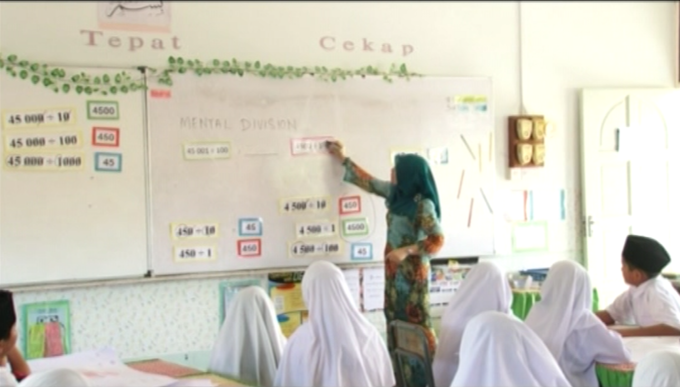

Slide 20
Discussion and Conclusion
The advent of the new technology will change the way teachers teach.
However, teaching with technology needs to be complemented with the incorporation of other important process skills (such as mathematical thinking, communication and connection), and teachers will seek resources other than textbooks to get ideas on how best to teach a topic.
The dbook was also introduced last year. Noe teachers who do not get the chance to use the smart-board can have interactivity in their classroom, because the dBook can be inserted with basic tools (like drawing, compass, ruler), animations and interactive simulations (using Adobe Flash) or videos.
Recent interactive teaching tools like ‘mimio’ also made interactive teaching cheaper.
Therefore, design and implementation of teaching will be more innovative and effective for the benefit of thechildren

