Slide 1
Strong velocity gradient related to the 2011 Tohoku Earthquake using travel time data from active seismicity detected by the dense seismic network
○Makoto Matsubara
National Research Institute for Earth Science and Disaster Prevention (NIED)

Slide 2
Outline
Seismic observation (NIED Hi-net)
Seismicity and velocity structure related with the Tohoku earthquake
Problem for mathematics
2012/02/15
APEC - Tsukuba International Conference VI

Slide 3
Seismic observation (NIED Hi-net)

Slide 4
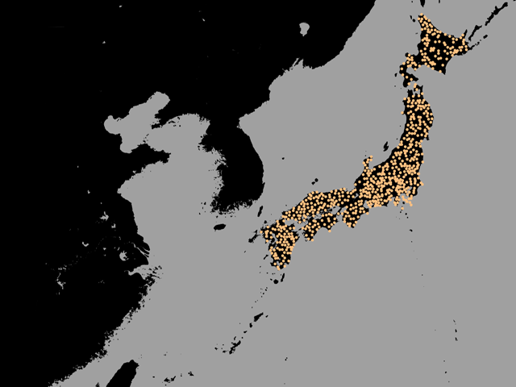
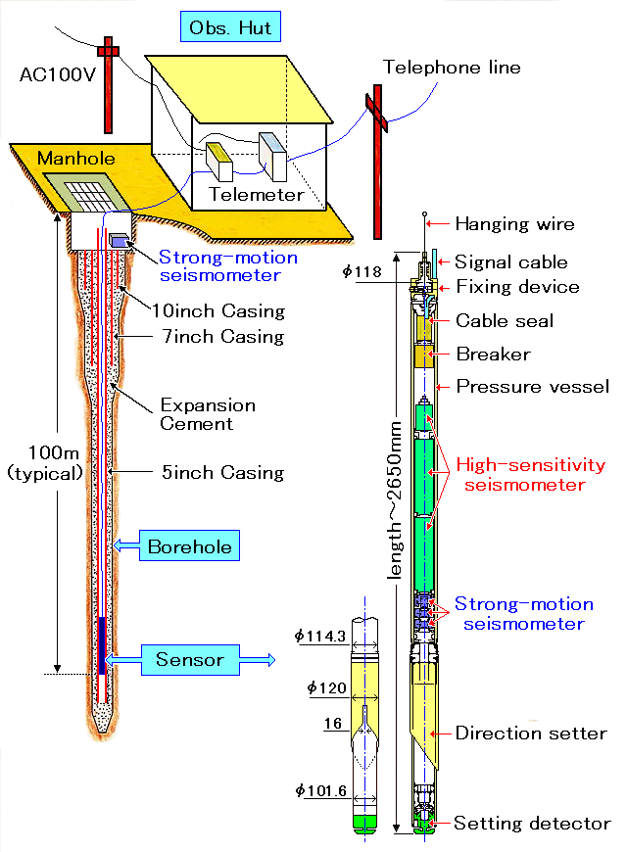
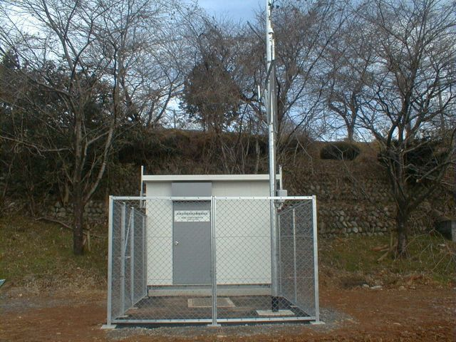
Hi-net (High-sensitivity seismograph Network)

Slide 5
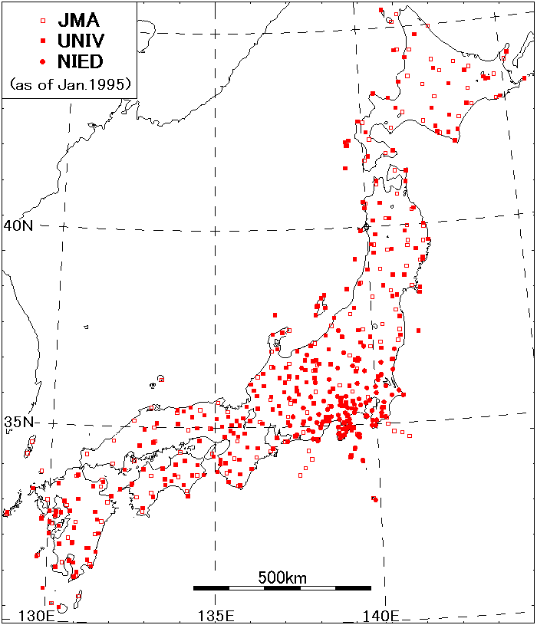
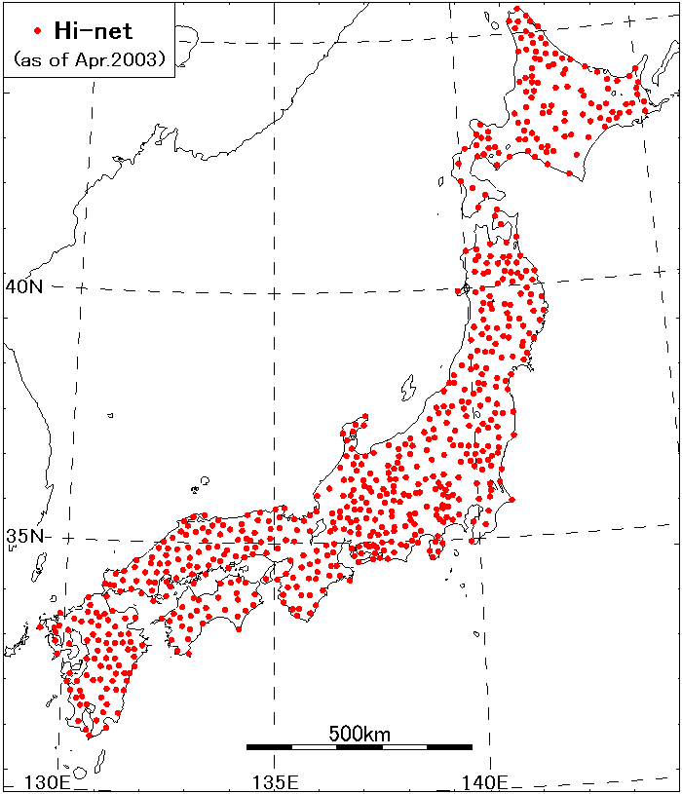
Seismic stations before and after 1995 event
- before Kobe Eq. -
- after Kobe Eq. -
NIED Hi-net:782 stns. (as of Jan 2010)
JMA: 188 stns. UNIV: 274 stns. NIED: 89 stns. Total: 551 stns.
(as of Jan 1995)
All the data are concentrated to JMA and a unified processing was started on October 1997
Inhomogeneous distribution
2012/02/15
APEC - Tsukuba International Conference VI

Slide 6
Contribution to JMA unified hypocenter catalog
Kyushu U.
Kagoshima U.
Kochi U.
JAMSTEC
DPRI
AIST
Nagoya U.
Hirosaki U.
ERI
5 %
Tohoku U.
7 %
NIED
Hi-net
Hokkaido U.
JMA
57 %
22 %
(March, 2009)
2012/02/15
APEC - Tsukuba International Conference VI

Slide 7
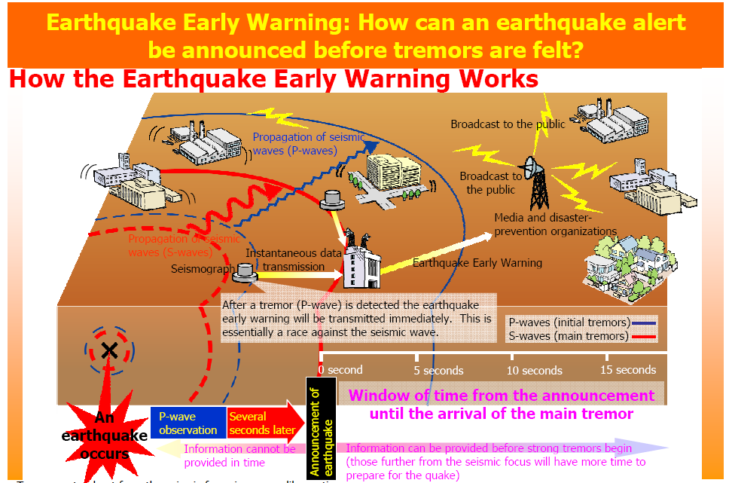
About 200 JMA stations and 800 NIED Hi-net stations are used.
2012/02/15
APEC - Tsukuba International Conference VI

Slide 8
Seismic waveform of the Tohoku earthquake

Slide 9
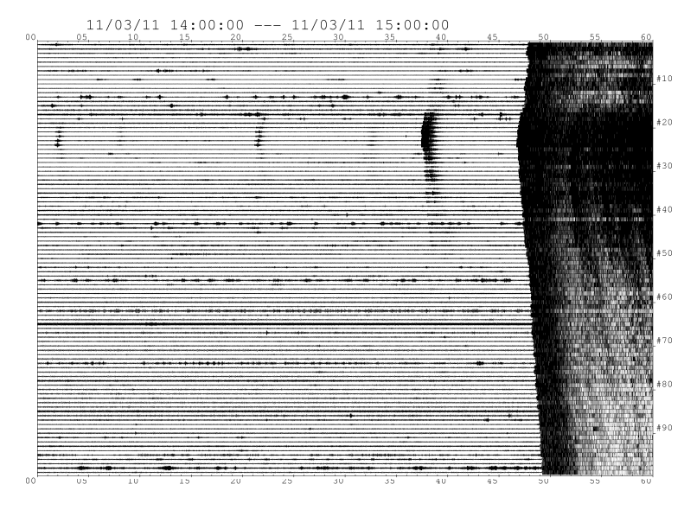
Waveform for the Tohoku earthquake
14:00
15:00
March 11, 2011
North
South

Slide 10
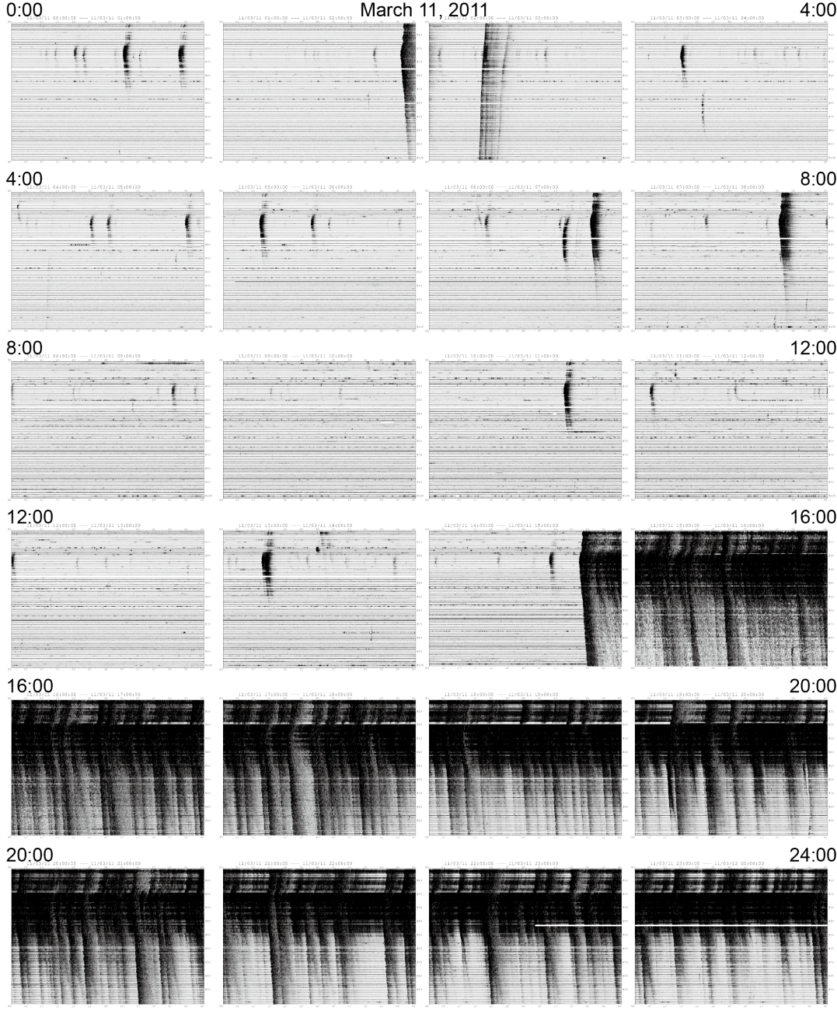
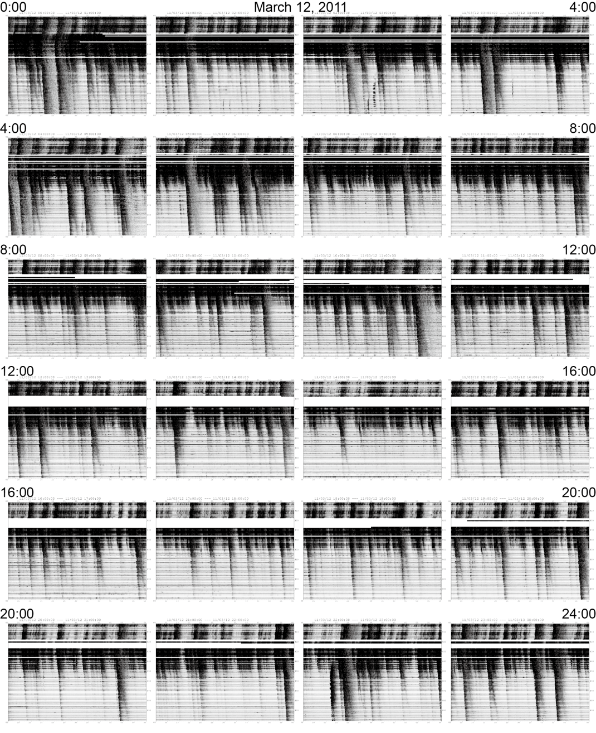
0:00
March 11
0:00
March 12
4:00
4:00
8:00
8:00
12:00
12:00
16:00
16:00
20:00
20:00

Slide 11
Shake map and damage of seismic stations

Slide 12
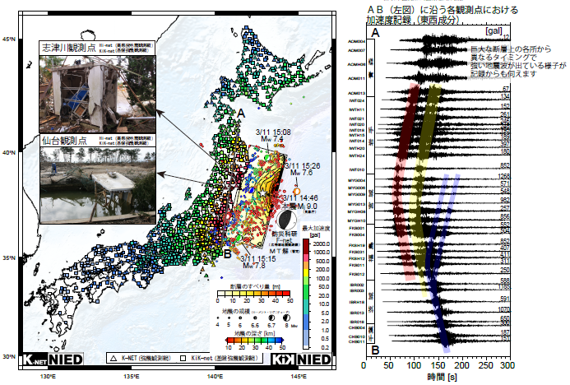
Shake map and damage of seismic stations
Shizugawa (18 m)
Sendai (2 m)
Large acceleration
Small acceleration

Slide 13
Waveforms at stations along the coast
Acceleration waveform
Shizugawa
Many seismic wave emitted from different place at different time
Sendai
Time[s]

Slide 14
Aftershock seismicity

Slide 15
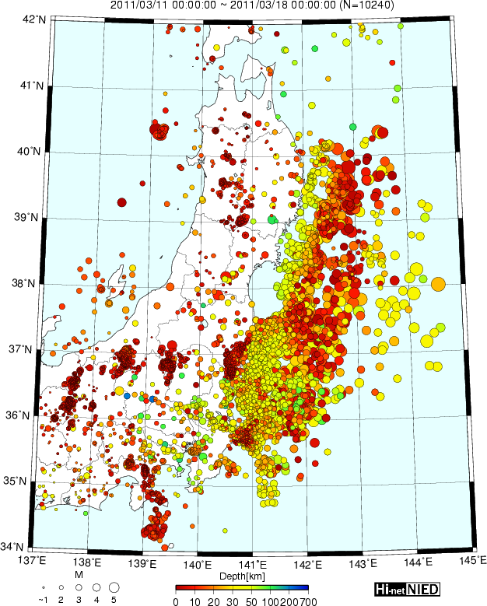
Hypocenters of aftershocks in one week
Aftershock along
the plate boundary

Slide 16
Hypocenter of aftershock in one week
Induced seismicity
after the Tohoku earthquake

Slide 17
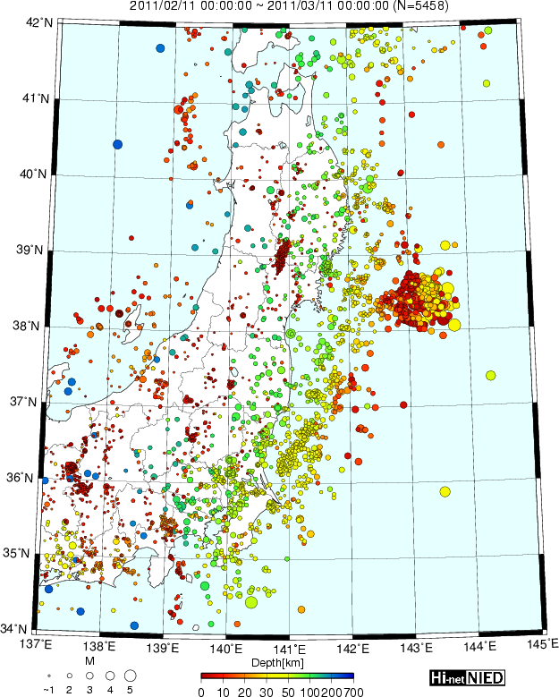
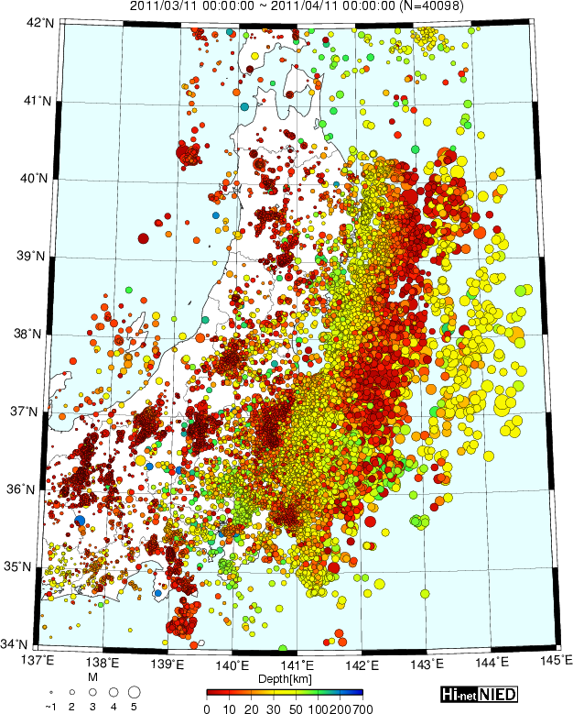
Seismicity before and after the Tohoku event
2/11 - 3/10
3/11 - 4/10
Activated seismicity
In volcanic zone
Aftershocks
of March 9
event (M7.3)

Slide 18
Seismic velocity structure

Slide 19
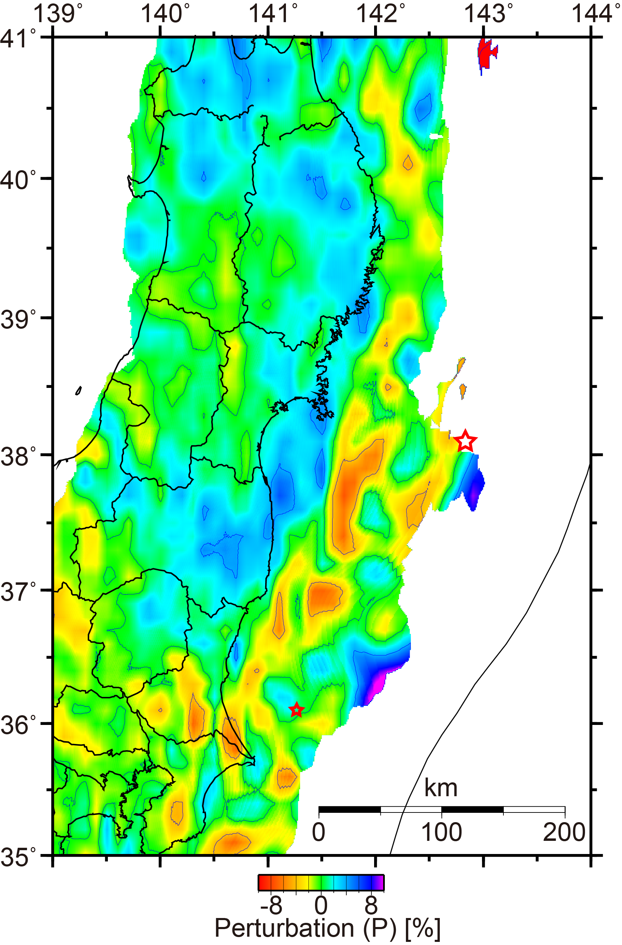
Seismic velocity structure within the Pacific plate
Matsubara and Obara (2011)
Two low-velocity zones
Landward remarkable low-velocity zone
High-velocity zone on the seaward side

Slide 20
Seismic velocity structure within the Pacific plate
Matsubara and Obara (2011)
Initial rupture point consistent with the boundary of the low-/high-velocity zones

Slide 21
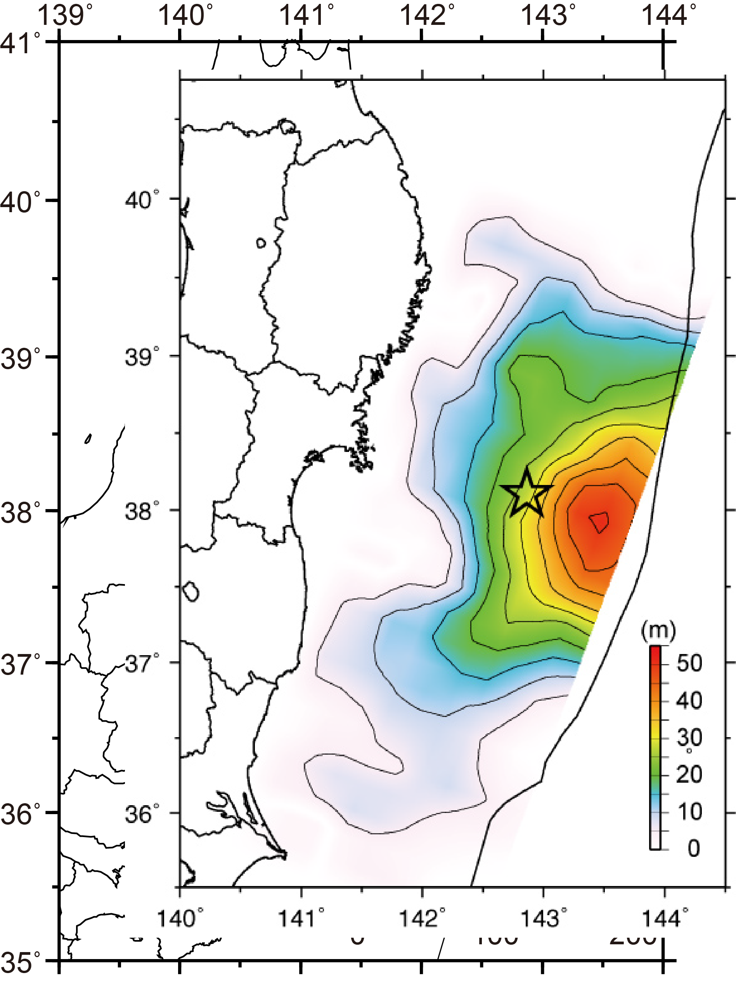
Comparison with coseismic slip region
(Yagi, 2011)
Large slip on the east side of the initial rupture point
Slip region extends 100 km on the west side of the initial rupture point

Slide 22
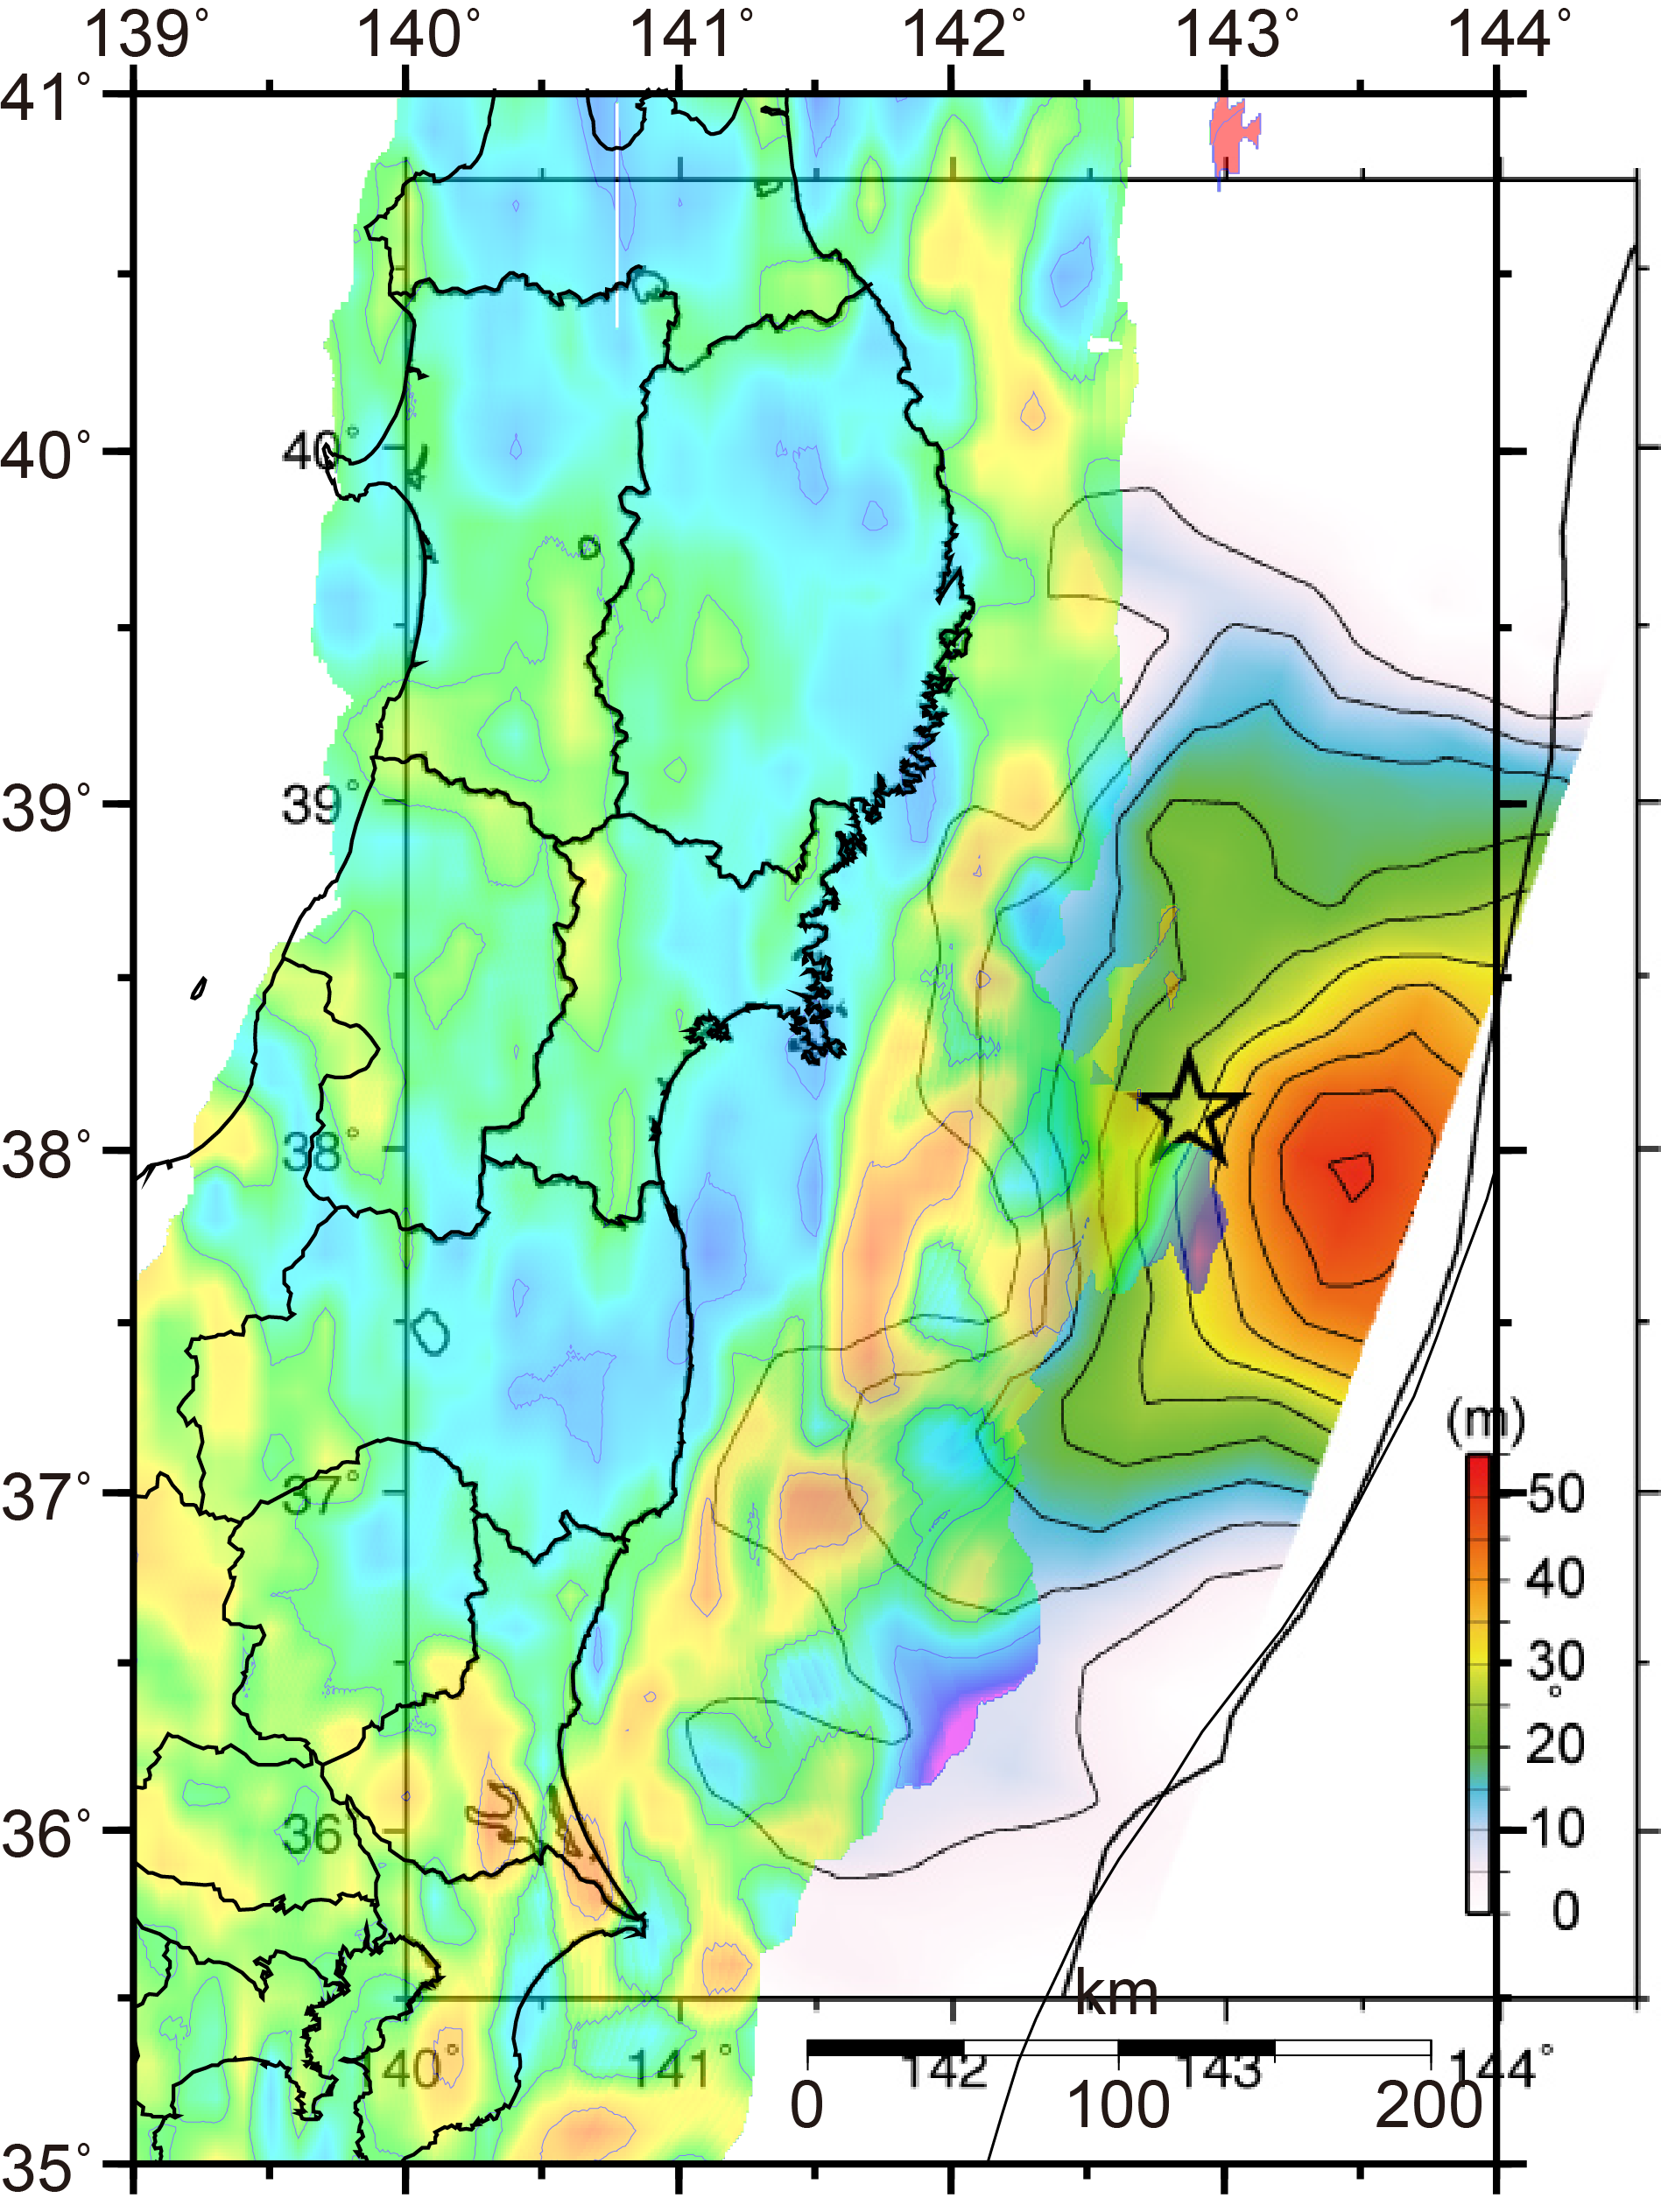
(Yagi, 2011)

Slide 23
Western edge of the slip region consistent with the low-velocity zone
(八木, 2011)

Slide 24
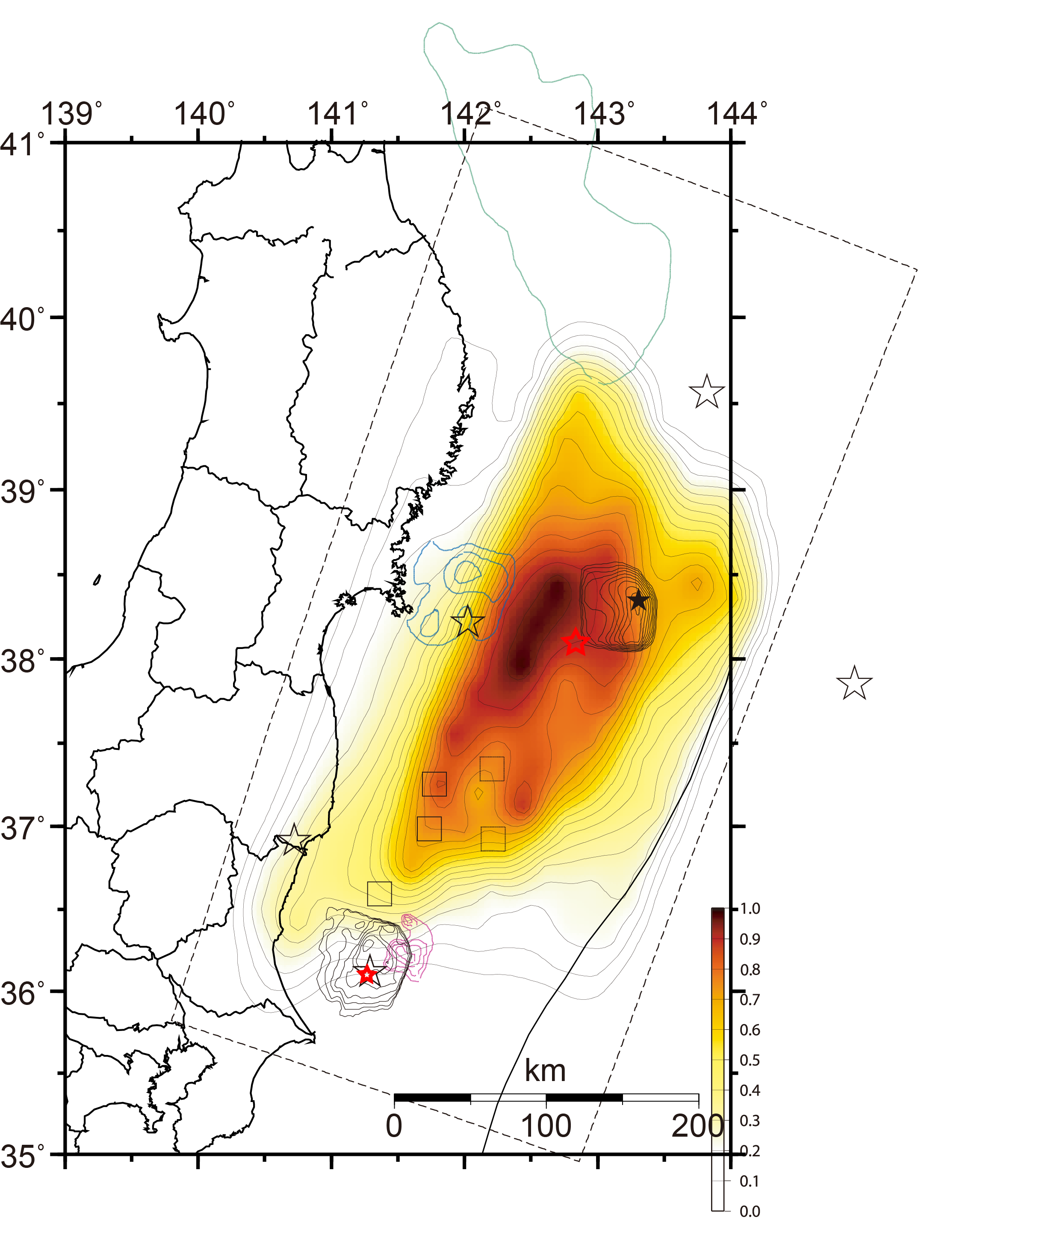
Comparison with strong energy emission region
(Honda et al., 2011)
Strong-energy-radiated region on the west side of the initial rupture point
Consistent
with the high-velocity zone
between
two low-velocity zones

Slide 25
Comparison with strong energy emission region
(Honda et al., 2011)
Strong-energy-radiated region extending south-southwestward
Slightly-strong-energy-radiated region on the east side of the initial rupture point

Slide 26
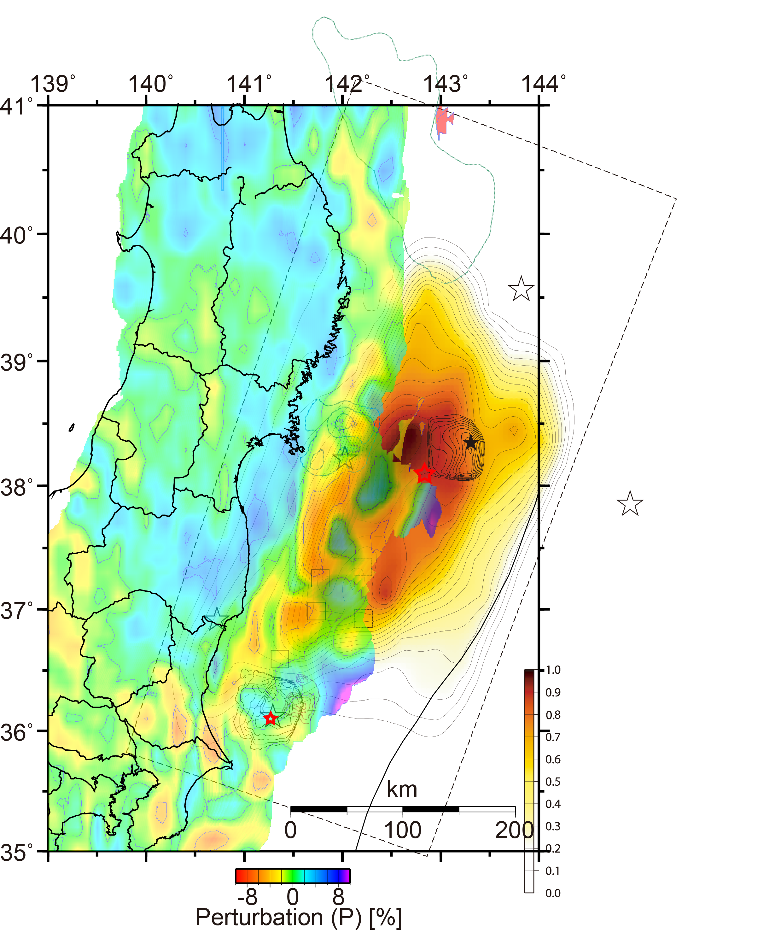
(Honda et al., 2011)

Slide 27
Strong-energy-radiated region on the west side of the initial rupture point
Consistent
with the high-velocity zone
between
two low-velocity zones

Slide 28
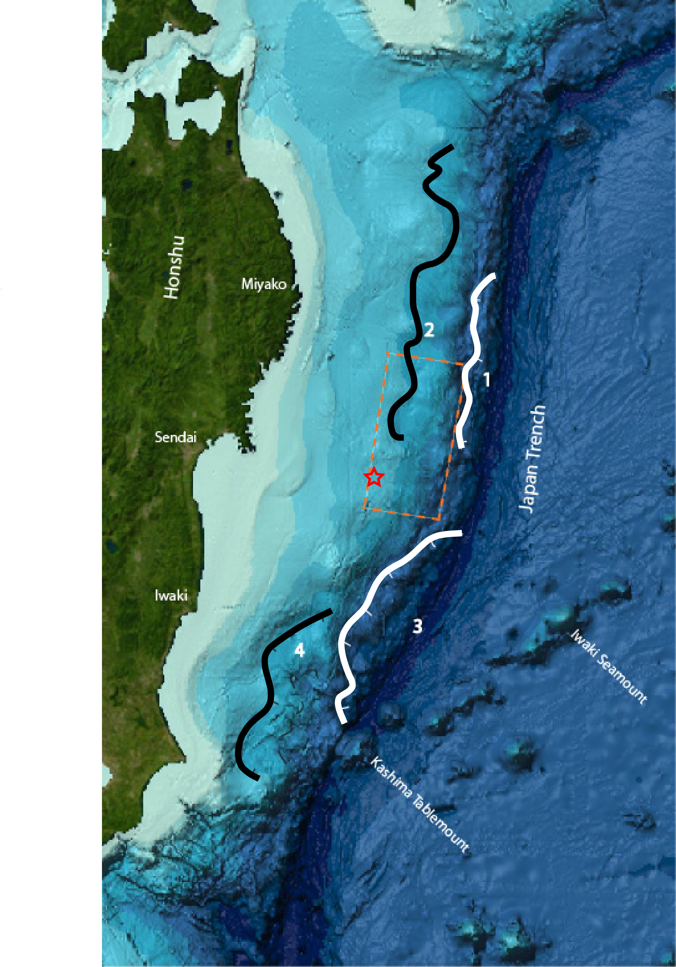
Seamount ? Low-velocity zone near the initial rupture point
Subducted seamount off Ibaraki and Fukushima
(Yamasaki and Okamura, 1989)
Subducted seamount estimated from the configuration of seafloor
(Hudnut, 2011)

Slide 29
Matsubara and Obara (2011)
(Hudnut, 2011)

Slide 30
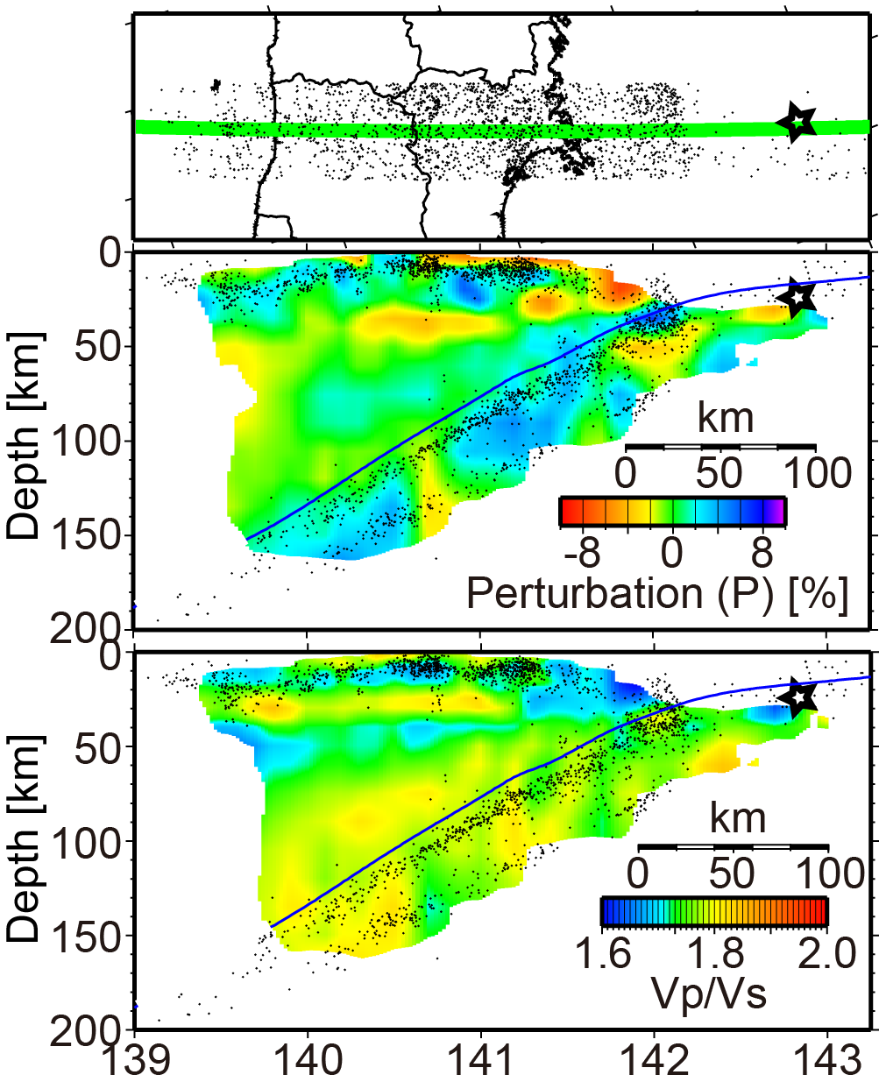
Matsubara and Obara (2011)

Slide 31
Matsubara and Obara (2011)
(Hudnut, 2011)

Slide 32
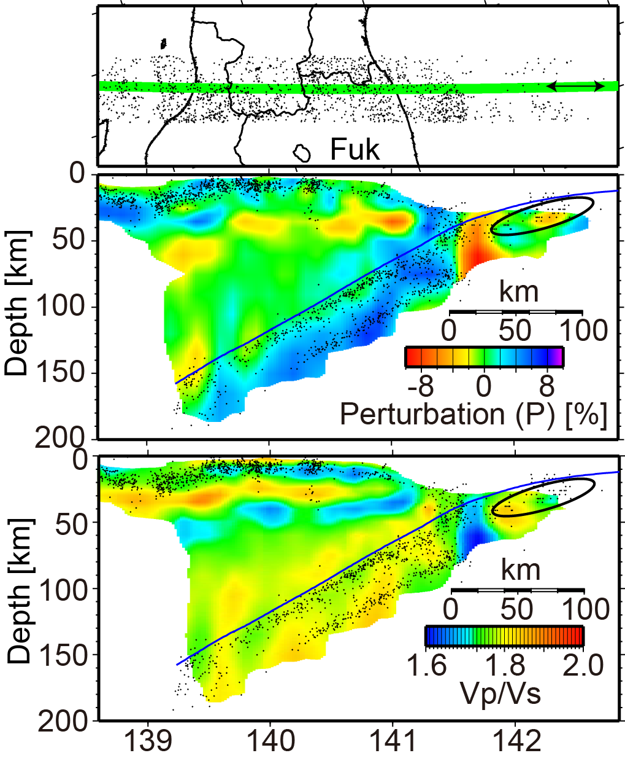
Matsubara and Obara (2011)

Slide 33
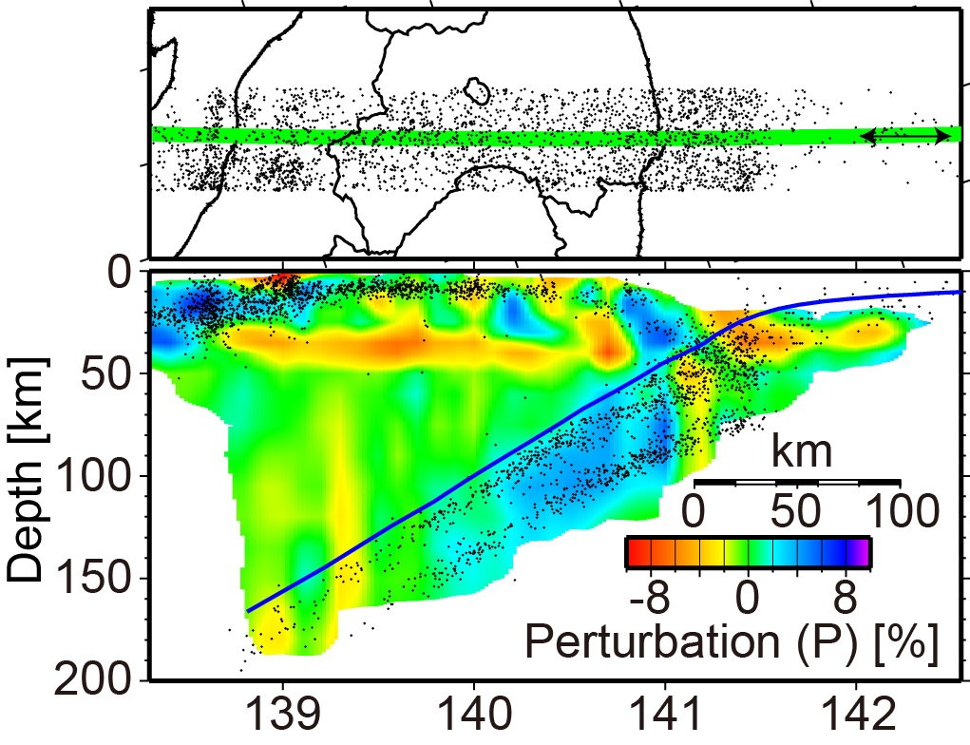
Matsubara and Obara (2011)
Continuous low-velocity and low-Vp/Vs zone
Possibility of existence of subducted seamount

Slide 34
Matsubara and Obara (2011)
Low-velocity zone as a fluctuation within the high-velocity zone
Action as the initial rupture point
Large slip region

Slide 35
Seismic velocity structure within the Pacific plate and coseismic slip region
Two low-V zone off Tohoku region
Hypocenter consistent with the boundary of the high-/low-V zone
High-V zone between the low-V zones consistent with the strong-energy-radiated region
Coseismic slip region consistent with high-V zone on the east side of the landward low-V zone

Slide 36
Initial rupture within the fluctuated structure to huge coseismic slip
Low-V and low-Vp/Vs zone as the fluctuation within the high-V zone
Subducted seamount as a fluctuation within the heterogeneous structure acting as a initial rupture point
Rupture over whole high-V zone (asperity) lead to huge earthquake?

Slide 37
Determination of hypocenter

Slide 38
Seismic wave (Body wave)
P-wave
Primary
Compressional
S-wave
Secondary
Transverse

Slide 39
Traditional method to determine hypocenter
No GPS satellite
Difficulty in detection of accurate exact time.
Relatively easy to measure time between the arrival times of P- and S-waves
Use of differential time between the arrival times of P- and S-waves (S-P time)
S-P time
[sec]

Slide 40
Empirical method to estimate the distance to hypocenter
Typical crustal seismic velocity
P-wave: 6.0 km/s
S-wave: 3.5 km/s
In the case of 8 km hypocentral distance:
P-wave arrives in 1.33 s.
S-wave arrives in 2.28 s.
S-P time → about 0.95 s = 2.28 - 1.33.
Distance between hypocenter and seismic station is approximately 8x[S-P time(s)] km.

Slide 41
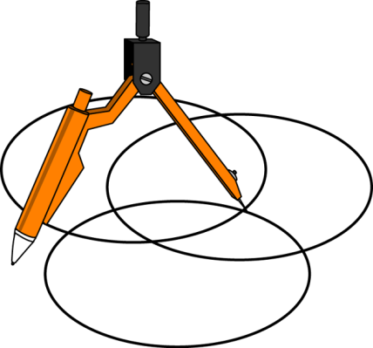
Empirical method to estimate the distance to hypocenter
Distance between hypocenter and seismic station is approximately 8x[S-P time(s)] km.
Measure S-P time at least three stations or more.
Estimation of hypocenter with compasses.

Slide 42
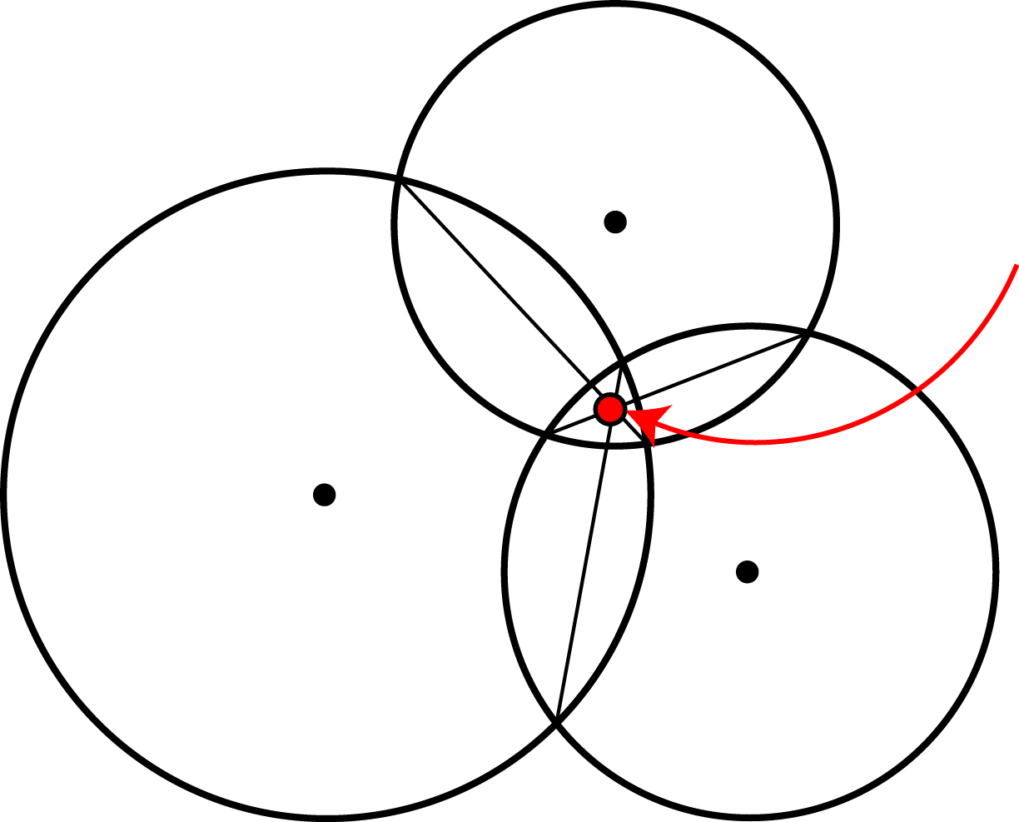
Traditional method to determine hypocenter
Station A
Epicenter (E)
Station B
Station C
$$\text{Radius}=8×\text{[}\text{S}\text{−}\text{P} \text{time} \text{at} \text{each} \text{station}\text{]}$$

Slide 43
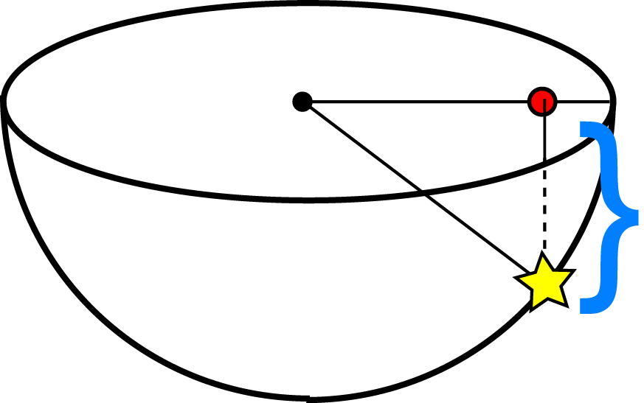
Traditional method to determine hypocenter
Station A
Epicenter (E)
Station B
Station C
Epicenter (E)
$$\text{Radius}=8×\text{[}\text{S}\text{−}\text{P} \text{time} \text{at} \text{each} \text{station}\text{]}$$
Station A
Depth (D)
$$D=\sqrt{R_{A}^{2}−{\overline{\text{AE}}}^{2}}$$
Hypocenter
Pythagorean theorem
$$R_{A}=8×\text{[}\text{S}\text{−}\text{P} \text{time} \text{at} \text{Station} \text{A}\text{]}$$

Slide 44
Calculation of ray path, seismic velocity, and traveltime

Slide 45
Ray path
Fermat’s Principle
Light follows the path of least time.
Seismic wave also does.
To rescue someone in the water, you would run along the beach until you are almost closest point on the shore, rather than swimming directly to the person.
Beach
Running: Faster
Swimming: Slower
Sea

Slide 46
The deeper zone, the higher velocity, generally
Deeper zone is compressed by loading above that and becomes harder than the shallower zone.
Soft material: low velocity → slow
Hard material: high velocity → fast
The deeper zone, the faster seismic velocity
Ray passes through deeper high-velocity zone to reach as fast as possible.
Sometimes, there is low-velocity zone in the deeper zone owing to the geological material

Slide 47
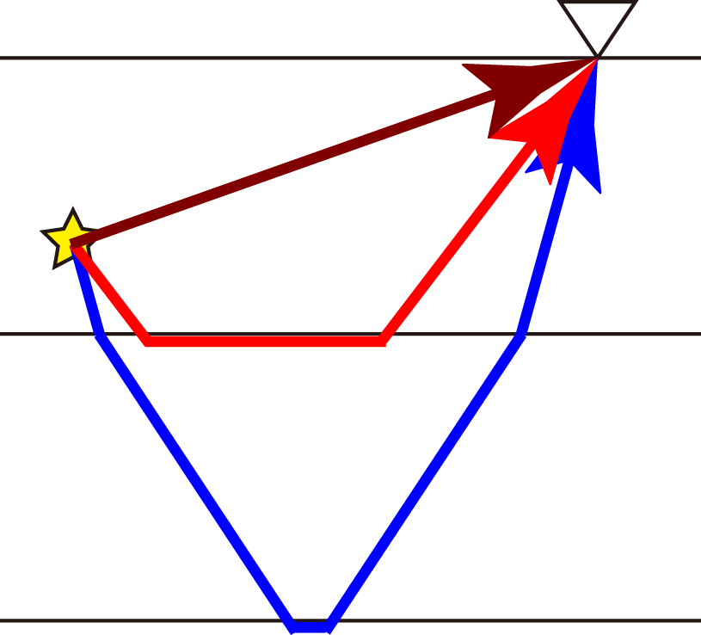
Example of ray path in homogeneous layer structure
Station
Fastest
Hypocenter
Low-velocity layer
High-velocity layer
Very-high-velocity layer
Ray shoots out upward if the seismic station exists near the hypocenter.

Slide 48
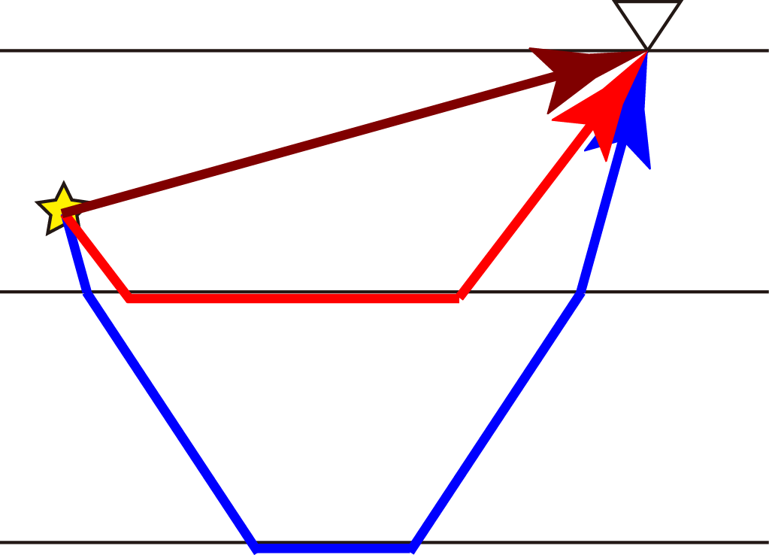
Example of ray path
Station
Hypocenter
Fastest
Low-velocity layer
High-velocity layer
Very-high-velocity layer
Ray shoots out downward if the station is far from the hypocenter since the deeper layer has high-velocity.

Slide 49
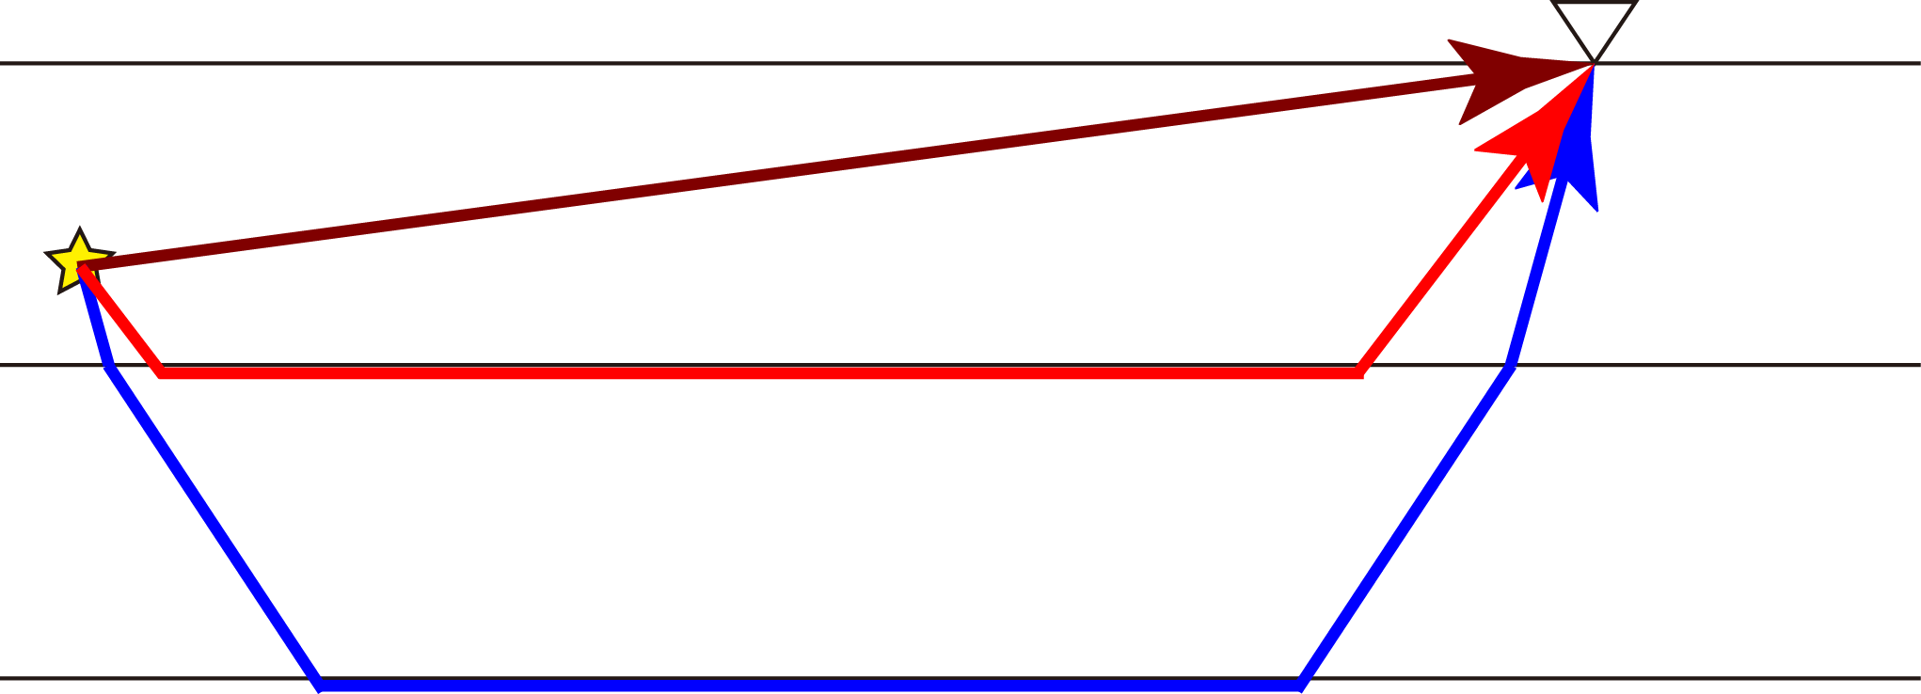
Example of ray path
Station
Hypocenter
Low-velocity layer
High-velocity layer
Fastest
Very-high-velocity layer
Ray shoots out downward and pass though deeper layer if the station is far away from the hypocenter since the deeper layers have high-velocities.

Slide 50
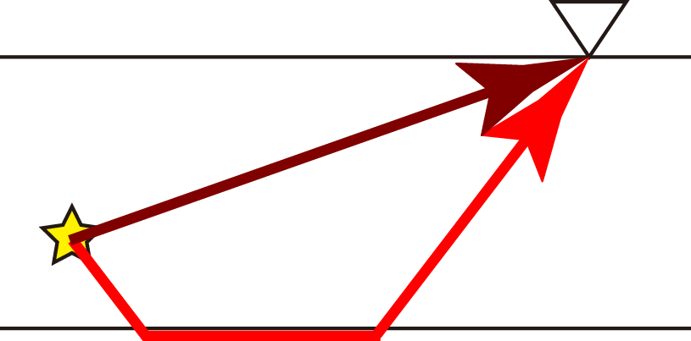
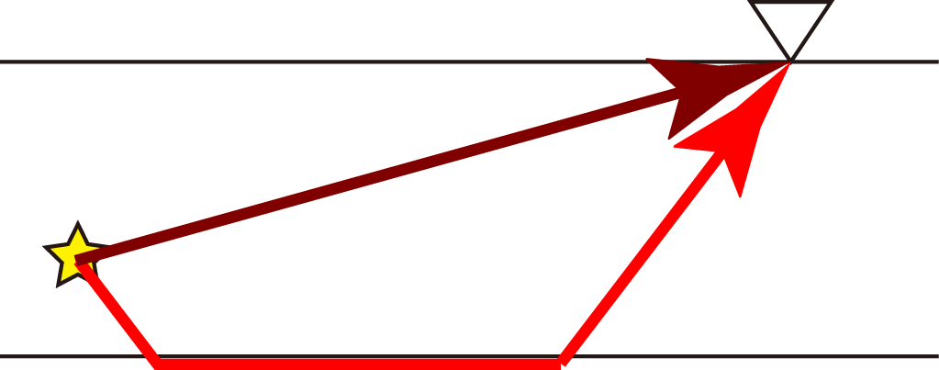
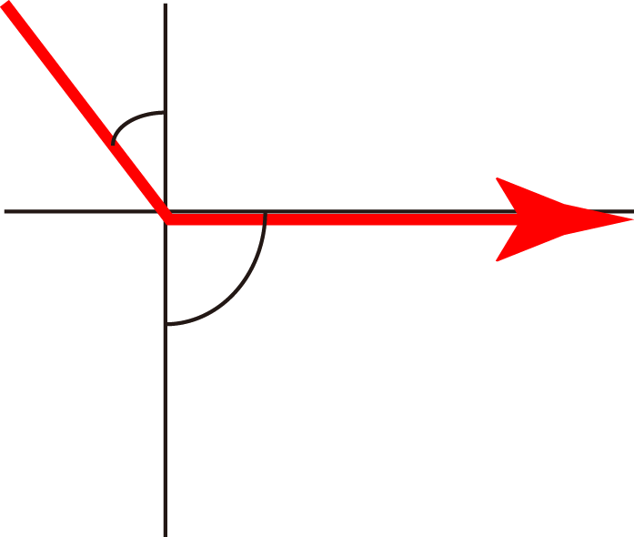
At what distance does the head wave arrive earlier?
D < ? km
D > ? km
Station
Station
Faster
Direct wave
Hypocenter
Hypocenter
5 km/s layer
Faster
Snell’s law
6 km/s layer
Refracted wave
Head wave
$$i$$
$$\frac{\sin{i}}{\sin{j}}=\frac{v_{1}}{v_{2}}$$
D: Hypocenter distance
$$v_{1}$$
$$v_{2}$$
$$j$$

Slide 51
At what distance does the head wave arrive earlier?
Known:
Velocity of each layer: 5 and 6 km/s
Thickness of the first layer: about 10 km$≈3\sqrt{11}$
Depth of hypocenter: 6.6 km$≈2\sqrt{11}$
15
Station
$$\sqrt{{\left(2\sqrt{11}\right)}^{2}+{\left(5+x+15\right)}^{2}}$$
$$2\sqrt{11}$$
Hypocenter
$$3\sqrt{11}$$
5
18
$$\sqrt{11}$$
5 km/s layer
6
$$\sin{i}=\frac{\sin{i}}{\sin{j}}=\frac{v_{1}}{v_{2}}=\frac{5}{6}$$
6 km/s layer

Slide 52
At what distance does the head wave arrive earlier?
$$\frac{\sqrt{{\left(2\sqrt{11}\right)}^{2}+{\left(5+x+15\right)}^{2}}}{5}>\frac{6+18}{5}+\frac{x}{6}$$
$$x>16.97 \text{km}$$
$$D>31.97 \text{km}$$
Traveltime for direct wave
Traveltime for head wave
15
Station
$$\sqrt{{\left(2\sqrt{11}\right)}^{2}+{\left(5+x+15\right)}^{2}}$$
$$2\sqrt{11}$$
Hypocenter
$$3\sqrt{11}$$
5
18
$$\sqrt{11}$$
5 km/s layer
6
$$\sin{i}=\frac{\sin{i}}{\sin{j}}=\frac{v_{1}}{v_{2}}=\frac{5}{6}$$
6 km/s layer

Slide 53
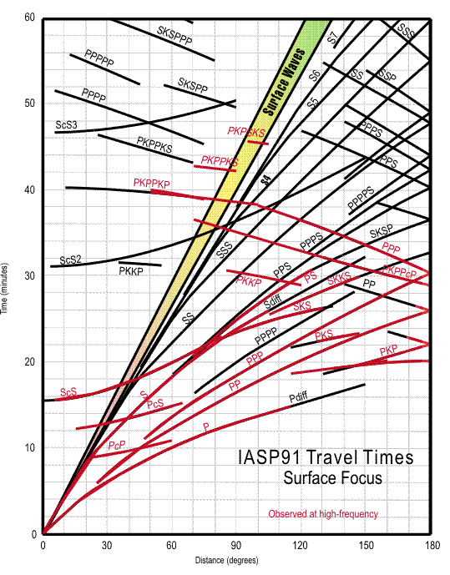
Traveltime curve
Many kinds of waves
How long it takes to reach seismic station for each kind of wave.
Assumption of event at earth surface
Time (minutes)
Distance (degrees)
(USGS)

Slide 54
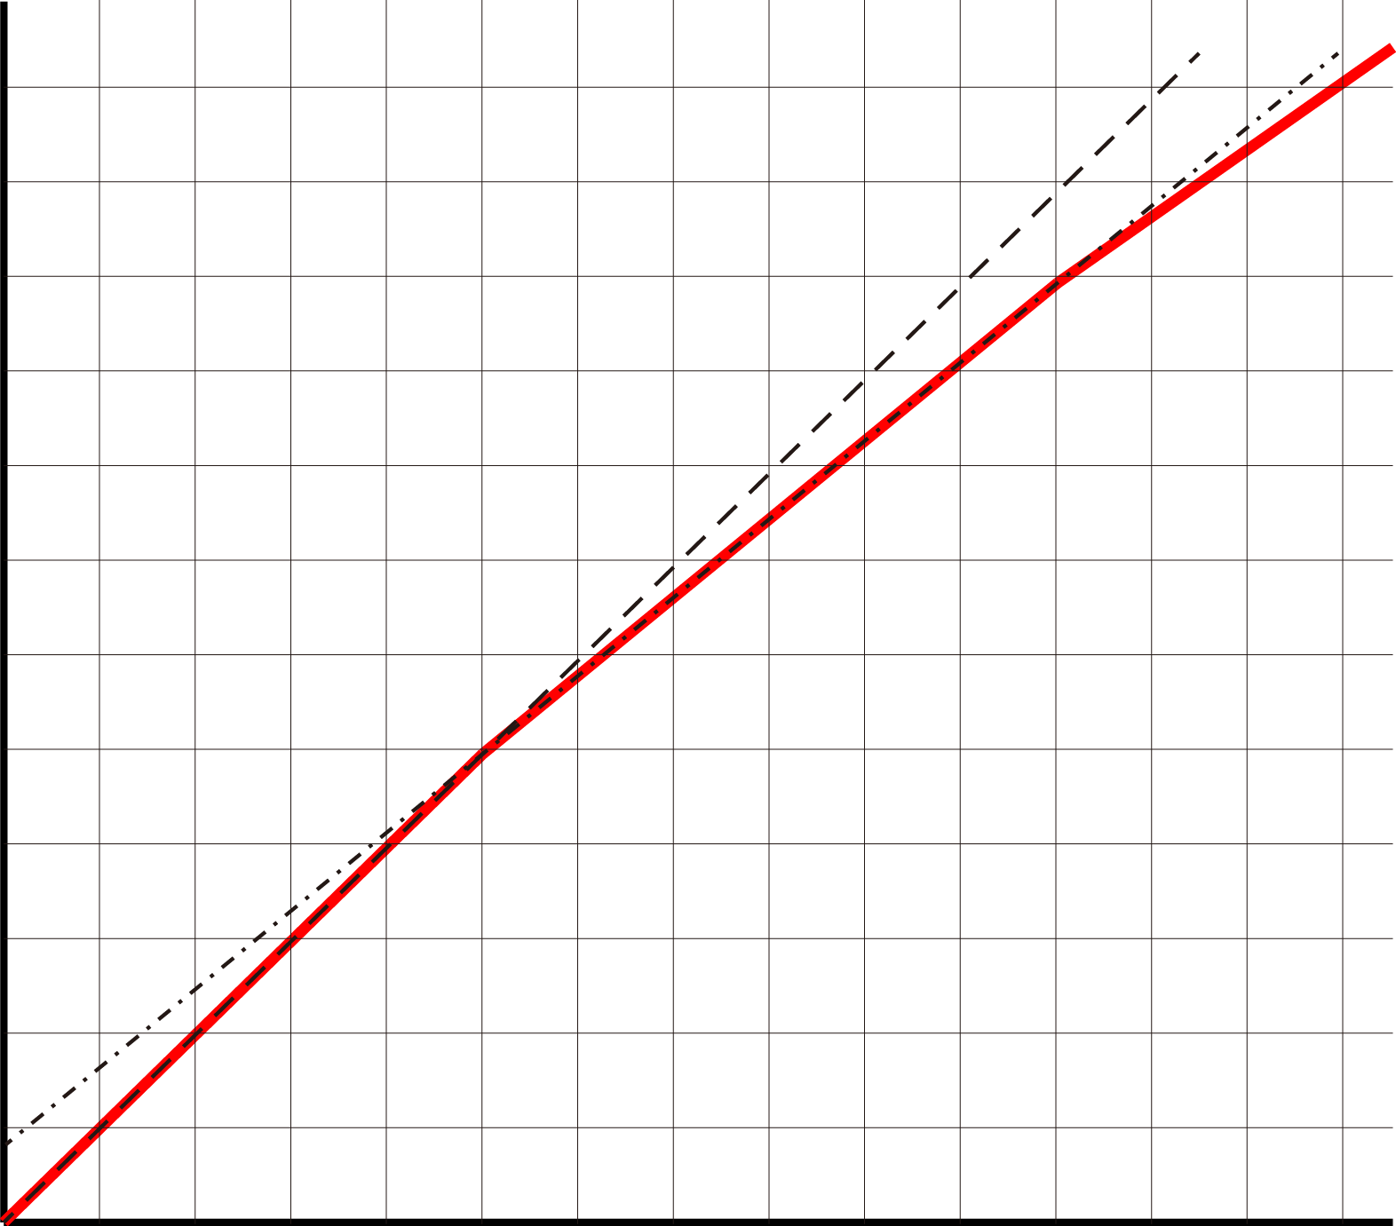
Estimation of seismic velocity structure in case of layer structure
Plot traveltime and distance at many seismic stations to draw travel time curve
Estimate the seismic velocity and thickness of each layer.
20
Time (sec)
10
0
50
100
Distance (km)

Slide 55
Estimation of seismic velocity structure in case of layer structure
Seismic velocity is estimated from slope of the line.
20
7 km/s
Time (sec)
6 km/s
10
5 km/s
0
50
100
Distance (km)

Slide 56
Estimation of seismic velocity structure in case of layer structure
Seismic velocity is estimated from slope of the line.
Estimate thickness of each layer from traveltimes.
20
(110 km, 20 s)
7 km/s
Time (sec)
(50 km, 10 s)
6 km/s
10
5 km/s
0
50
100
Distance (km)

Slide 57
Estimation of seismic velocity structure in case of layer structure
50 km
$$5$$
$$h$$
$$\sqrt{11}$$
$$6$$
$$i$$
ratio
5 km/s layer
$$\sin{i}=\frac{\sin{i}}{\sin{j}}=\frac{v_{1}}{v_{2}}=\frac{5}{6}$$
6 km/s layer
$$i$$
$$j$$
$$\frac{\frac{6h}{\sqrt{11}}×2}{5}+\frac{50−\frac{5h}{\sqrt{11}}}{6}=10=\frac{50}{5}$$
$$h=7.5 \text{km}$$

Slide 58
Advanced method of inversion of seismic velocity

Slide 59
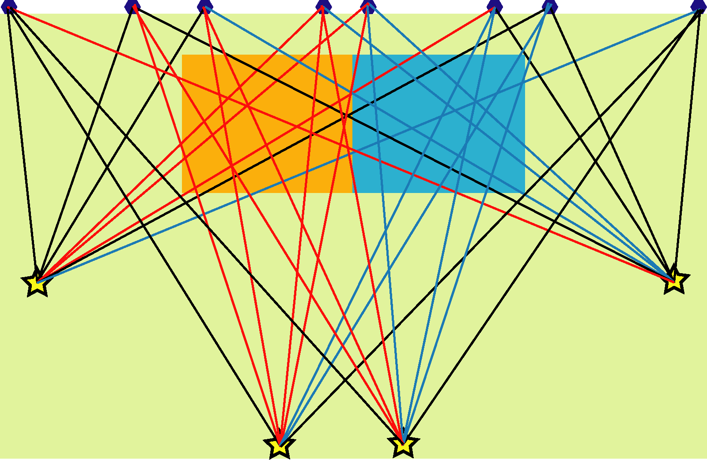
Seismic tomography
Method of resolving internal structure in the earth like CT scan
Ray passing through
mainly slow zone
→ Long time
Slow
zone
Fast
zone
Ray passing through
mainly fast zone
→ Short time
Average
velocity
zone
Ray passing through
average zone
Notes:
これまで、2002年に大まかな日本全国のトモグラフィーを報告した後、その後地域ごとの構造を報告、掲載してきましたが今回は、日本全国を水平20km、深さ方向10-30kmの分解能の構造を報告します。

Slide 60
Principle of seismic tomography
Traveltime: Time of wave propagation from hypocenter to seismic station
Residual ＝ to – tc
to: Observed traveltime
tc: Calculated traveltime
Distance between
the earthquake
and seismic station [km]
Seismic velocity
[km/s]
＝
Traveltime [s]

Slide 61
Principle of seismic tomography
Residual ＝ $t_{o}−t_{c}$
$t_{o}$: Observed traveltime
$t_{c}$: Calculated traveltime
Positive residual:
Actually more time to propagate
Actual seismic velocity is slower
than the assumed seismic velocity

Slide 62
Principle of seismic tomography
Residual ＝ $t_{o}−t_{c}$
$t_{o}$: Observed traveltime
$t_{c}$: Calculated traveltime
Negative residual:
Actually less time to propagate
Actual seismic velocity is faster
than the assumed seismic velocity

Slide 63
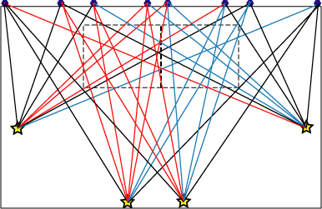
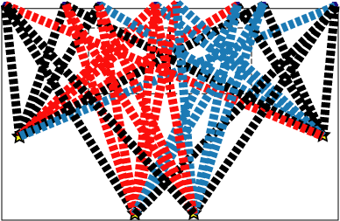
Process of seismic tomography
Residual :
Difference between observed and calculated traveltimes
Distribution of residuals
on ray paths
Calculation of residuals
Homogeneous
media

Slide 64
Process of seismic tomography
Estimation
of high velocity zone
Estimation
of low velocity zone
Distribution of residuals
on ray paths
Calculation of residuals
Homogeneous
media

Slide 65
Observation equation
$\text{Slowness}\text{[}\text{s}\text{/}\text{km}\text{]}=\frac{1}{\text{velocity}\text{ [}\text{km}\text{/}\text{s}\text{]}}$
(Time to proceed 1 km)
$\text{Slowness}×\text{Length} \text{of} \text{ray} \text{path}=\text{Traveltime}$
[s/km] [km] [s]
Length
of ray path
at a grid node
For each ray
(Matrix)
Slowness
at a grid node
(Vector)
Unknown
Traveltime
for each
Ray path
(Vector)
X
=

Slide 66
Observation equation
Length of ray path
at a grid node
traveltime of each ray path
Number of ray paths
Slowness
at a grid node
We can solve
with calculation
of inverse matrix
BUT
Too huge matrix
X
=
Number of unknown parameters

Slide 67
Tsunami arrival

Slide 68
Tsunami velocity
Tsunami velocity $v=\sqrt{gh}$
$g$: Gravitational acceleration$≈9.8$
$h$: Depth of water (sea)
Depth: 1000 m → $v=$ 99 m/s $≈$ 350 km/h
Depth: 3000 m → $v=$ 171 m/s $≈$ 617 km/h
Depth: 5000 m → $v=$ 221 m/s $≈$ 800 km/h

Slide 69
Estimation of arrival time of tsunami
Pacific ocean: Average depth 4000 m
Tsunami velocity 200 m/s $≈$ 700 km/h
Distance between Japan and Chile across Pacific ocean: 17000 km
$\frac{\text{1700 }\text{km}}{\text{700 }\text{km}\text{/}\text{h}}≈\text{24.28 }\text{hours}≈\text{1 }\text{day}$

Slide 70
Estimation of arrival time of tsunami
Known
Distance to hypocenter
Depth of the water (sea)
We can estimate the arrival time of tsunami
We can study both arithmetic and disaster prevention.

Slide 71
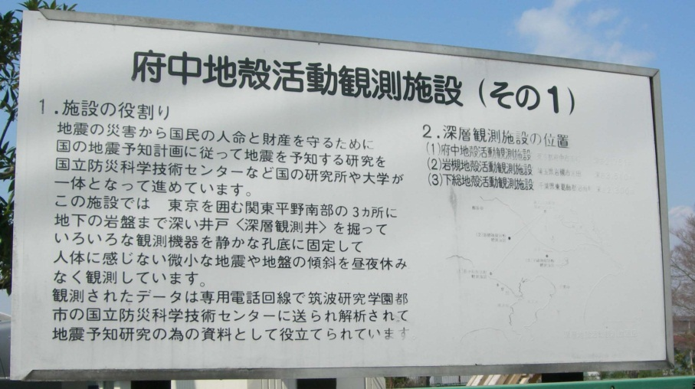
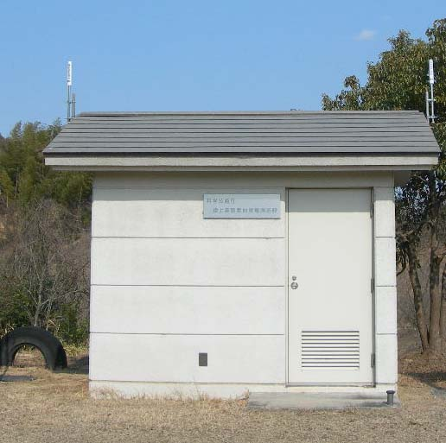
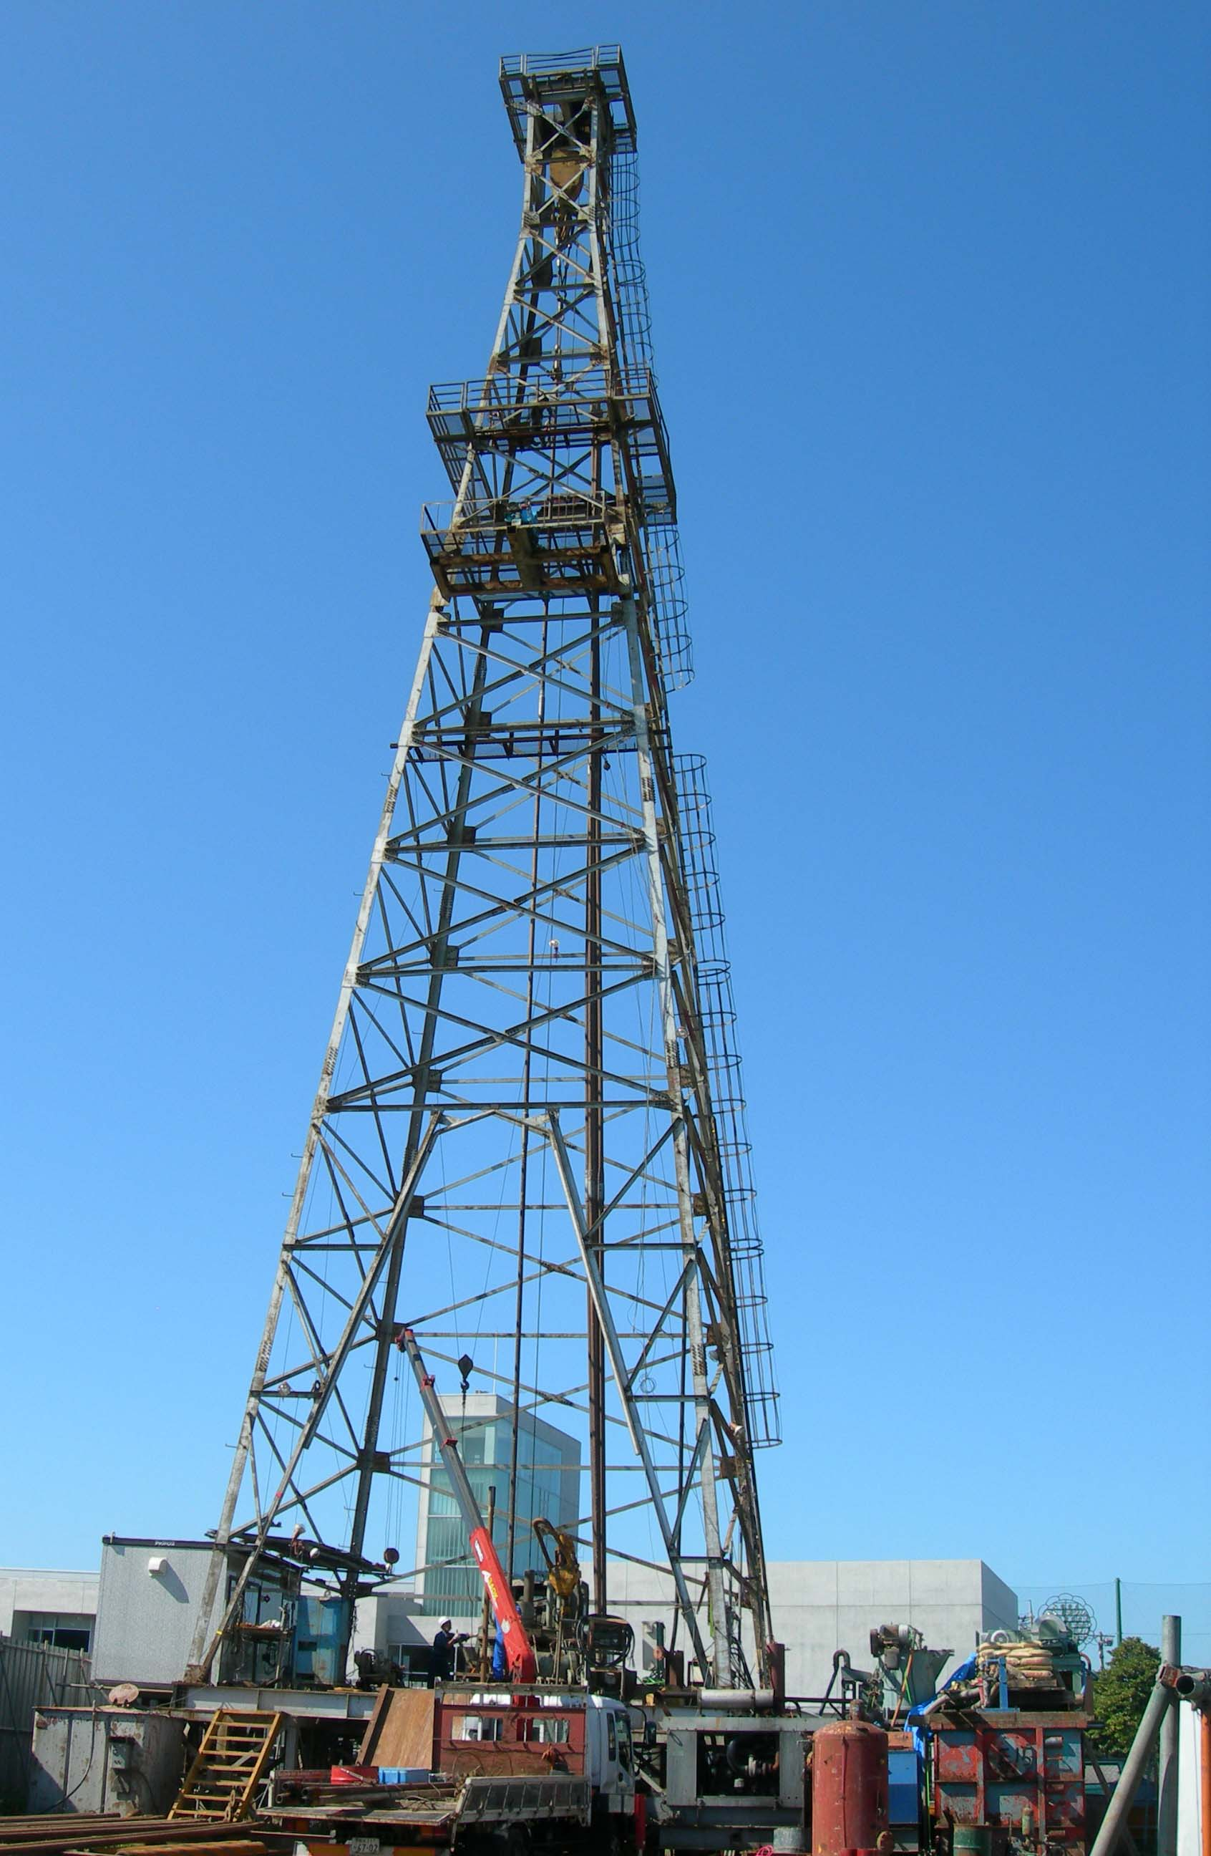
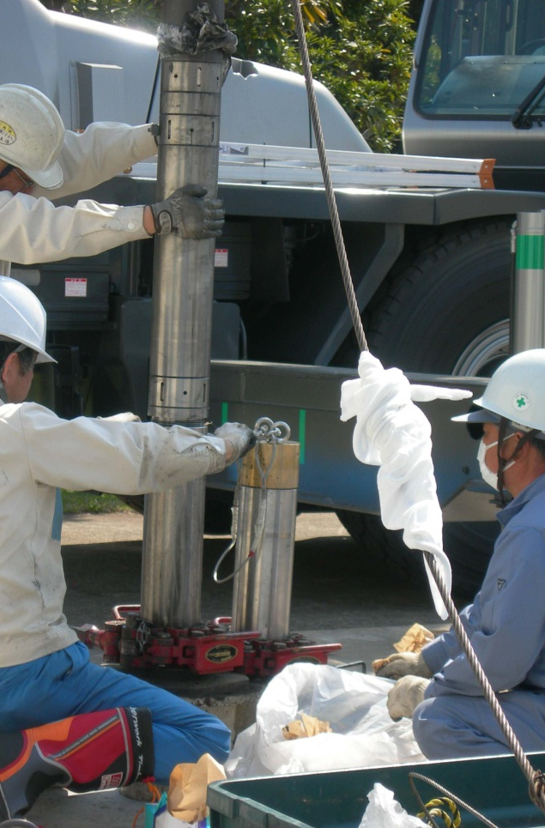
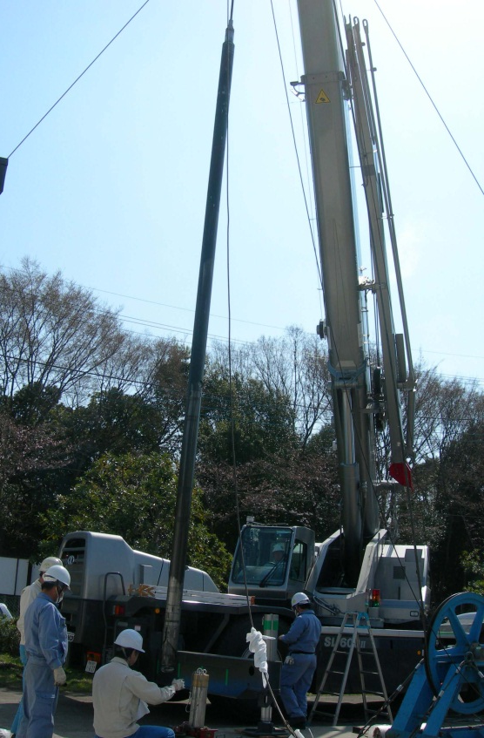
Thank you for your attention!

