Slide 1
A Project meeting for the APEC HRD 04 11A
"Emergency Preparedness Education: Learning from Experience, Science of Disasters, and Preparing for the Future"
Tsukuba International Congress Center, Ibaraki, Japan
Damage of infrastructures due to the 2011 off the Pacific Coast of Tohoku earthquake and tsunami
Case study for water outages and sewerage disruption
in the Kanto regions -
G. Shoji
Faculty of Engineering, Information and Systems
University of Tsukuba
gshoji@kz.tsukuba.ac.jp

Slide 2
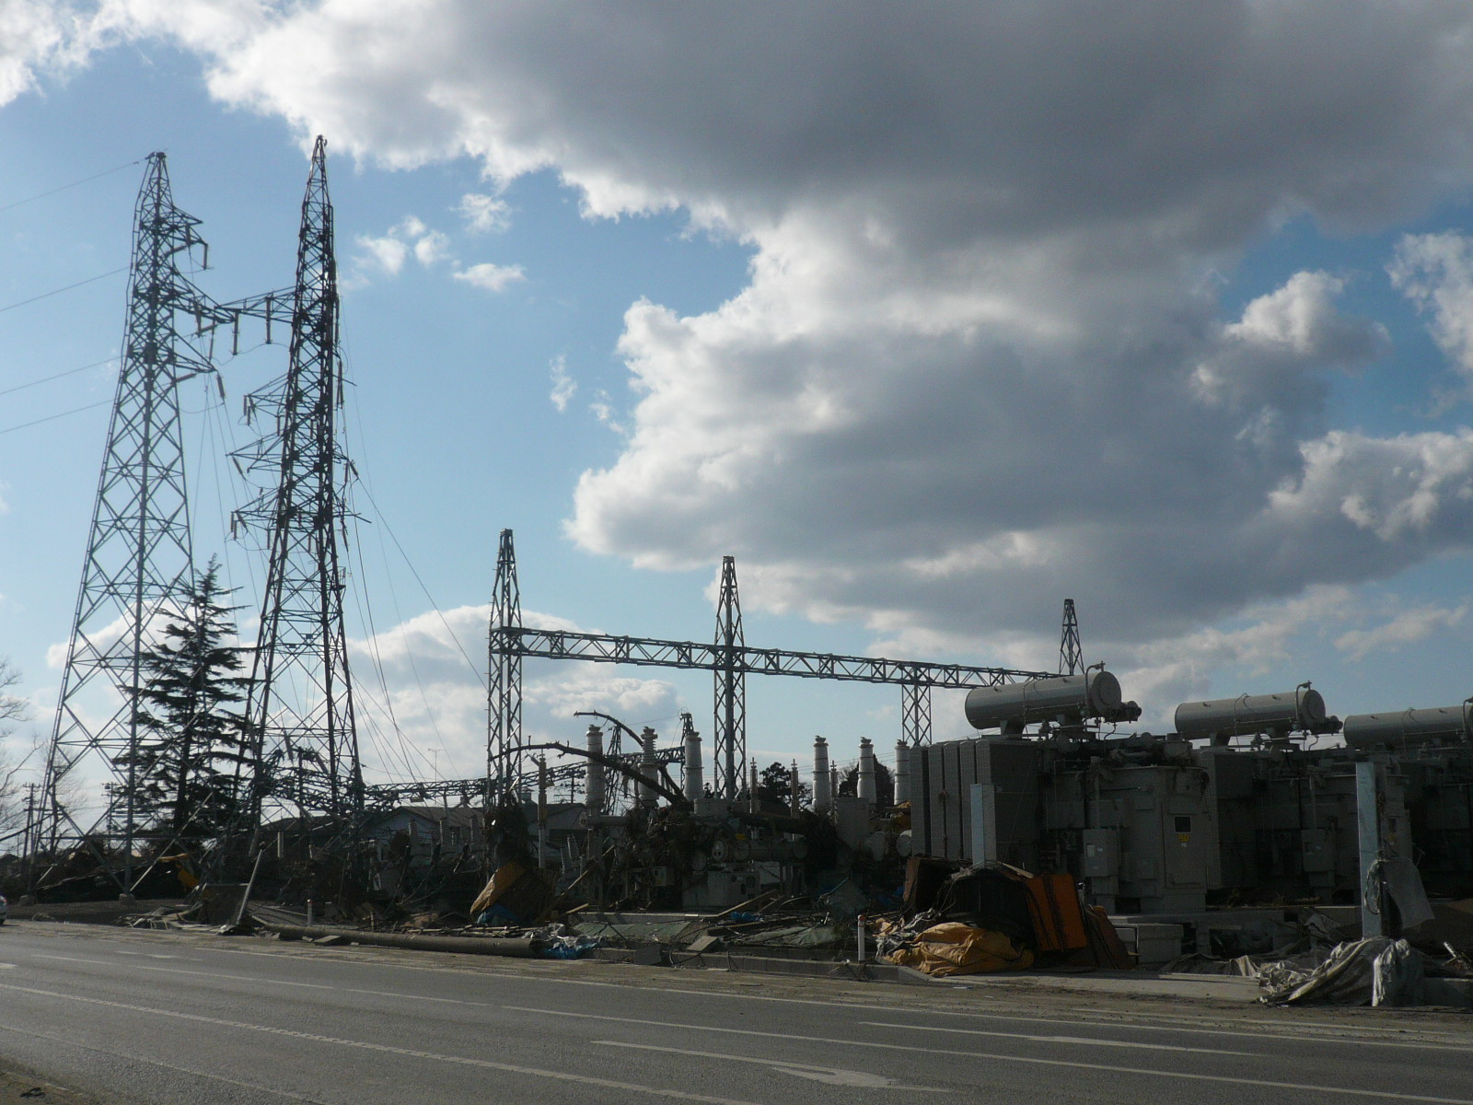
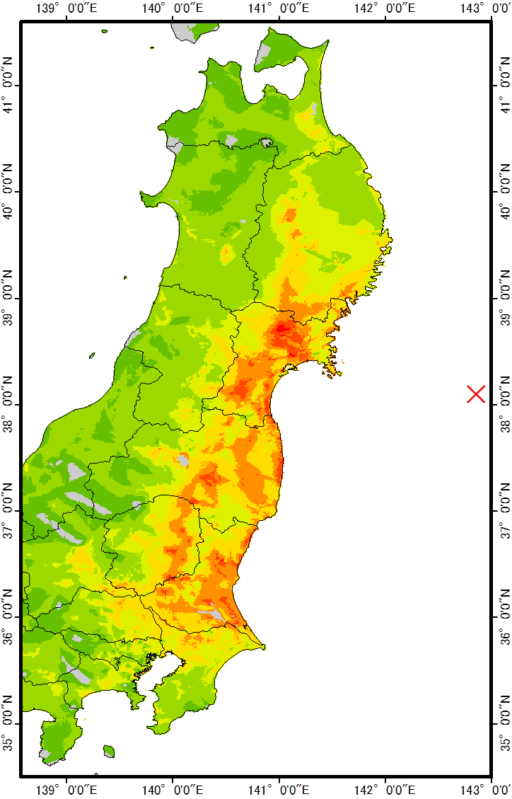
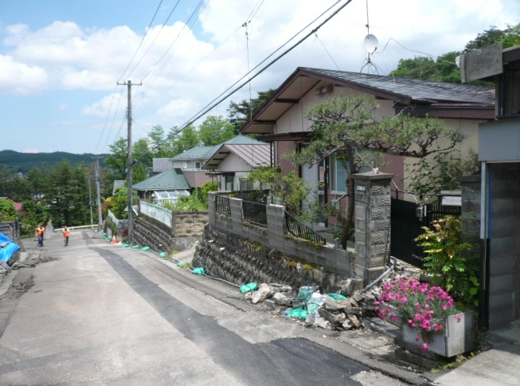
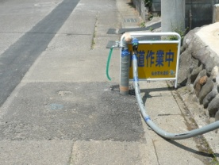
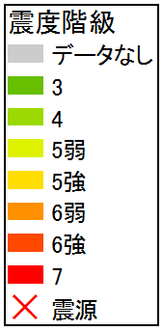
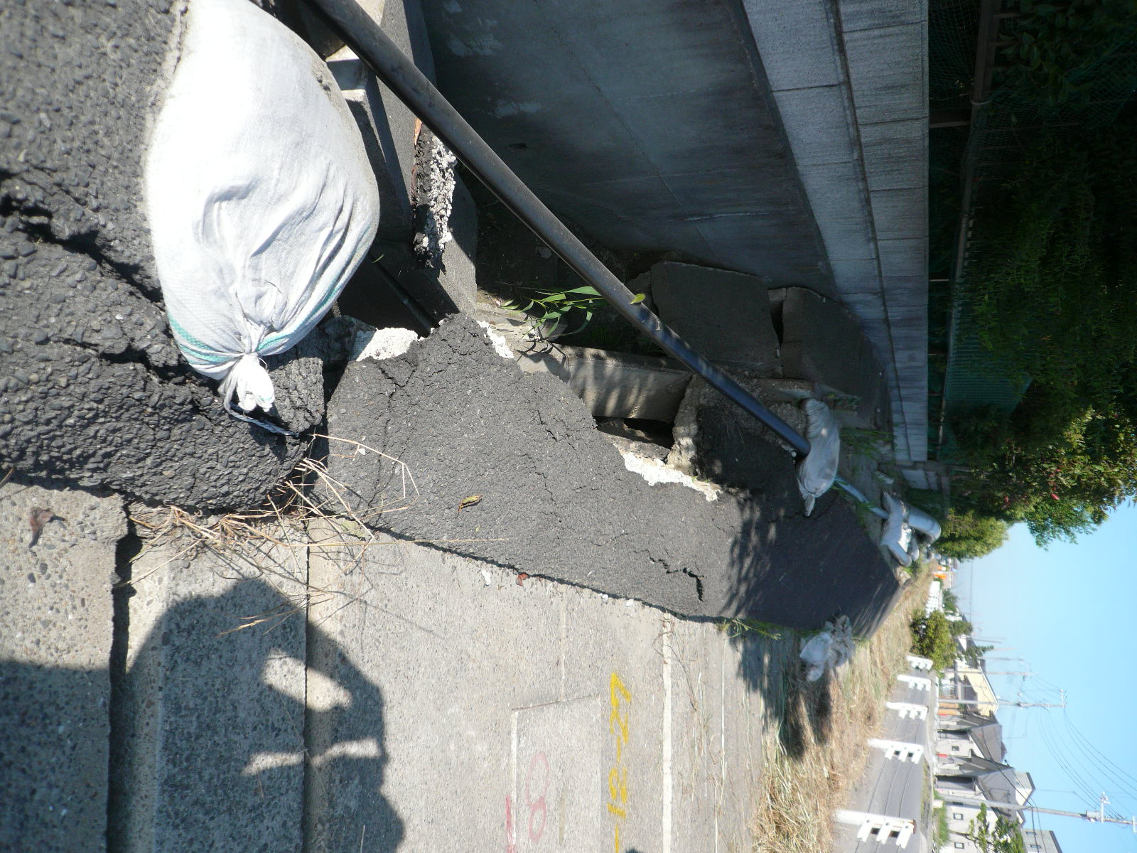
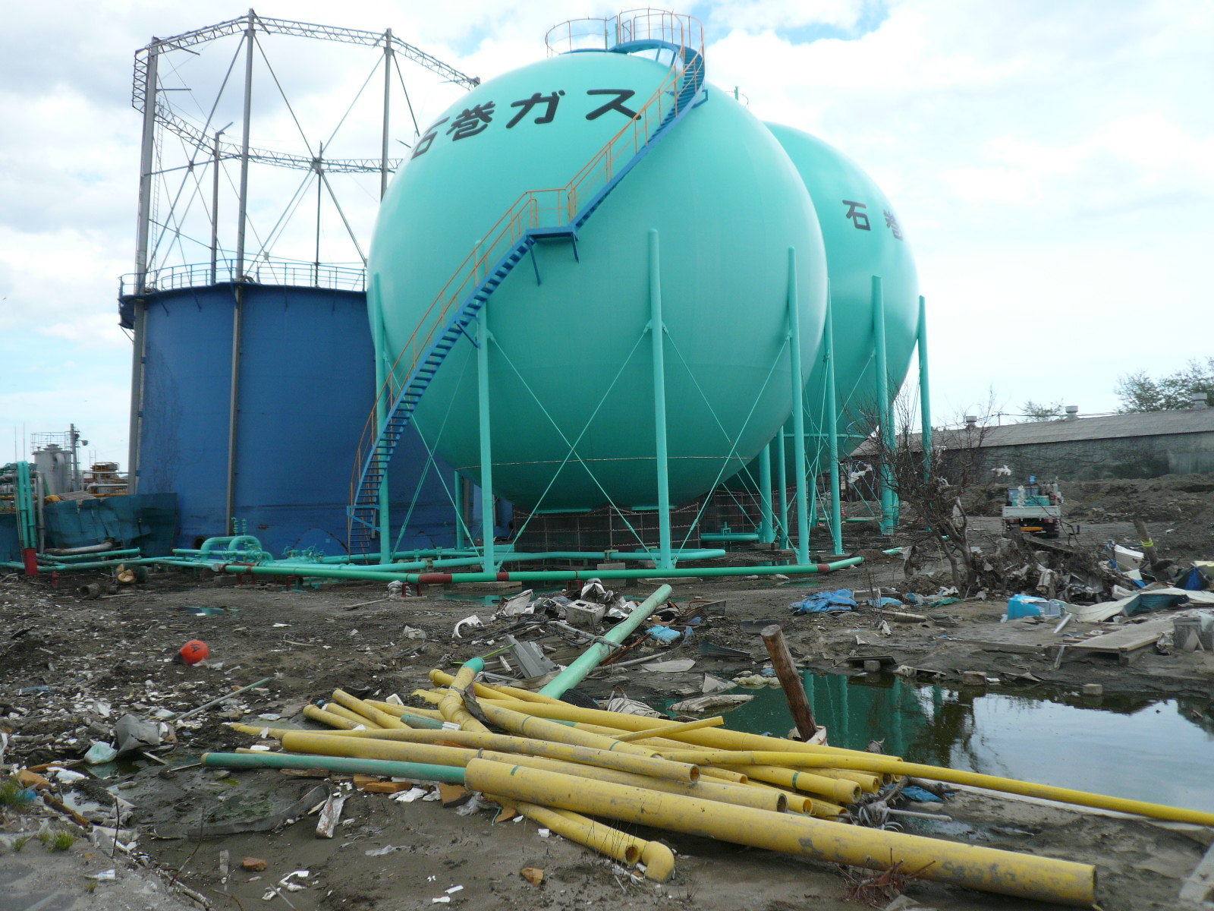
Extreme damage of infrastructures due to the 2011 off the Pacific Coast of Tohoku EQ and tsunami
Damage of substations of electric power supply systems
Seismic intensity distribution
Inundation areas
Inundation height (m)
Damage of buried pipelines of water supply systems
Power failures of 4,858,580 houses in the areas offered by Tohoku Electric Power Company as of March 17, 2011
Damage of buried pipelines of sewerage systems
Damage of gasholders of gas supply systems
0
20
40
Reference data on inundation areas:
Geospatial Information Authority of Japan (GSI)
Disruption of totally 460,000 houses as of March 12, 2011
Reference data on inundation heights:
The 2011 Tohoku Earthquake Tsunami Joint Survey Group Sep. 7th, 2011 Version

Slide 3
Now, focus on damage of water treatments in the 2011 off the Pacific Coast of Tohoku EQ and tsunami
Date: 14:46:18, March 11, 2011 (JST)
Magnitude: Mw =9.0
Epicenter: 38.322°N, 142.369°E
Depth: 32km
Total damage of water supply systems
Water outages:2,105,091 houses
Epicenter
Total damage of sewerage systems
Sewerage pipelines:642km
Manholes:20,659
Treatment facilities:120
Pump stations:112
Damaged areas
Google earth, http://maps.google.com/maps

Slide 4
Water outages in the 2011 off the Pacific Coast of Tohoku EQ and tsunami
Number of water outages/ Number of households
Ibaraki :444,288
/1,088,848
Tochigi :56,061
/745,045
Gunma :54
/755,297
Saitama :150
/2,842,662
Chiba :373,069
/2,515,220
Niigata :2,852
/8,389,22
Nagano :804
/794,362
Gifu :30
/736,555
Total :2,105,091
Aomori :1,824
    /513,311
Iwate :179,308
/483,971
Miyagi :616,480
/901,254
Fukushima:394,142
/720,587
Akita :28,190
/390,335
Yamagata:7,839
/388,670
Map by authors. Data sources of map: MHLW, Damage situation and measures for the Great East Japan Earthquake (11th – 34th Announcement), http://www.mhlw.go.jp/stf/houdou/2r98520000014j15.html

Slide 5
Sewerage damage in the 2011 off the Pacific Coast of Tohoku EQ and tsunami
Damaged pipeline lengths [km]/
Buried pipeline lengths [km] *1
Number of damaged manholes *2
Total :20,659
Aomori :0
Iwate :170
Miyagi :11,194
Fukushima:3,397
Ibaraki :4,656
Tochigi :25
Saitama :6
Chiba :981
Kanagawa:13
Tokyo :212
Niigata :5
Total :642
Aomori :0.1 /113
Iwate :13 /3,712
Miyagi :312 /9,702
Fukushima:120 /5,110
Ibaraki :129 /9,509
Tochigi :2 /287
Saitama :0.006 /214
Chiba :54 /8,510
Kanagawa:0.5 /11,625
Tokyo :12 /15,793
Niigata :1 /426
Map by authors. Data sources of map:
*1 MLIT, The Great East Japan Earthquake (105th Report), http://www.mlit.go.jp/saigai/saigai_110311.html,
*2 Investigation Committee on Countermeasures to Sewerage Damage due to Earthquake and Tsunami,
5th Committee document, http://www.mlit.go.jp/mizukokudo/sewerage/mizukokudo_sewerage_tk_000186.html

Slide 6
For anticipated future seismic hazards
Seismic strengthening for pipelines and its prioritization
Planning of effective restoration strategy
0.14
Sewerage networks and seismic hazards
e.g. Tokyo city area
Seismic fragility curve: Model for predicting damage
0.12
0.10
0.08
Damage ratio
0.06
Real data in the Kobe earthquake
0.04
0.02
0
Sewerage damage in the 1995 Kobe earthquake
4.5 5.0 5.5 6.0 6.5 7.0
Seismic intensity
IJ
It is much significant to model damage data for accurate seismic risk assessment

Slide 7
Analytical frameworks
Collect the damage data of water supply systems (WSS) and sewerage systems (SS) suffered by ground excitations at Ibaraki and Chiba prefectures by carrying out interviews for related local government sectors.
Quantify two damage ratios R_{N} on physical damage points and R_{L} on disrupted pipeline lengths, for 14 municipalities in Ibaraki prefecture and 8 municipalities in Chiba prefecture.
Compare the damage ratios in subject municipalities with estimated ones derived by our previously proposed seismic fragility curves.

Slide 8
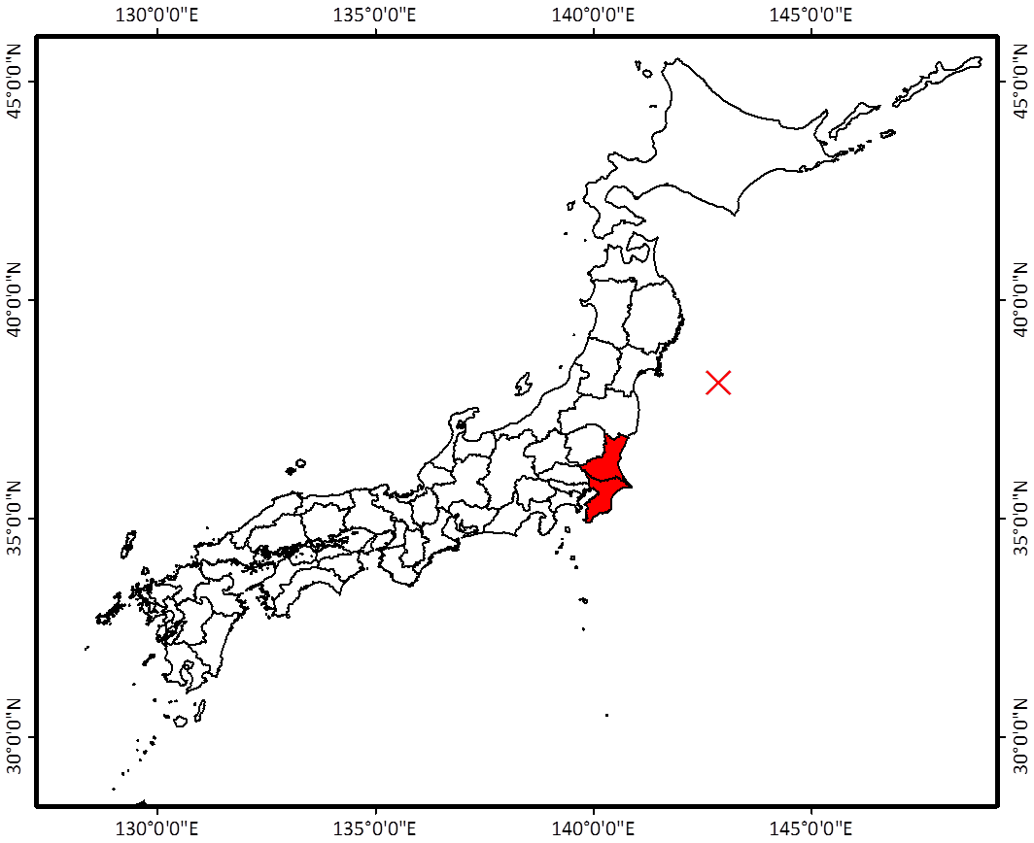


Target areas for analysis
Japan
Target areas: Ibaraki Prefecture
Chiba Prefecture
2011.3.11
Epicenter
1995.1.17
Kobe EQ

Slide 9
Estimation of seismic intensity distribution
Sources
Mw and location of hypocenter： Japan Meteorological Agency (2011)
Attenuation relationship：
Si & Midorikawa (1999)
Amplification factor on
Seismic intensity IJ：
Suetomi et al. (2005)
Instrumental seismic intensity IJ
Interpolate the spatial distribution on IJ by Simple Kriging method based on the strong ground motions data by Japan Meteorological Agency (2011) and National Research Institute for Earth Science and Disaster Prevention (2011)

Slide 10
Subject municipalities
and derived seismic intensity distribution
Seismic intensity IJ
Kasama
Hitachi
-3.4
Mito
3.4-4.4
Hitachinaka
4.5-4.9
Shimotsuma
Oarai
5.0-5.4
Omitama
5.5-5.9
6.0-6.4
Tsukuba
Hokota
6.5-
Kashima
Toride
Itako
Ichikawa
Kamisu
Inashiki
Katori
Funabashi
Abiko
Urayasu
Sakura
Narashino
Chiba

Slide 11
Analyzed data for WSS and SS
Set damage data on distribution pipes and sanitary pipes
for unifying physical constraints of exposed engineered systems
- Total pipeline lengths L
- Disrupted pipeline lengths L_{d}
- Number of physical damage points N_{p}
Damage modes
Consequences measures for WSS damage
Restoration periods
Consequences measures for SS damage
Periods of restriction for use for sewerage systems
Temporary restoration periods
Median of estimated seismic intensities IJ_{m} for third meshes overlapped to the areas of subject municipalities

Slide 12
Definition of damage ratios
R_{N} : Ratio of number of physical damage points N_{p}
divided by total lengths L
Dimension
[point / km]
R_{L} : Ratio of disrupted lengths L_{d} divided by
total lengths L
Dimension
[km / km]

Slide 13
Relation of R_{N} and IJ_{m} for water supply systems
1.2
Urayasu
1.0
R_{N} [/km]
0.8
Kashima
0.6
0.4
Inashiki
Kamisu
0.2
0
4.5
5.0
5.5
6.0
IJ_{m}
Urayasu and Kashima data: Extremely large R_{N} of
0.654/km to 1.081/km with IJ_{m} of 5.1 to 5.8
Inashiki and Kamisu data: Larger R_{N} of
0.247/km to 0.316/km with IJ_{m} of 5.3 to 5.5

Slide 14
Relation of R_{N} and IJ_{m} for water supply systems
1.2
1.0
R_{N} [/km]
0.8
South Ibaraki Waterworks Agency (Ushiku, Ryugasaki, Toride)
Tsukuba
0.6
Narashino
Kasama
Oarai
Shimotsuma
Sakura
Hitachi
0.4
Chiba
Mito
Funabashi
Hitachinaka
0.2
Ichikawa
Hokota
0
Omitama
4.5
5.0
5.5
6.0
IJ_{m}
Hitachi, Hitachinaka, Mito, Oarai, Hokota and Narashino data: Middle R_{N} of 0.0571/km to 0.136/km with IJ_{m} of 5.2 to 5.8

Slide 15
Relation of R_{L} and IJ_{m} for sewerage systems
0.6
Hinode, Itako
0.5
R_{L} [km/km]
0.4
0.3
0.2
Urayasu
Kashima
0.1
0
4.5
5.0
5.5
6.0
IJ_{m}
Hinode areas in Itako data: Remarkably huge R_{L} of
0.538 with IJ_{m} of 5.9
Kashima and Urayasu data: Extremely large R_{L} of
0.0907 to 0.112 with IJ_{m} of 5.1 to 5.8

Slide 16
Relation of R_{L} and IJ_{m} for sewerage systems
0.6
0.5
R_{L} [km/km]
0.4
0.3
Kasama
Kamisu
Inashiki
0.2
Katori
Hitachinaka
0.1
Chuo, Chiba
Hokota
0
4.5
5.0
5.5
6.0
IJ_{m}
Kasama areas in Kasama, Kamisu and Katori data : Larger R_{L} of 0.0649 to 0.0818 with IJ_{m} of 5.2 to 5.4
Hitachinaka, Hokota, Inashiki data and Chuo areas in Chiba : Middle R_{L} of 0.0228 to 0.0412 with IJ_{m} of 5.0 to 5.8

Slide 17
Relation of restoration periods for water supply systems and IJ_{m}
[day]
[day]
60
60
Kamisu
Kamisu
50
50
Restoration periods
Restoration periods
40
40
Katori
Kashima
Kashima
30
30
Urayasu
Urayasu
Inashiki
Inashiki
20
20
10
10
0
0
4.5
5.0
5.5
6.0
0
0.2
0.4
0.6
0.8
1.0
1.2
IJ_{m}
R_{N} [/km]
Kamisu: Longest 57 days due to larger R_{N}
Kashima and Urayasu: 26 days to 34 days due to largest R_{N}
Inashiki: 23 days due to larger R_{N}
Katori: 37days due to largest R_{L}

Slide 18
Relation of periods of restriction for use for sewerage systems and IJ_{m}
120
[day]
120
[day]
Periods of restriction for use
Narashino
Periods of restriction for use
100
100
80
Kamisu
80
Kamisu
60
60
Itako, Hinode
Itako
40
Urayasu
40
Urayasu
Inashiki
20
20
Inashiki
0
0
4.5
5.0
5.5
6.0
0
0.1
0.2
0.3
0.4
0.5
0.6
IJ_{m}
R_{L} [km/km]
Narashino: Longest 112 days due to next largest R_{N}
Kamisu: Second longest 83 days due to larger R_{L}
Itako, Inashiki and Urayasu: Longer 34 days to 44 days due to largest, larger and middle R_{L}

Slide 19
Comparison of SS damage ratio R_{L} in the Tohoku earthquake with those in the Kobe earthquake
0.6
Hinode, Itako
Previously proposed seismic fragility curve (SFC) : Model for predicting damage
0.5
R_{L} [km/km]
0.4
0.3
0.2
0.1
Mito
Kobe data
0
4.5
5.0
5.5
6.0
6.5
7.0
IJ_{m}
R_{L} at Mito and other 10 municipalities show good agreement with estimated values by SFC.
R_{L} at Hinode areas in Itako with IJ_{m} of 5.9 shows remarkably larger value than the value by SFC due to severe liquefaction.

Slide 20
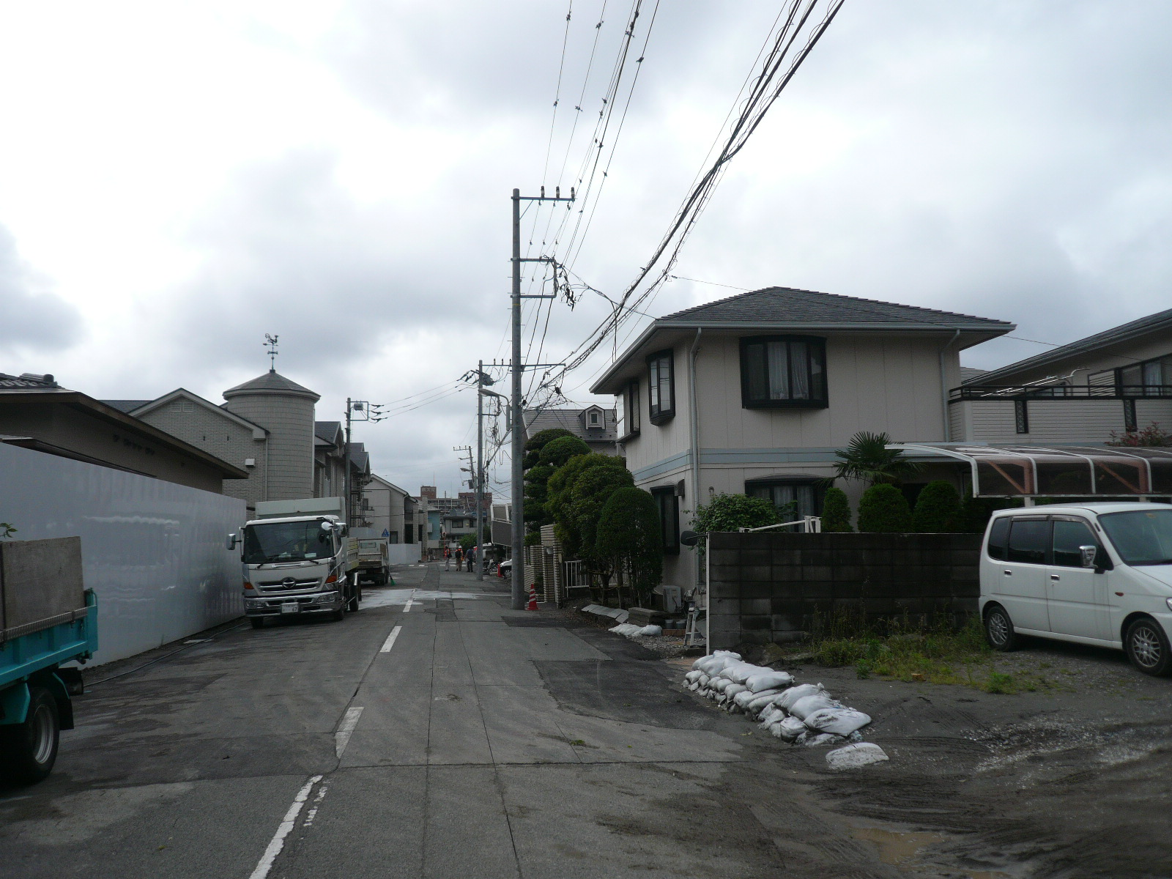
Comparison of SS damage ratio R_{L} in the Tohoku earthquake with those in the Kobe earthquake
0.6
0.5
Seismic fragility curve (SFC) : Model for predicting damage
R_{L} [km/km]
Urayasu
0.4
0.3
Chiba,
Chuo
0.2
Katori
0.1
Abiko
Kobe data
0
4.5
5.0
5.5
6.0
6.5
7.0
IJ_{m}
R_{L} at Katori, Abiko, Chuo treatment areas in Chiba and Urayasu with IJ_{m} of nearly 5.0 show larger values than those by SFC due to SS damage by severe liquefaction.

Slide 21
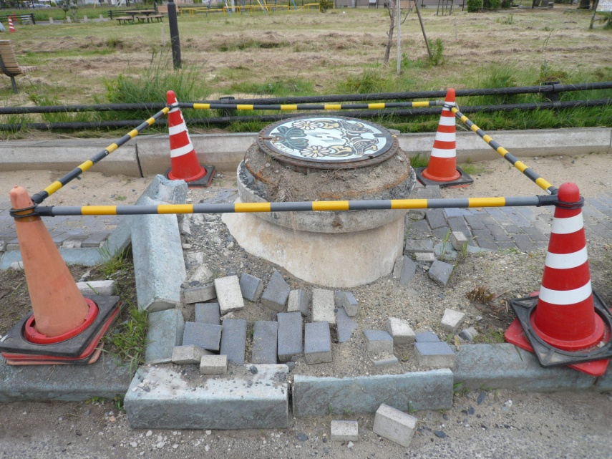
Comparison of SS damage ratio R_{L} in the Tohoku earthquake with those in the Kobe earthquake
0.6
0.5
Seismic fragility curve (SFC) : Model for predicting damage
R_{L} [km/km]
0.4
0.3
Hitachinaka
Kasama
0.2
Inashiki
Kashima
Hokota
0.1
Kamisu
Kobe data
0
4.5
5.0
5.5
6.0
6.5
7.0
IJ_{m}
R_{L} at Hitachinaka, Hokota, Kashima, Inashiki, Kasama treatment areas in Kasama and Kamisu with IJ_{m} of nearly 5.5 show larger values than those by SFC due to combination of strong ground excitations and liquefaction.

Slide 22
Conclusions
Evaluate the dependency of physical damage and restoration of water supply systems (WSS) and sewerage systems (SS) on seismic intensities in the 2011 off the Pacific Coast of Tohoku earthquake focusing on the damage at Ibaraki and Chiba prefectures.
Quantify two damage ratios R_{N} on physical damage points and R_{L} on disrupted pipeline lengths.
Compare the damage ratios in the Tohoku earthquake with estimated ones derived by previously proposed seismic fragility curves.

