Slide 1
Emergency Preparedness Education: Learning from Experience, Science of Disasters, and Preparing for the Future: Brunei
Madihah Khalid
Universiti Brunei Darussalam

Slide 2
Introduction
After the Indian ocean tsunami end of 2004, many countries are aware of the importance of Disaster Management.
National Disaster Management Centre (NDMC) in Brunei is the body assigned to look into matters concerning disasters including natural disasters.
A coordinated multi-hazard approach to disaster management have been factored into policies, planning and programming related to sustainable development, relief, rehabilitation, and recovery activities. This new strategy was incorporated in the Disaster Management Order (2006) (DMO) was gazetted in 1 June 2006.
The DMO provides for the legal basis for action to disaster management including disaster risk reduction in Brunei. NDMC can also provide a platform to provide impetus on disaster projects, not limited to mitigation, monitoring and prevention projects.
As a member of ASEAN, Brunei adhere to the following framework

Slide 3
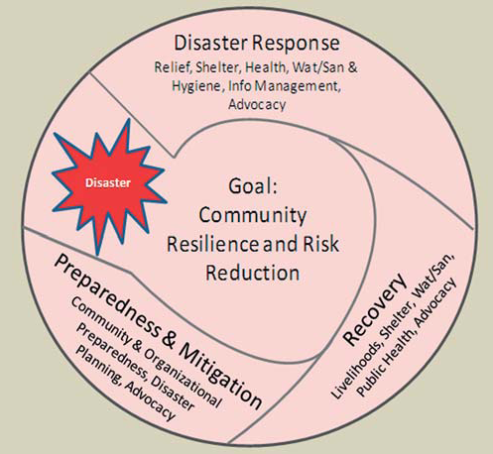
Framework for DRR (Disaster Risk Reduction) in SEA

Slide 4
National progress report on the implementation of the Hyogo Framework for Action (2009-2011)
Priority for action 3: Core indicator 2 - School curricula , education material and relevant trainings include disaster risk reduction and recovery concepts and practices.
Level of Progress achieved: 2: Some progress, but without systematic policy and/ or institutional commitment
Is DRR included in the national educational curriculum? No
Means of verification: * No: Primary school curriculum * No: Secondary school curriculum
* No: University curriculum * No: Professional DRR education programmes
Description: DRR has yet to be incorporated in school curricula. However, outreach programme has been taken up seriously through other means such as the ASEAN Regional Drawing Competition and essay writing among students is held to promote awareness on disaster resilience among students, teachers and parents. NDMC with the collaboration of the Ministry of Education has been organizing this programme in conjunction with the ASEAN Day for Disaster Management (ADDM) and International Day for Disaster Reduction (IDDR) since 2008 . The objective of the competition is to promote and raise awareness on the initiatives of disaster reduction, especially for students in the ASEAN region.

Slide 5
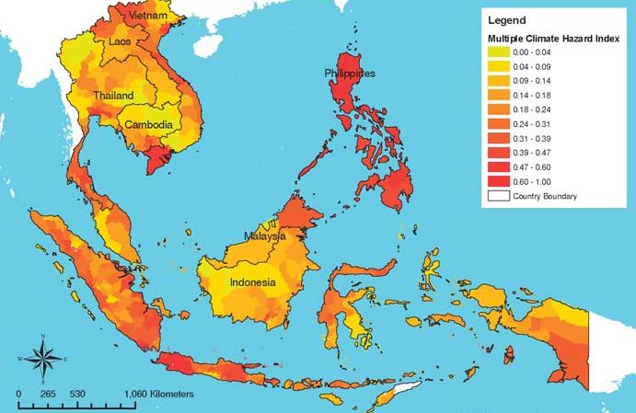
The overall climate change hazard map showing the combination of climate-related
hazards (tropical cyclones/typhoons, floods, landslides, droughts, and sea level rise) and the
hotspots in South-East Asia. Source EEPSEA

Slide 6
Natural Disasters from 1980 – 2010
Brunei Darussalam - Disaster Statistics
Data related to human and economic losses from disasters between 1980 and 2010. – From Prevention Web
http://www.preventionweb.net/english/professional/trainings-events/academics/?cid=25
No of events: | 1
No of people killed: | 0
Average killed per year: | ...
No of people affected: | 0
Average affected per year: | ...
Ecomomic Damage (US$ X 1,000): | 2,000
Ecomomic Damage per year (US$ X 1,000): | ...

Slide 7
Human Exposure – Modelled number of people present in
hazard zones that are thereby subject to potential losses
Hazard type | Population exposed |  | Country ranking
Cyclone | - |  | - out of 89
Drought | - |  | - out of 184
Flood | 23 |  | 161st out of 162
Landslide | 128 |  | 109th out of 162
Earthquake | - |  | - out of 153
Tsunami | - |  | - out of 76

Slide 8
Tsunami Lesson Plan
Tsunami is chosen rather than earthquake because of the possible chance of tsunami coming to Brunei, compared to none at all for earthquake.
This lesson will be can be taught to year 7 under the topic of proportion. It has also been made simpler for the possibilities of teaching to year 6.
This lesson is about proportion. Please refer lesson plan

Slide 9
Updates on Lesson Study in Brunei Darussalam
As was reported last year, Lesson Study has become a national project of Department of Schools.
Last year, 64 elementary schools were involved and this year all schools (about 120) would be involved.
To support the teachers, workshops and seminars on lesson study were organised and at the end of the month of February, there will be a mini conference where teachers involved in lesson study last year are asked to present their report.
Each school is provided with video camera, visualizer, etc. and a set of Japanese textbooks.

Slide 10
References
IFRC (2010): Reducing the risks: a framework for DRR in South-East Asia
Song. (2010). Enchanted Learning (1996 – 2010). Retrieved 22 January, 2012, from http://www.enchantedlearning.com/subjects/tsunami/
Passy’s world of ICT http://passyworldofict.blogspot.com/2011/03/tsunami-mathematics.html
Wikipedia (2012). Wave Shoaling. Retrieved 22 January, 2012, from http://en.wikipedia.org/wiki/Wave_shoaling

