Slide 1
Tasks for Problem Solving Related to Earthquakes
Soledad A. Ulep
Eligio C. Obille Jr.
University of the Philippines
National Institute for Science and Mathematics Education Development
(UP NISMED)

Slide 2
Waves are produced when an earthquake occurs. Primary waves (P-wave) shake the rock back and forth in the direction that the waves travel while secondary waves (S-wave) shake the rock at right angles to the direction that the waves travel.
Study the travel-time graph below.

Slide 3
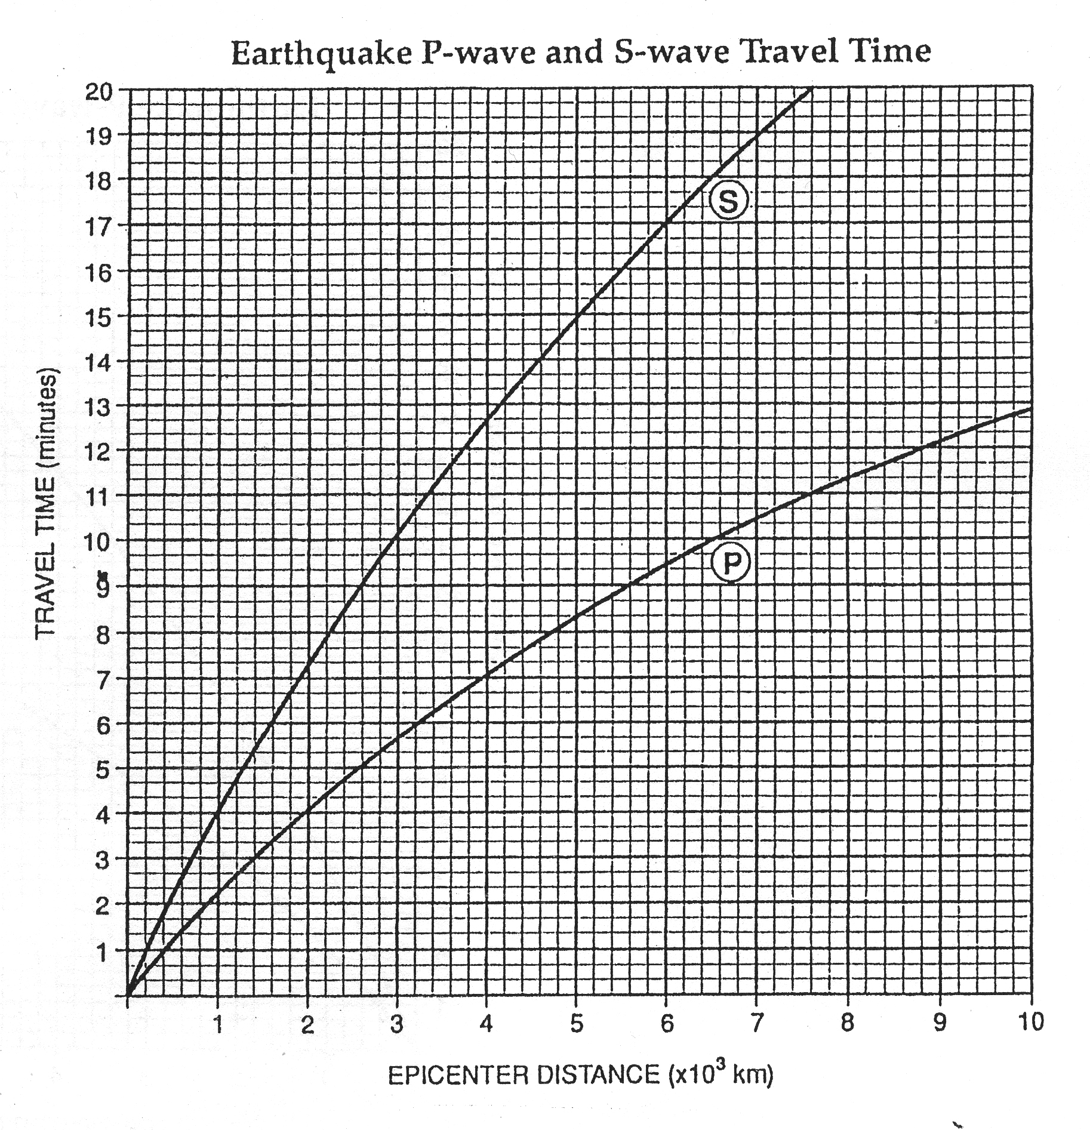

Slide 4
A. Write as many observations/interpretations as you can about the graph.
Some expected answers:
The P- and S-waves start from the origin at the same time.
The P-wave races ahead of the S-wave.
P-waves travel twice as fast as S-waves.
At places near the epicenter, the P-waves and the S-waves arrive quickly one after the other.
At places near the epicenter, the gap between their times of arrival is small.
At locations farther from the epicenter, the S-waves arrive much later than the P-waves.
At locations farther from the epicenter, the gap between their times of arrival is much greater.
We can tell how far we are from the epicenter of an earthquake by noting how big or small the time gap is between the times of arrival of the P- and the S-waves.

Slide 5
B. Suppose the P-wave arrived at Location A at 10:00:00 a.m. and the S-wave arrived at the same location at 10:05:40 a.m.
How far is Location A from the epicenter? Explain how you got your answer.

