Slide 1
Spreadsheets connect with Real-World Problems
Maggie Niess
Pejmon Sadri
Kwangho Lee

Slide 2
Spreadsheet software Hurricane Katrina
Generally available in school
Help students make mathematical connections with real world problems
Develop activities to engage middle school students in exploring real-world mathematical problems

Slide 3
Spreadsheet software Hurricane Katrina
Display Katrina’s widespread damage pictures impact on children
General statement for upcoming activities for students
Hurricane Katrina disrupted the lives of many children. Many people have donated toys. You are on a design team to create a playhouse that might be used by the children so that they can have safe place to play with the toys. Investigate various designs for a playhouse by building a model.

Slide 4
Activity 1
Design a model playhouse
The use of a spreadsheet to help determine the costs of producing two types of playhouses
Students investigate the costs of the different features and their impact on the total costs using a preformatted spreadsheet
Which model playhouse would cost the most to produce?

Slide 5
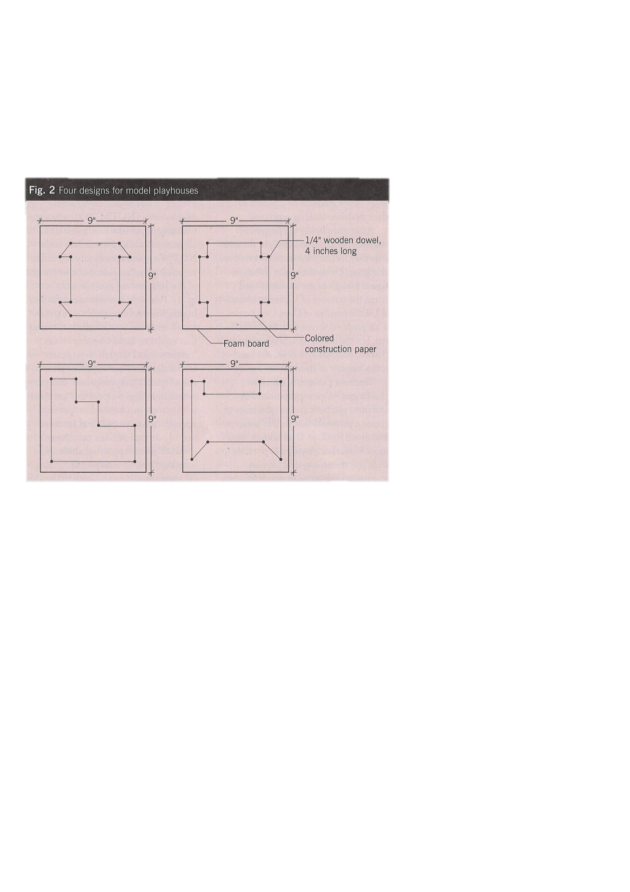

Slide 6
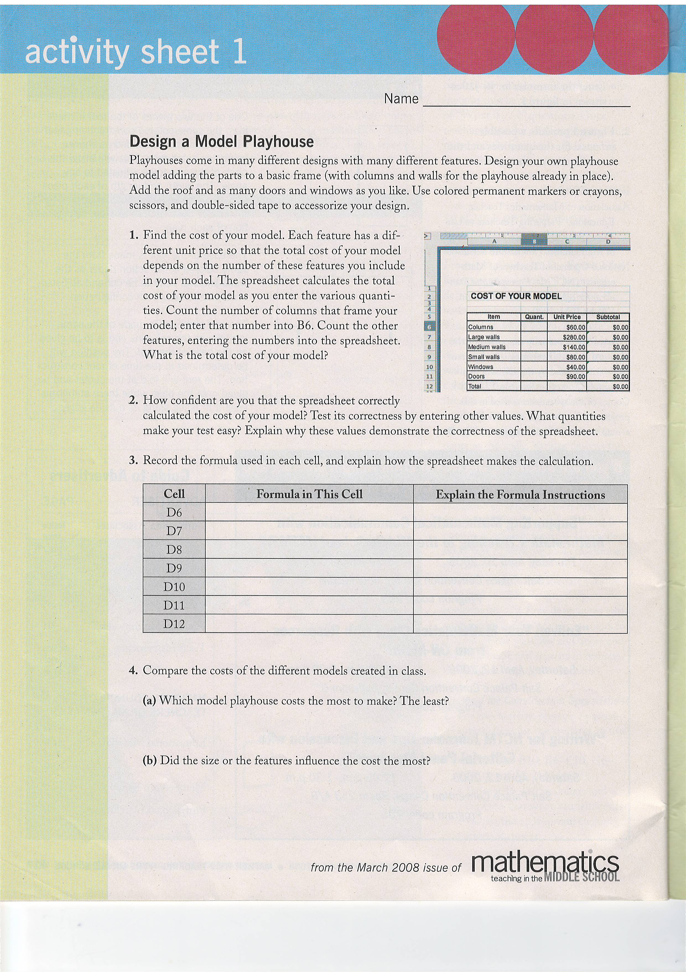

Slide 7
Activity 2
Investigate two playhouse designs
Students are engaged in a cost analysis of more realistic and complicated playhouse designs.
Two designs(Cape Code, Victorian)
Identify the features that are the most expensive(Dutch door, flower boxes etc)
CapeCode: $2,503 Victorian: $5,596
Multiple possibilities exist for reducing cost

Slide 9
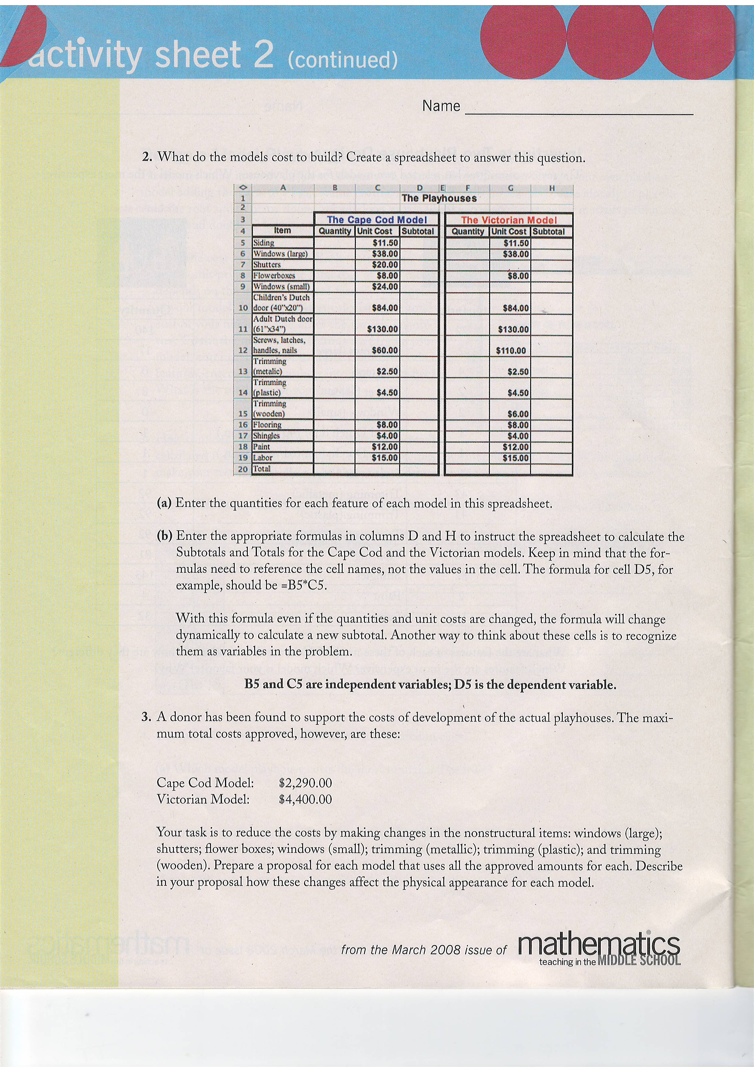

Slide 10
Activity 3
Proposal for construction
Activity sheet 3
Equation for the cost of the different type 2290©+4400(1/2)©=500000
The number for Cape Code ©: approximately 111
Victorian(1/2)©: 55

Slide 12
Conclusion
Students should be able to use mathematical models to represent and understand quantitative relationships
Spreadsheet capabilities provide a dynamic and powerful tool for addressing the objectives
Students learn much more about the mathematics embedded when they learn to design and create their own to explore mathematical problems

