Slide 1

Energy Data and Analysis in APEC
12 February, 2016
Masazumi HIRONO
Head
Energy Statistics & Training Office (ESTO)
Asia Pacific Energy Research Centre (APERC)

Slide 2

Outline of the Presentation
APEC Expert Group on Energy Data & Analysis (EGEDA)
APEC Energy Statistics Update
Energy Efficiency in the APEC region

Slide 3
APEC Expert Group on Energy Data & Analysis (EGEDA)
APEC Energy Statistics Update
Energy Efficiency in the APEC region

Slide 4
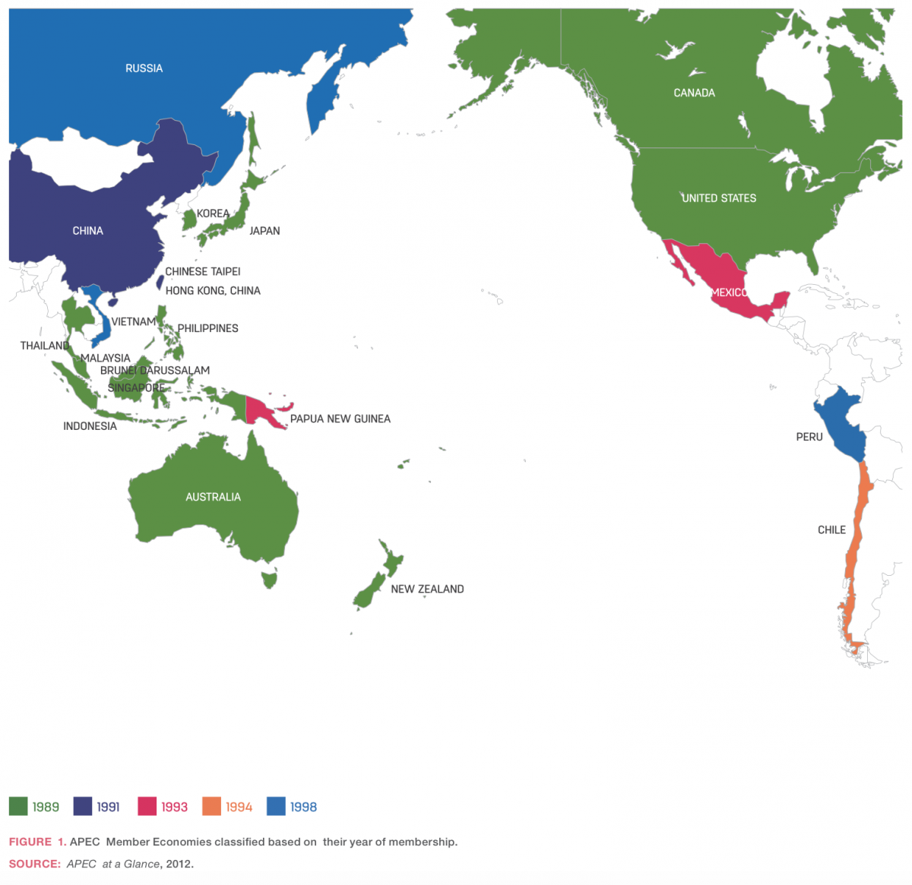
APEC: Asia Pacific Economic Cooperation (21 Economies)
An open framework for regional economic cooperation among 21 economies
Cooperative and voluntary basis
Activities for trade and investment liberalization, business facilitation, and economic and technical cooperation
Source: APERC Brochure (June 2015)
Source: http://apec2015.ph/about-apec/primer/

Slide 5
APEC Energy Working Group (EWG)
APEC EWG, as one of the 15 working groups under the APEC umbrella, was established in 1990.
EWG aims at:
-Strengthening regional and domestic energy security and resilience across the region;
-Lowering the carbon intensity of energy supply and use;
-Promoting the diversification of fuels and sources; and
-Training a gender-inclusive energy workforce.
EWG, in recognition of the importance of energy data collection among member economies, created an Expert Group on Energy Data in 1991, which was renamed as an Expert Group on Energy Data and Analysis in 1999.

Slide 6
Expert Group on Energy Data & Analysis (EGEDA) 1
EGNRET
（EG on New Renewable Energy Technology）
Source: APERC Brochure (June 2015)

Slide 7
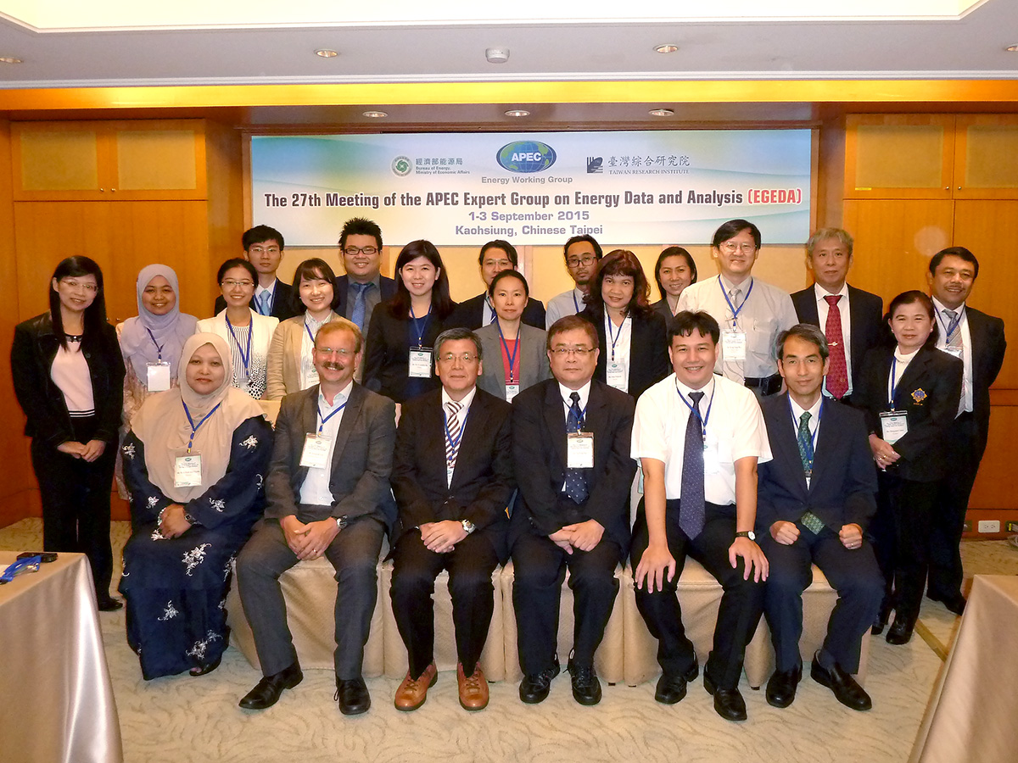
Expert Group on Energy Data & Analysis (EGEDA) 2

Slide 8
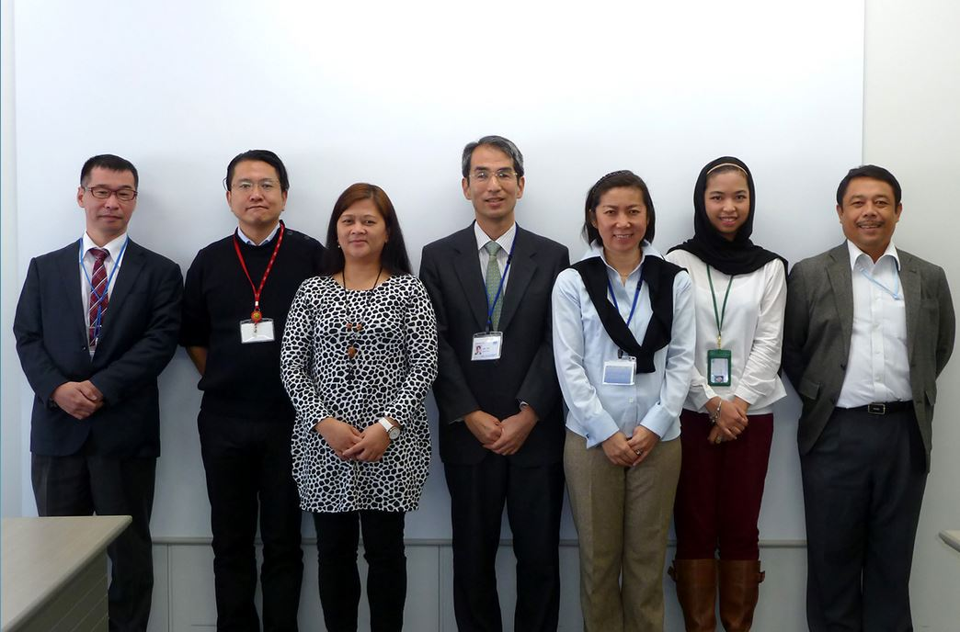
APERC ESTO (Energy Statistics & Training Office)
ESTO=Coordinating Agency of EGEDA
(Expert Group on Energy Data & Analysis)
Data collection
Database management
Publication
Training
-Short-term (2 weeks)
-Medium-term (2 months)

Slide 9
APEC Energy Database: Data Collection from Member Economies
Energy Data
Monthly (Energy Supply and Demand)
Oil and gas (JODI: Joint Organisations Data Initiative)
Quarterly (Energy Supply)
Coal, oil, petroleum products, gas and electricity
Annual (Energy Supply and Demand)
Coal, oil, petroleum products, gas, electricity/heat, new&renewables
Other Data (Energy Related Annual Data)
Energy prices, CO2 emission
Oil/gas reserves and producing/refining capacity

Slide 10

Energy Database: Web-site
Annual Publication: Energy Statistics and Handbook

Slide 11
EGEDA’s Next Steps
Undertake a trial data collection of end-use energy data from the residential and commercial sectors using APEC Energy Efficiency Template
Revise the New and Renewable Energy Questionnaire to collect more accurate and detailed information
Start online data submission system in APEC

Slide 12
APEC Energy Efficiency Template 1
Contents: Residential Sector
Space Heating
Space Cooling
Water Heating
Cooking
Lighting
Refrigerators / Freezers
Dish Washers
Clothes Washers / Clothes Dryers
Television/Home entertainment
PC/Information & communication technology
Other Appliances
Total Energy Use in Residential Sector

Slide 13
APEC Energy Efficiency Template 2
Contents: Commercial Sector
Space Heating
Space Cooling
Water Heating
Lighting
Other Building Energy Use
Non-Building Energy Use
Total Energy Use in
Commercial Sector

Slide 14
APEC Energy Efficiency Template 3
Energy
Petroleum Products
Natural Gas
Coal & Coal Products
Combustive Renewables
Heat
Electricity
Other

Slide 15

JODI (Joint Organisations Data Initiative): Monthly Data Collection
Collection of monthly oil and gas statistics from each partner organisation's member countries through a harmonised questionnaire

Slide 16
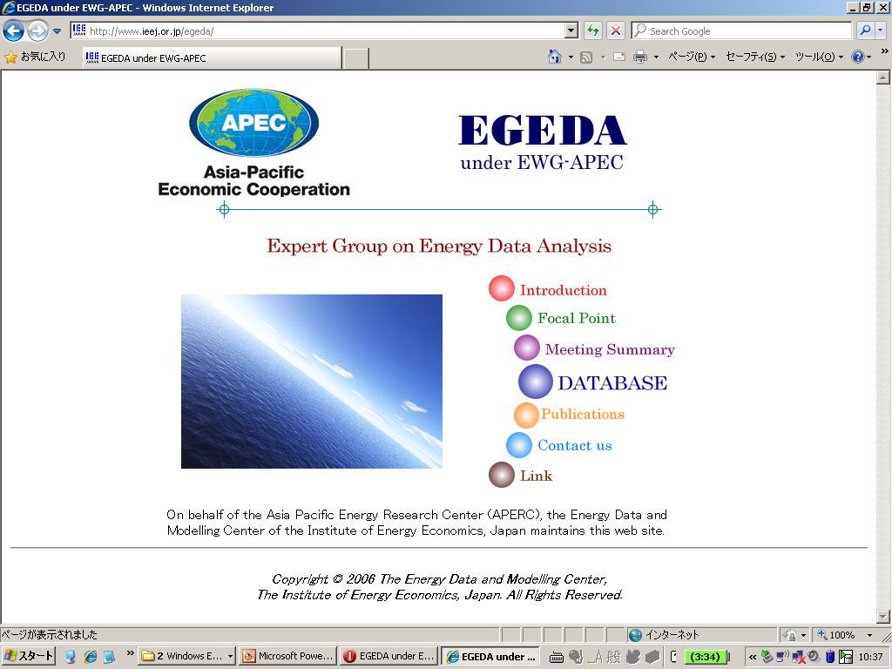
Energy Database: Web-site
APEC Energy Database: Web-site
Monthly Oil & Gas data
- JODI-Oil
- JODI-Gas
Quarterly Energy Supply Data
Annual Energy Data
http://www.ieej.or.jp/egeda/

Slide 17

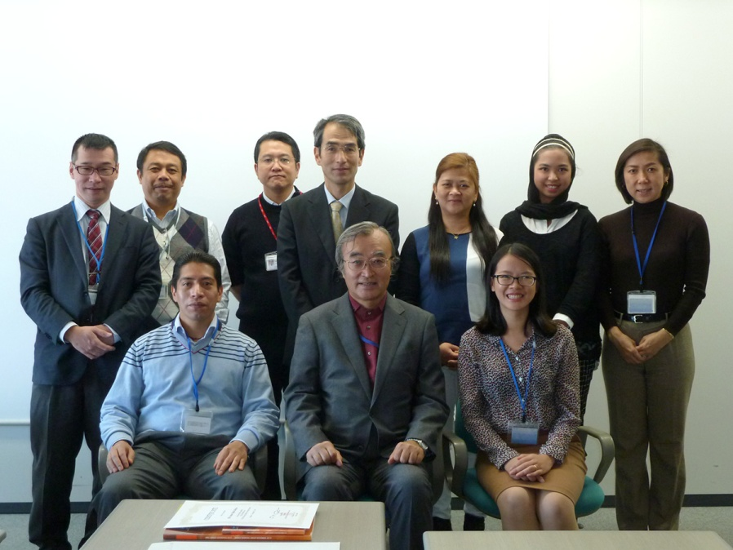
Energy Database: Web-site
Training on Energy Statistics (Short-Term and Medium-Term)
Short-Term (2 weeks)
August 2015
Medium-Term (8 weeks)
October to November 2015

Slide 18
APEC Expert Group on Energy Data & Analysis (EGEDA)
APEC Energy Statistics Update
Energy Efficiency in the APEC region

Slide 19
APEC and the World: Population & GDP
  APEC population increased by 0.9% per year from 1990, 2,806 million in 2013.
  APEC’s share in population was below 40% in 2013, decreasing from 43% in 1990.
  APEC’s share of the world GDP increased from 52% in 1990 to 58% in 2013.

Slide 20
APEC and the World: Primary Energy Supply and its Share in the World
  Total Primary Energy Supply in 2013 is 7,845 Mtoe; 4.4% increase from 2012.

Slide 21
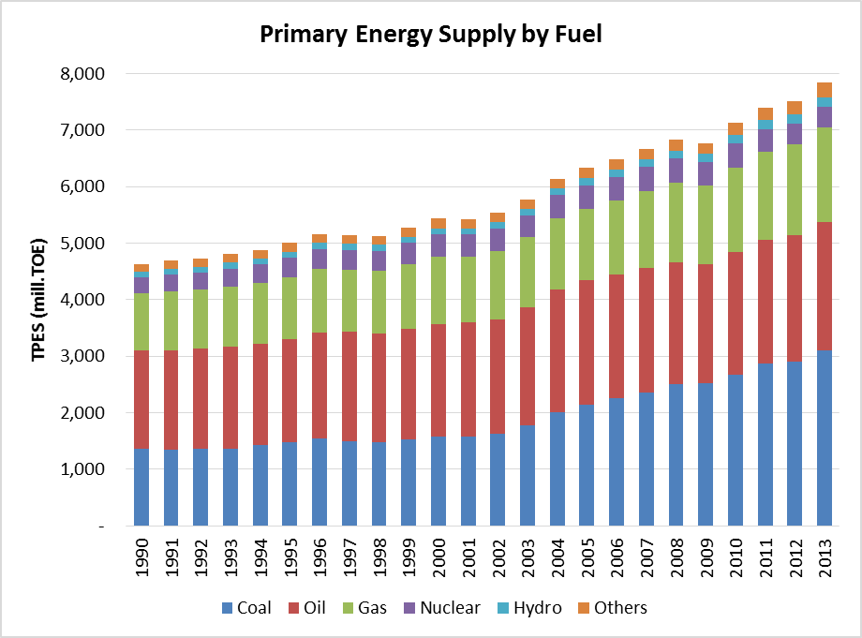
Primary Energy Supply: by Fuel
  Total Primary Energy Supply increased by 2.3% per year, 54% of increase was derived from coal.
  The share of oil decreased from 38% in 1990 to 29% in 2013.

Slide 22
Primary Energy Supply: Indigenous Production
  Indigenous production increased by 5% from 2012 to 7,478 Mtoe in 2013.
  Self sufficiency ratio of total energy was 95% in 2013.

Slide 23
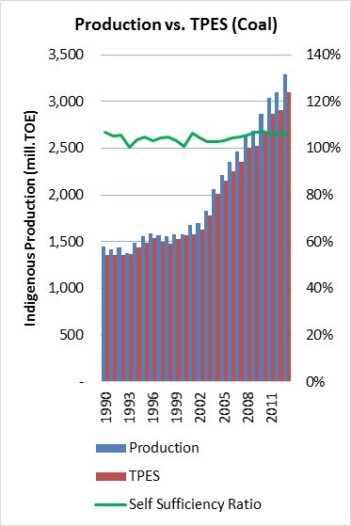
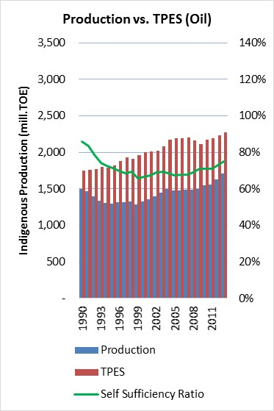
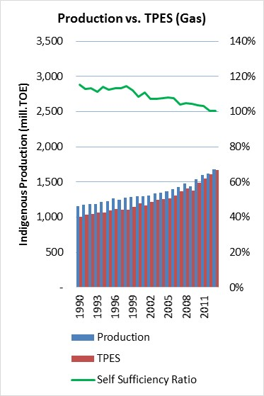
Primary Energy Supply: Self Sufficiency
  Self sufficiency ratio of coal and gas: >100%.
  Self sufficiency ratio of oil: 75%, in increasing trend

Slide 24
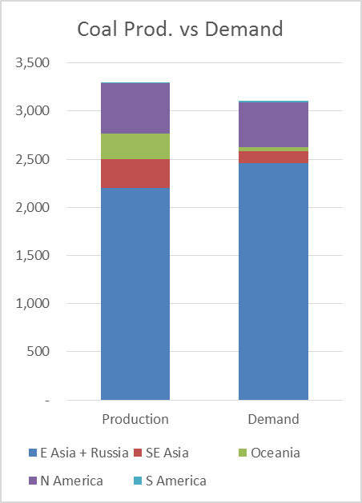
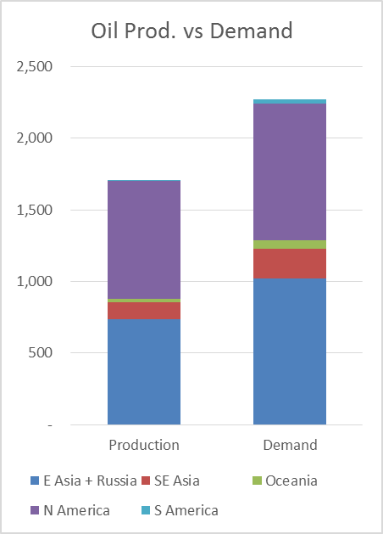
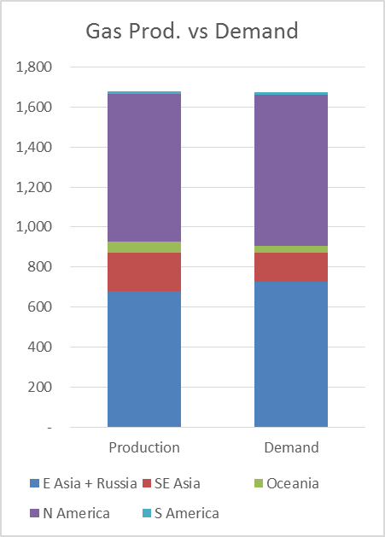
Primary Energy Supply: Fuel Production and Demand
  67% of coal is produced in East Asia & Russia.
  Oil demand is higher than oil production in all sub-regions.
  44% of gas is produced in North America.

Slide 25
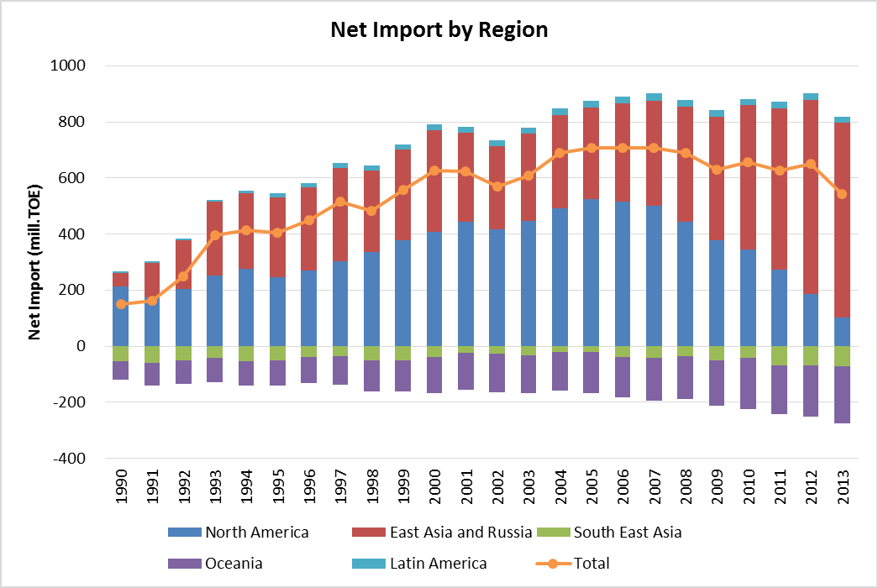
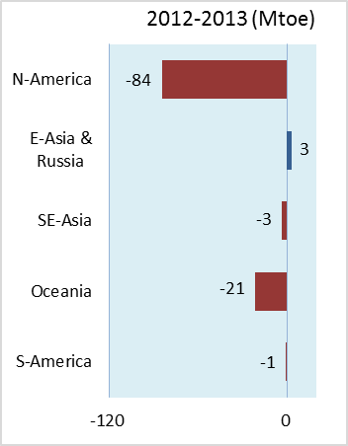
Net Imports
  Net imports were 543 Mtoe in 2013, 16% decrease from 2012.

Slide 26
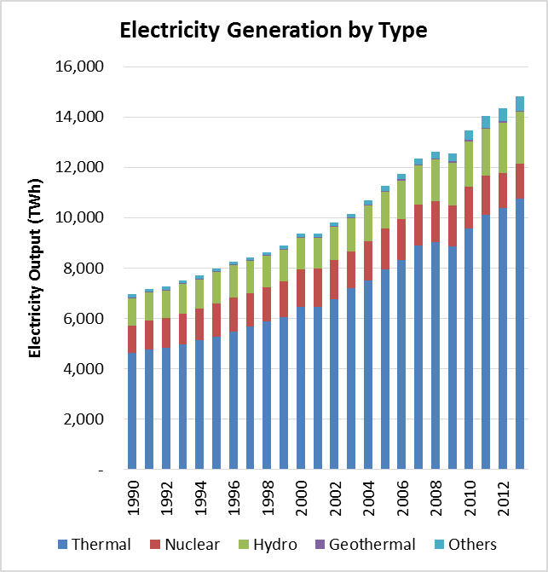
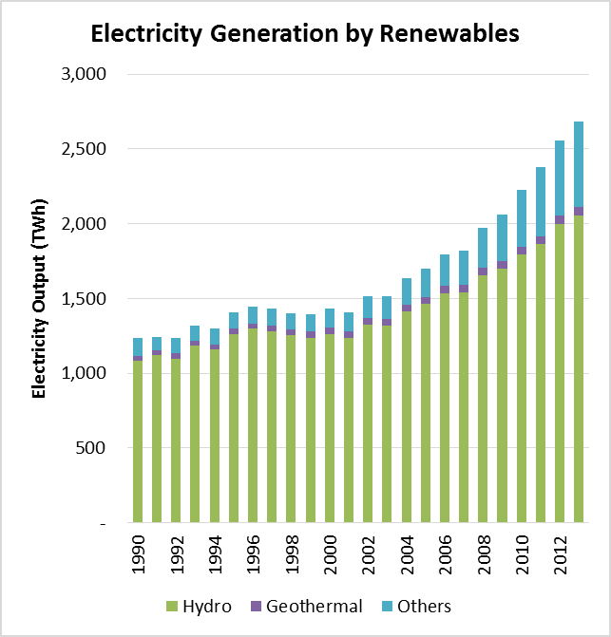
Electricity Generation
  Power generation in 2013 increased by 3.4% from 2012 to 14,829TWh.
  Renewable generation grew from 1,236TWh in 1990 to 2,681TWh in 2013.

Slide 27
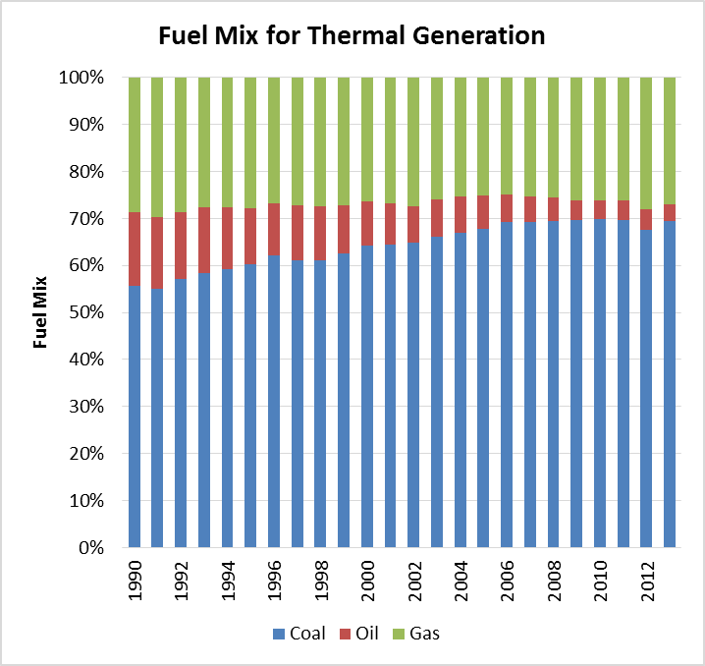
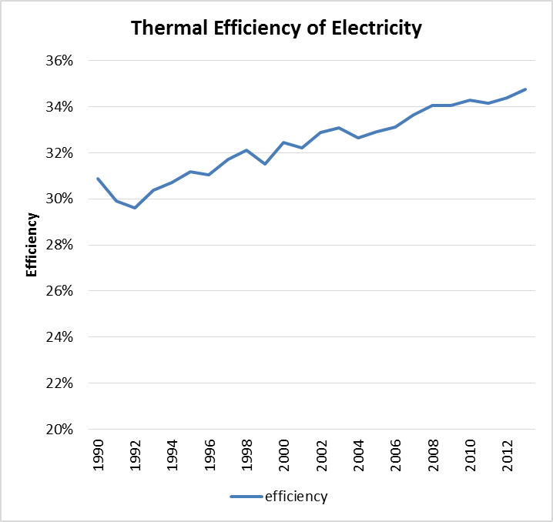
Fuel Consumption & Efficiency for Thermal Generation
  The share of oil for thermal generation decreased from 16% in 1990 to 4% in 2013.
  Average thermal efficiency in power generation reached 35% in 2013.

Slide 28
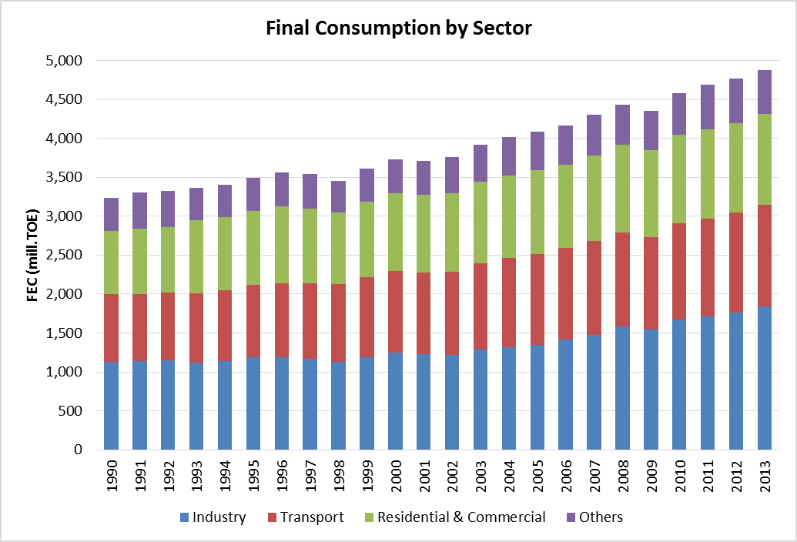
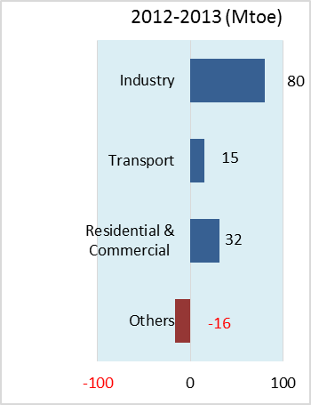
Final Consumption by Sector
  Total Final Consumption increased by 1,638 Mtoe from 1990, 43% of which was industrial consumption.

Slide 29
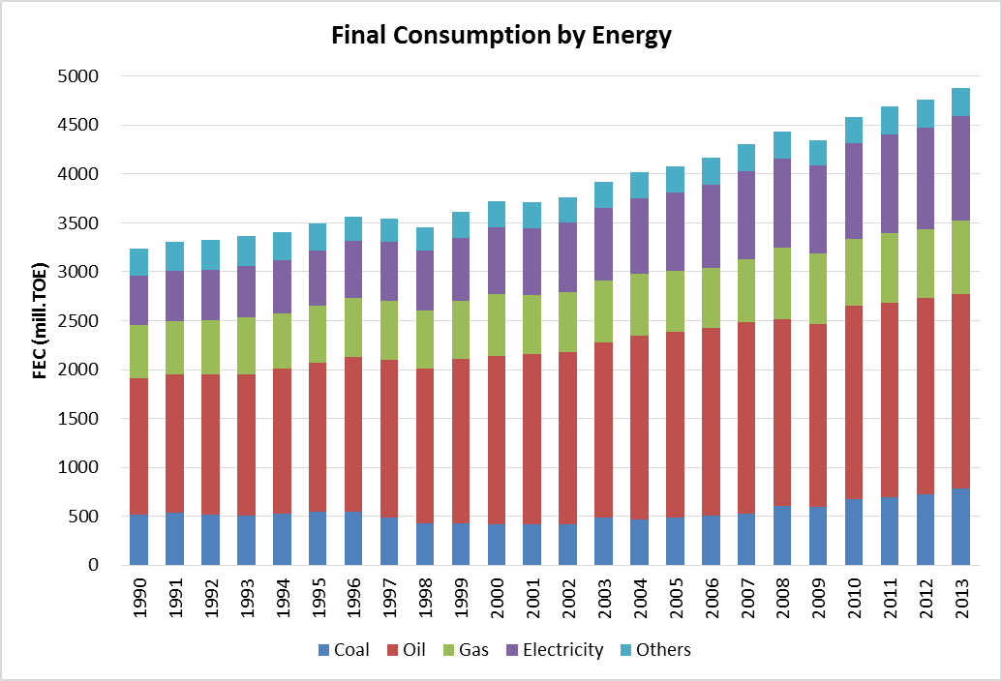
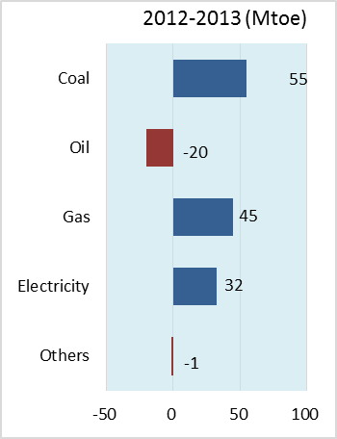
Fuel Consumption by Energy
  Although the share of oil was highest (40.8%) in 2013, the share is decreasing, while coal, gas and electricity consumption increased.

Slide 30
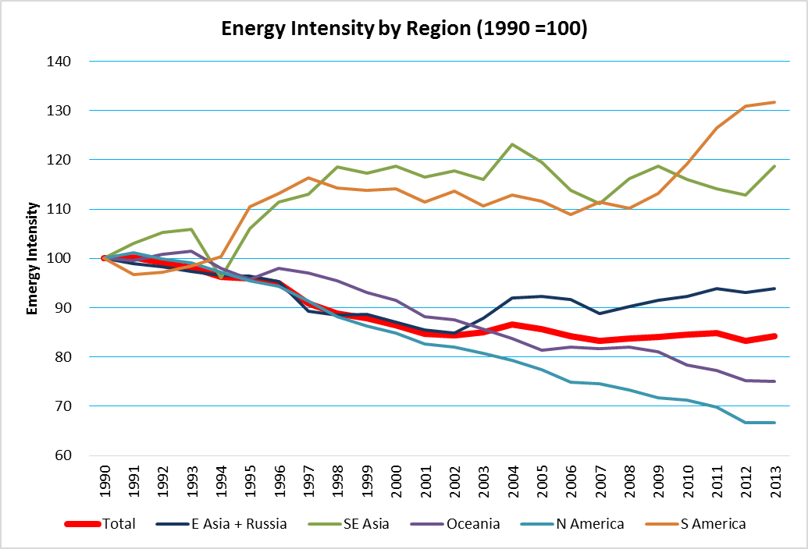
Energy Intensity (Total Primary Energy Supply/GDP)
  The energy intensity was 198 toe / million USD in 2013, -0.7% decrease per annum from 1990.

Slide 31
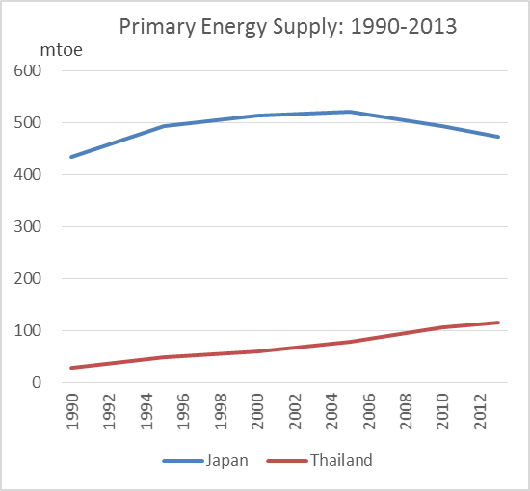
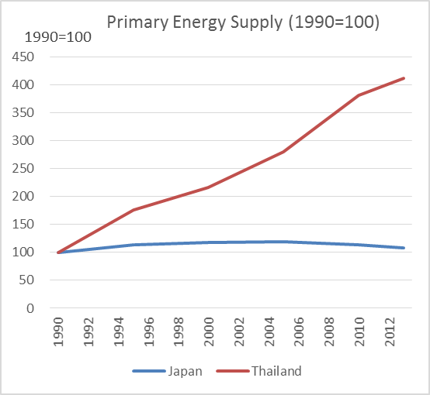
Energy Update in Thailand 1: Primary Energy Supply
  Total Primary Energy Supply in Thailand has been growing by an average annual rate of 6.3 % since 1990.

Slide 32
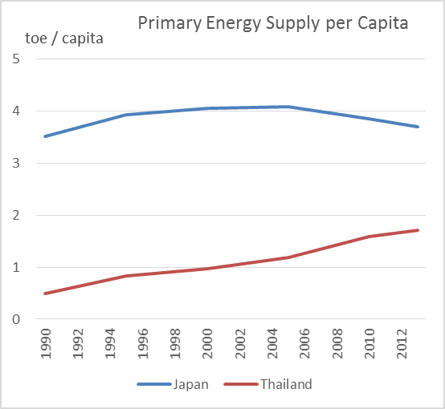
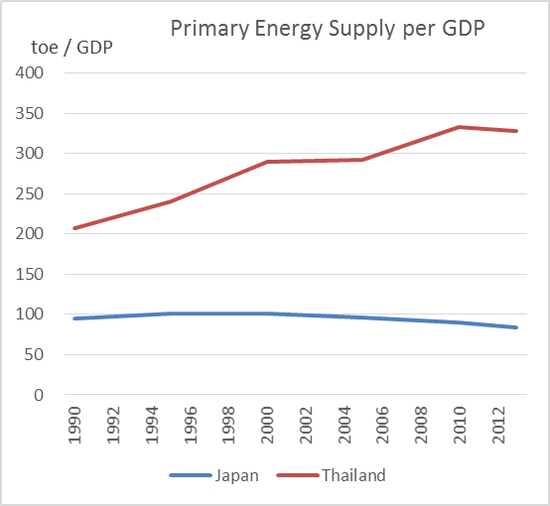
Energy Update in Thailand 2: Primary Energy Supply/Capita GDP
  Energy supply per capita in Thailand has increased by 245 % from 1990 to 2013.

Slide 33
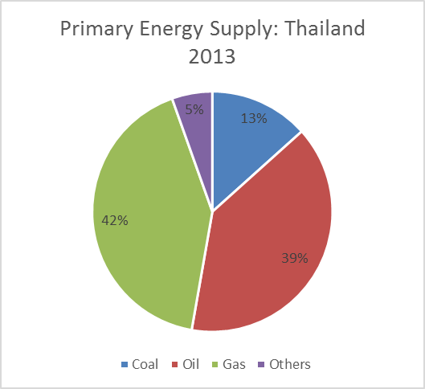
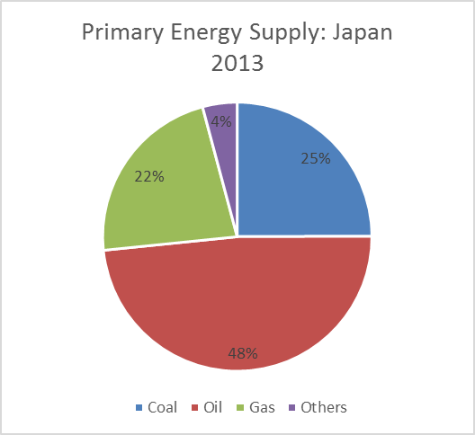
Energy Update in Thailand 3: Energy Supply Mix 1
  In Thailand, gas and oil accounts for 42% and 39%, respectively.

Slide 34
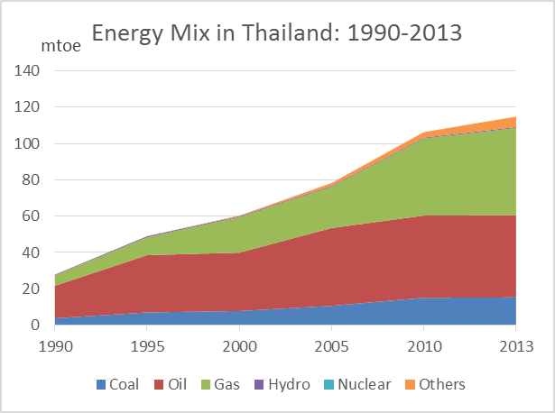
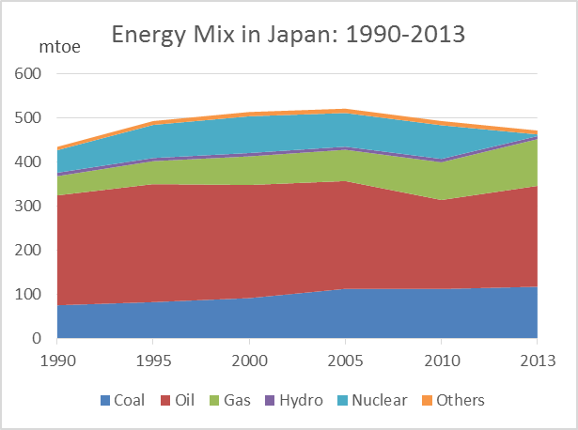
Energy Update in Thailand 4: Energy Supply Mix 2 (1990–2013)
  Gas is increasing its share in Thailand, while the share of oil is decreasing.

Slide 35
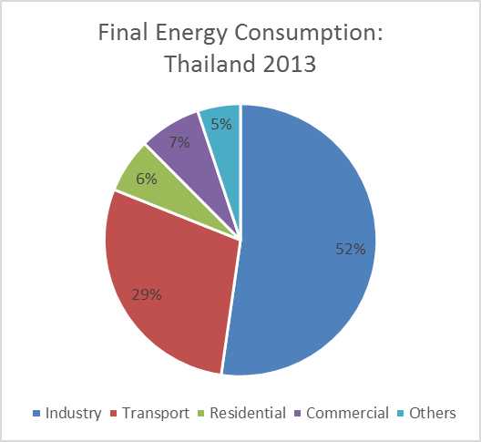
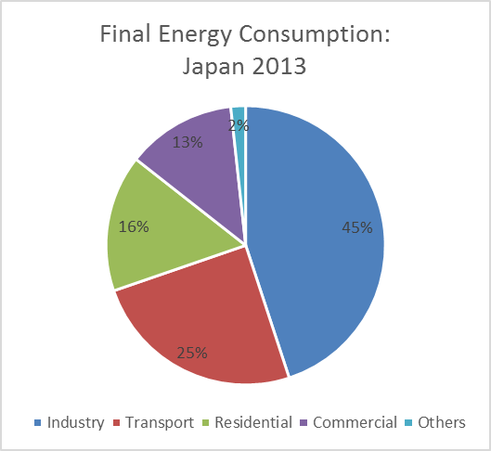
Energy Update in Thailand 5: Final Energy Consumption
  In Thailand, industry and transport uses account for 52% and 29%, respectively.

Slide 36
APEC Expert Group on Energy Data & Analysis (EGEDA)
APEC Energy Statistics Update
Energy Efficiency in the APEC region

Slide 37
Energy Efficiency in the APEC region 1
Darwin Declaration (2007)
Achieving Energy Security and Sustainable Development through Efficiency, Conservation and Diversity
APEC Leaders agreed to:
Fukui DECLARATION (2010)
Low Carbon Paths to Energy Security: Cooperative Energy Solutions for A Sustainable APEC:
APEC Leaders agreed to:
-Improving energy efficiency is one of the quickest, greenest and most cost-effective ways to address energy security, economic growth and climate change challenges at the same time;
-Intensify the analysis of the potential for further energy intensity improvement as the aspirational energy intensity reduction goal by at least 25 percent from 2005 levels by 2030, will be far surpassed if recent trends continue.
Honolulu Declaration (2011)
Toward a Seamless Regional Economy:
APEC Leaders and members agreed to work together for greater economic cohesion and security to promote green growth goals:
- Rationalise and phase out inefficient fossil-fuel subsidies that encourage wasteful consumption, while recognising the importance of providing those in need with essential energy services, and set up a voluntary reporting mechanism on progress, which we will review annually;
-Aspire to reduce APEC's aggregate energy intensity by 45% percent by 2035;”
– work towards achieving an APEC-wide aspirational goal of a reduction in energy intensity of at least 25 percent by 2030 (with 2005 as the base year);
–facilitate and review progress through the voluntary APEC Energy Peer Review Mechanism with a report back to APEC Leaders in 2010, and
–promote policies that advance the deployment of low and zero emission energy uses.

Slide 38
Energy Efficiency in the APEC region 2
● Subsequent to APEC Leaders setting the target to reduce energy intensity by 45% by 2035 (against the 2005 level), APERC has been endeavoring to help the APEC Energy Working Group develop their response to the APEC Energy Minister’s instruction, in part by analysing evidence of energy intensity reduction
● Energy intensity is most commonly defined as the amount of energy consumption per unit of GDP, as GDP data are readily available and easy to obtain. It is often used as a proxy to analyse energy efficiency improvements

Slide 39
Energy Efficiency in the APEC region 3
 | 2005-2013 (Latest) | 2005-2012 (EWG 48)
Primary Energy Intensity | -12.4% | -10.8%
Final Energy Intensity | -15.1% | -14.4%
Final Energy Intensity (excluding non-energy) | -15.5% | -12.3%
 | Trend to 2035 (Latest) | Trend to 2035 (EWG 48)
Primary Energy Intensity | -39.2% | -38.8%
Final Energy Intensity | -45.8% | -48.7%
Final Energy Intensity (excluding non-energy) | -46.7% | -43.0%

Slide 40

ESTO is looking forward to working with you.
Thank you very much for your kind attention
http://aperc.ieej.or.jp

