Slide 1
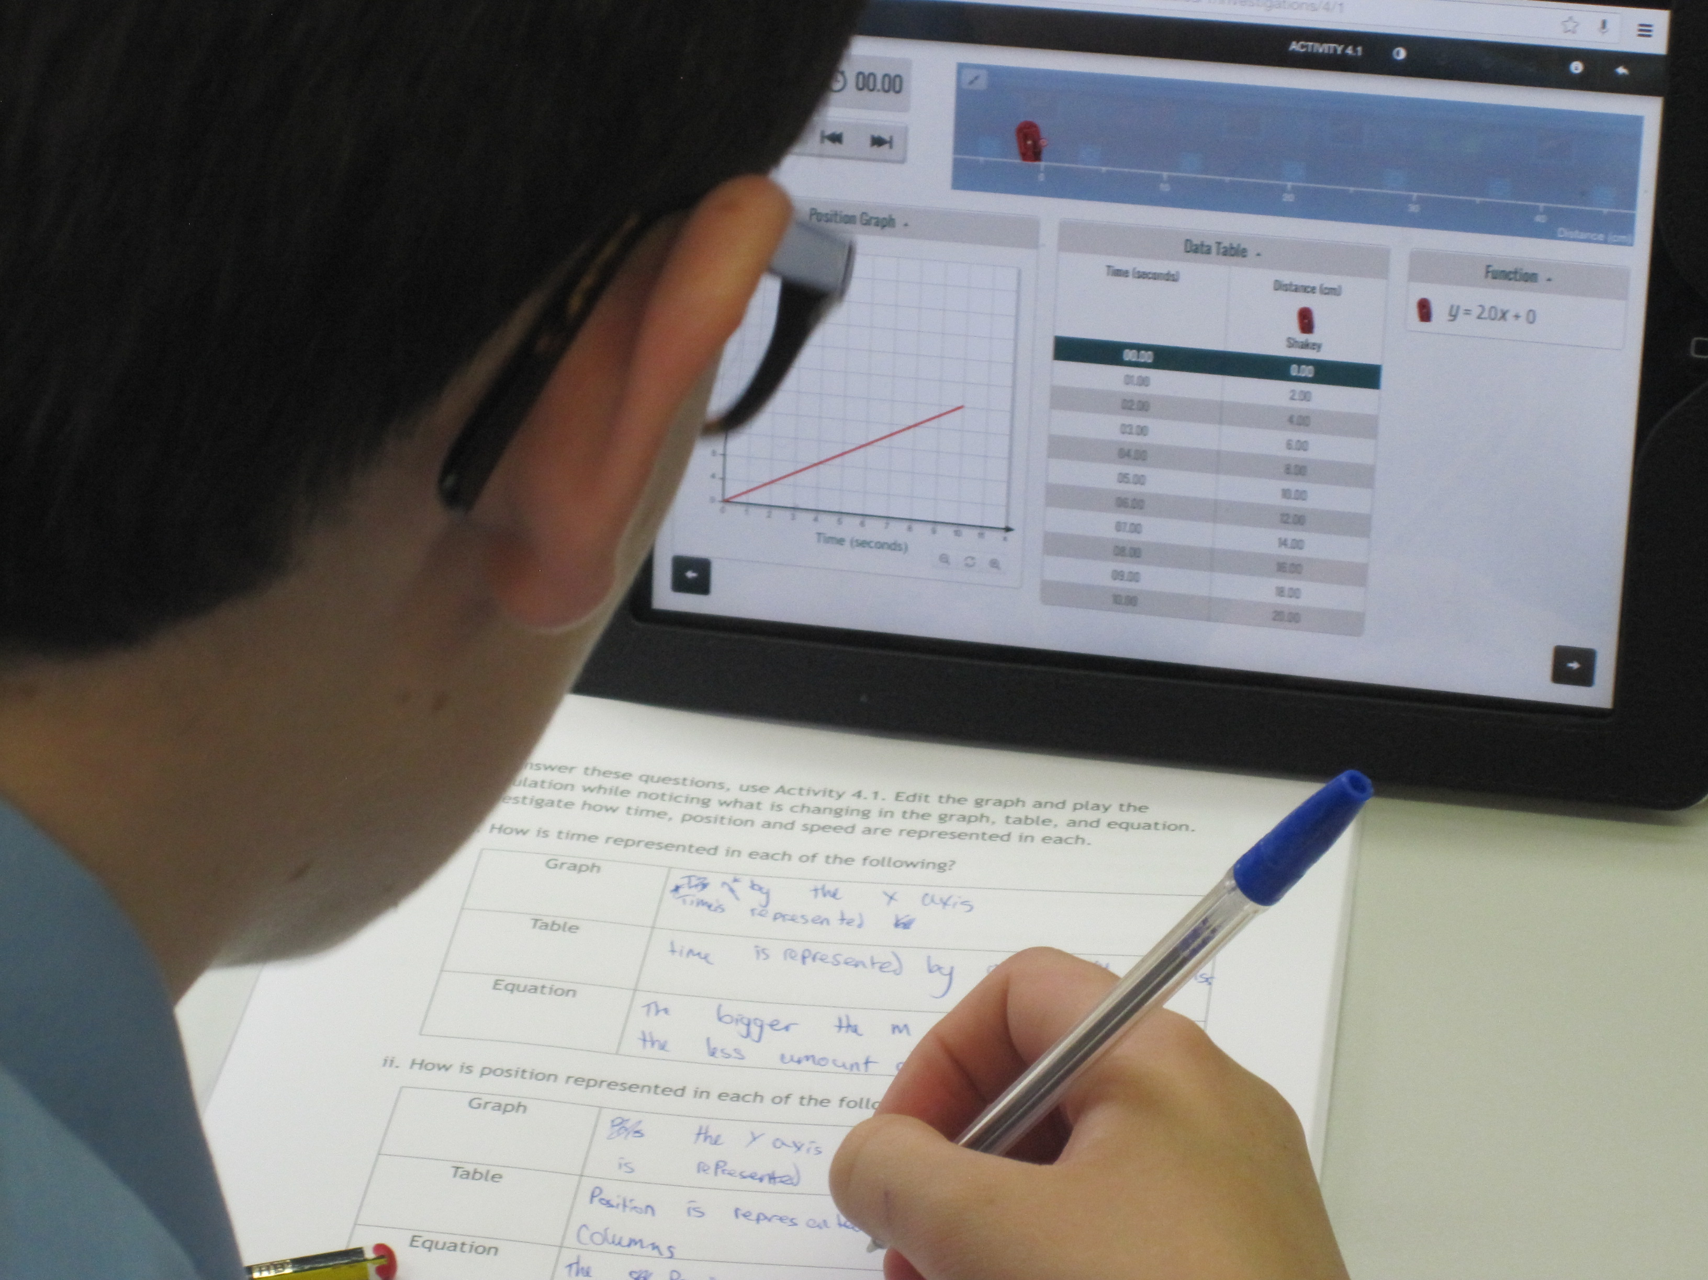
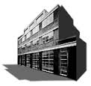
Technology in mathematics education: Implications for professional development
Alison Clark-Wilson
UCL Knowledge Lab, University College London

Slide 2
Some initial assumptions…
all curricula outline the mathematical content knowledge that students should learn (statutory documents? text books?)
some curricula state (explicitly/implicitly) how students should learn
some curricula state (explicitly/implicitly) how teachers should teach
some curricula are designed in parallel with the accompanying high-stakes tests/assessments

Slide 3
Around the world
Many countries and jurisdictions have attempted to develop mathematics curricula that embed dynamic technologies.
Most have encountered difficulties in widespread implementation due to:
insufficient professional development opportunities
difficulties over the role of (and access to) the technology in assessment
lack of systemic belief that technology does change things – it is a part of the human story of the development of mathematics…

Slide 4
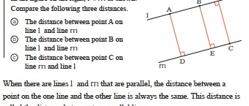
An example…

Slide 5
In England
the National Curriculum outlines the mathematical content knowledge that students should learn
the National Curriculum states implicitly how students should learn
the National Curriculum states implicitly how teachers should teach
the National Curriculum is not designed in parallel with the accompanying high-stakes tests/assessments

Slide 6
In England…Concerning technology use…
“Calculators should not be used as a substitute for good written and mental arithmetic. They should therefore only be introduced near the end of key stage 2 to support pupils’ conceptual understanding and exploration of more complex number problems, if written and mental arithmetic are secure.
In both primary and secondary schools, teachers should use their judgement about when ICT tools should be used.”

Slide 7
The research context
Cornerstone Maths Project aims to scale classroom use of ‘transformative technologies’ in English lower secondary mathematics through a ‘curricular activity system’ approach (Vahey et al 2013) that includes:
Web-based bespoke software
Pupil materials (in the form of sequenced investigations mediated by a ‘workbook’)
Teacher’s Guide
Mandatory professional development (face-to-face and ‘at distance’)
All focused on ‘hard to teach’ topics in 11-14 maths.

Slide 8
Research objective
To analyse the development of teachers’ mathematical knowledge for teaching and associated mathematics pedagogical practice with dynamic software related to three ‘hard to teach’ topics:
algebraic generalisation;
geometric similarity;
linear functions.

Slide 9
Research objective
To analyse the development of teachers’ mathematical knowledge for teaching and associated mathematics pedagogical practice with dynamic software related to three ‘hard to teach’ topics:
algebraic generalisation;
geometric similarity;
linear functions.

Slide 10
Important terms
transformative technologies - ‘computational tools through which students and teachers (re-)express their mathematical understandings’ (Clark-Wilson et al, 2013, Hoyles and Noss, 2003)
scaling - the processes and products that bring innovative technologies to most mathematics classrooms on a national level (elaborated from Hung et al, 2010).
landmark activity – one that is indicative of a rethinking of the mathematics or an extension of previously held ideas.

Slide 11
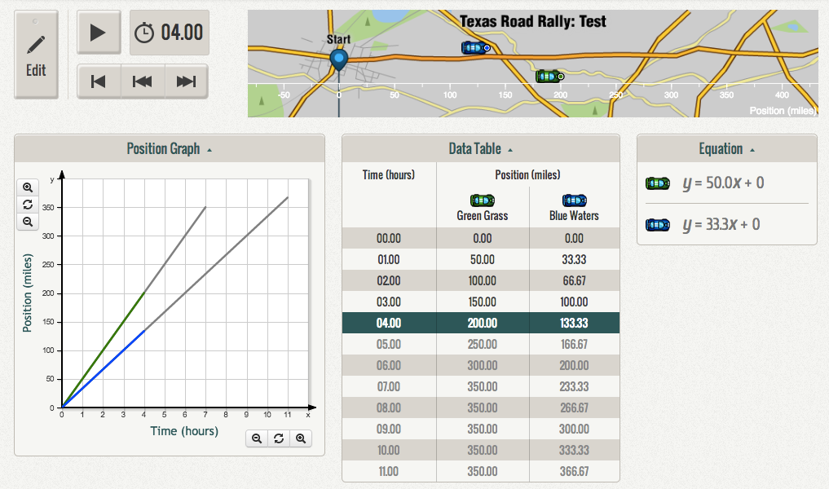
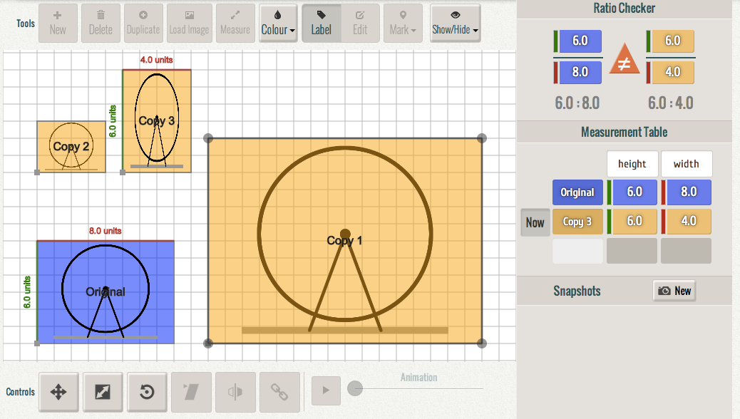
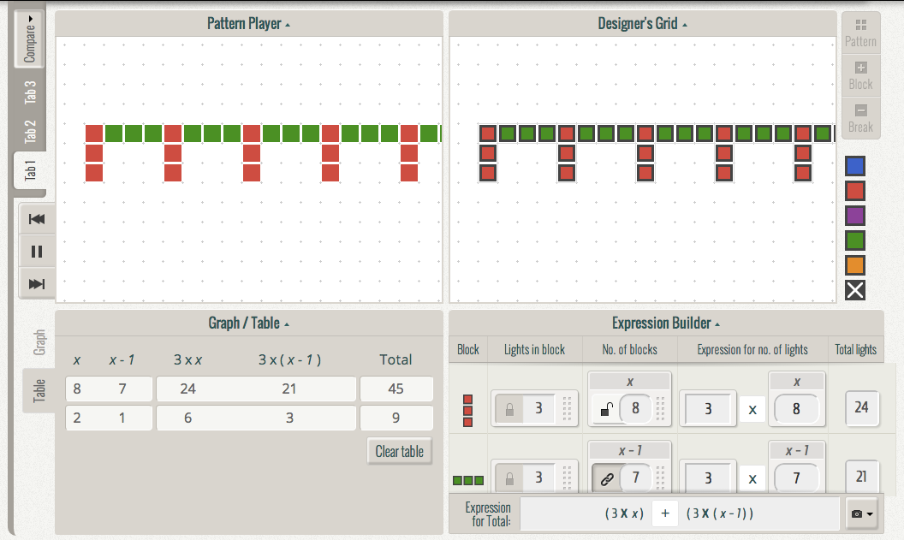
The curriculum units
(2-4 weeks of classroom work)
Unit 1 – linear functions
Unit 2 – geometric similarity
Unit 3 – patterns and expressions

Slide 12
Linear functions
Design principles:
dynamic simulation and linking between representations
drive the simulation from the graph or the function
show/hide representations, as appropriate
Big mathematical ideas
Coordinating algebraic, graphical, and tabular representations
y= mx+c as a model of constant velocity motion – the meaning of m and c in the motion context
Velocity as speed with direction and average velocity
Context: Developing games for mobile phones: using mathematics to analyse and create simulated motion games.
“Let’s work on a game with robots. We need to set up the mathematics to make our robots move at different speeds.”
12

Slide 13
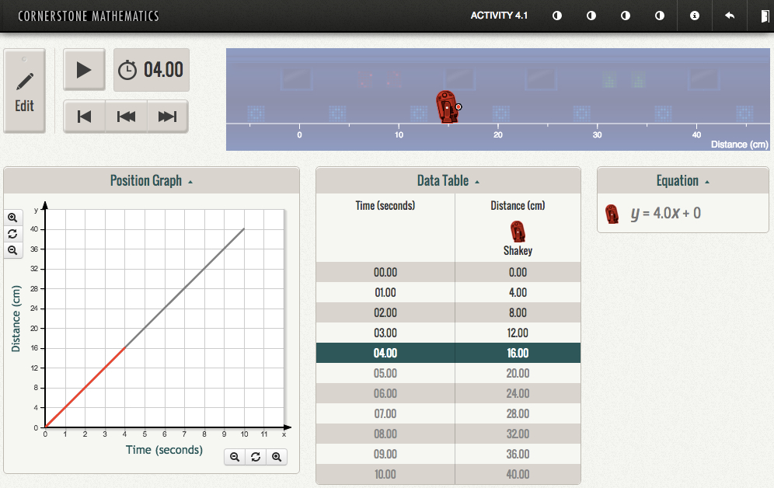
animation

Slide 14
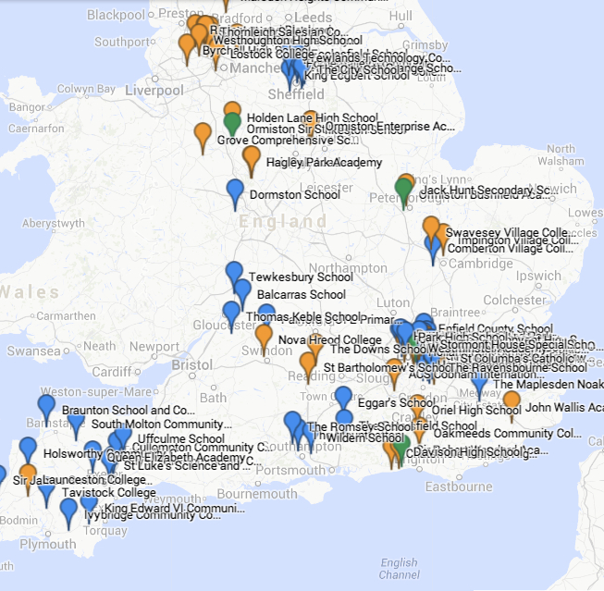
The current scale…
164 schools, 358 teachers, 9000 pupils
12 developing Cornerstone Maths networks across England
So our issue is, how do we research how the curriculum units are enacted…
at scale
14

Slide 15
The ‘landmark’ activity
provides an insight into how the classroom enactments align with the design principles for the curriculum units, i.e. the ‘implementation fidelity’.
what is memorable for the teachers about the curriculum unit?
which tasks are ‘landmark’ for them, and why?

Slide 16
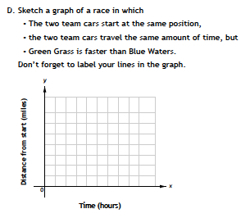

Slide 17
Teachers’ justifications
provoked rich mathematical discussion;
revealed important misconceptions;
revealed progress in understanding.
When answered together they showed immediately whether a pupil had understood the nature of the graphs, the different axes, the similarities and differences.
I could easily see which students had a deep understanding of the concept specifically how the position and time were placed on the graph and the meaning of these axes.

Slide 18
Adapted lesson study
all teachers plan to teach and reflect upon the same Cornerstone Maths ‘landmark’ activity.
plans are shared within a private online project community.
teach (and observe) the lesson.
project lesson observations and teacher interviews concern only that particular activity.
teachers meet to review and revise their plans.

Slide 19
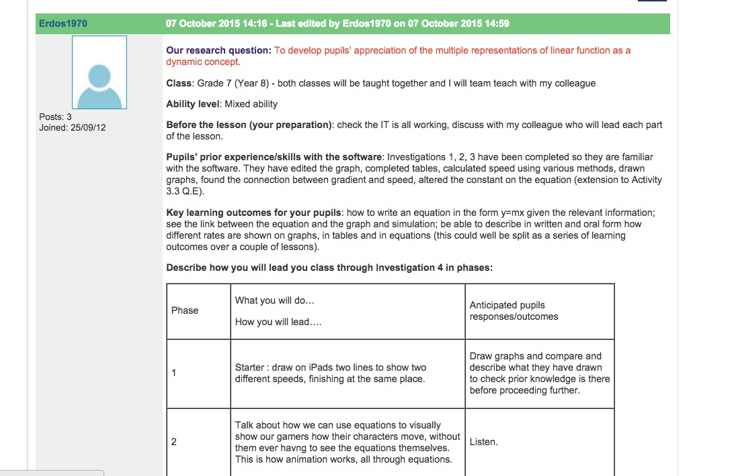

Slide 20
But scaling is not only ‘more schools’
Products:
more schools
more professional networks
improved student attainment
more whole departments involved
wider use of materials (more classes within schools)
more teachers within departments involved
Processes:
web based curricular activity system
teacher community
localised PD offer (school clusters becoming networks)
school devised evaluation approaches
school based PD offer
embedding in local schemes of work
development of multipliers

Slide 21
Alison Clark-Wilson,
a.clark-wilson@ucl.ac.uk
Acknowledgements
England (UCL Institute of Education, London)
US (Stanford Research International, CA)
Celia Hoyles
Richard Noss
Teresa Smart
Bola Abiloye
Jeremy Roschelle
Phil Vahey
Ken Rafanan
Jenifer Knudsen

